Slide 1
Skyward Family Access

Slide 2
Skyward Family Access
Skyward Family Access allows families to access student schedule, attendance, gradebook, academic history, discipline and school messages.

Slide 3
When logged into Skyward Family Access, parents/guardians can....
check grades
review assignments and due dates
check for missing assignments
review attendance
check messages
change notification settings

Slide 4
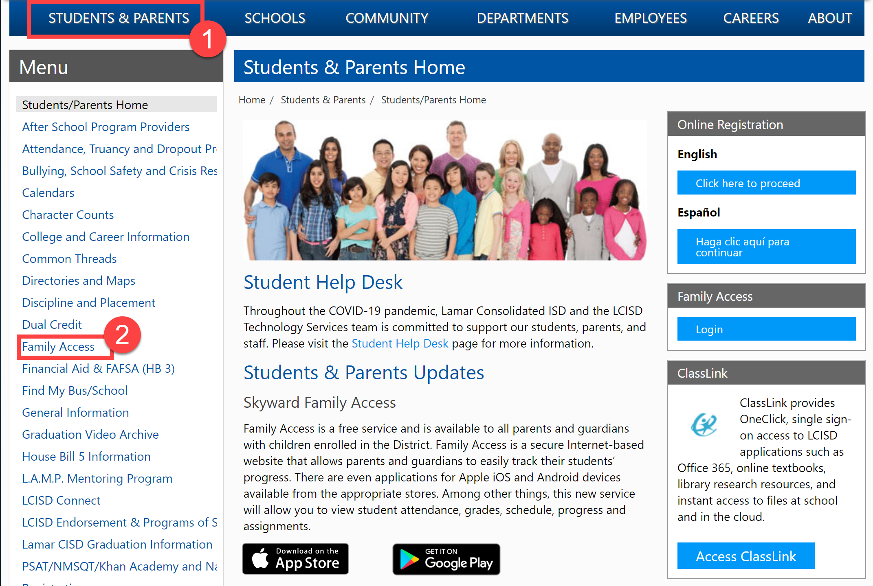
The LCISD Website – More Information
Visit www.LCISD.org
Select Students and Parents
Scroll down and click Family Access link on the left navigation

Slide 5
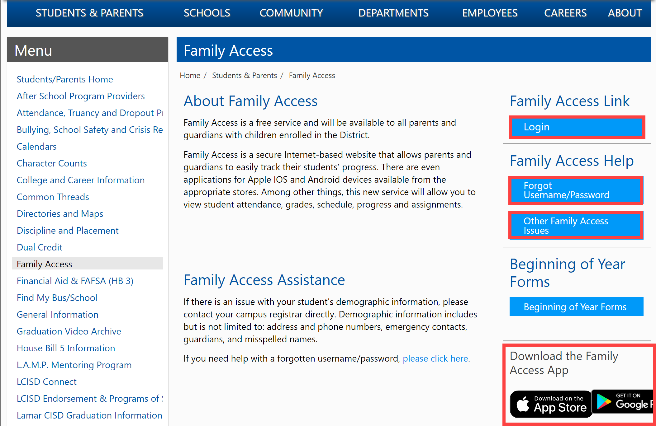
Family Access Assistance
Visit www.LCISD.org
Select Students and Parents
Scroll down and click Family Access link on the left navigation
Family Access Information
Login
Family Access Help
Download Family Access Apps onto devices

Slide 6
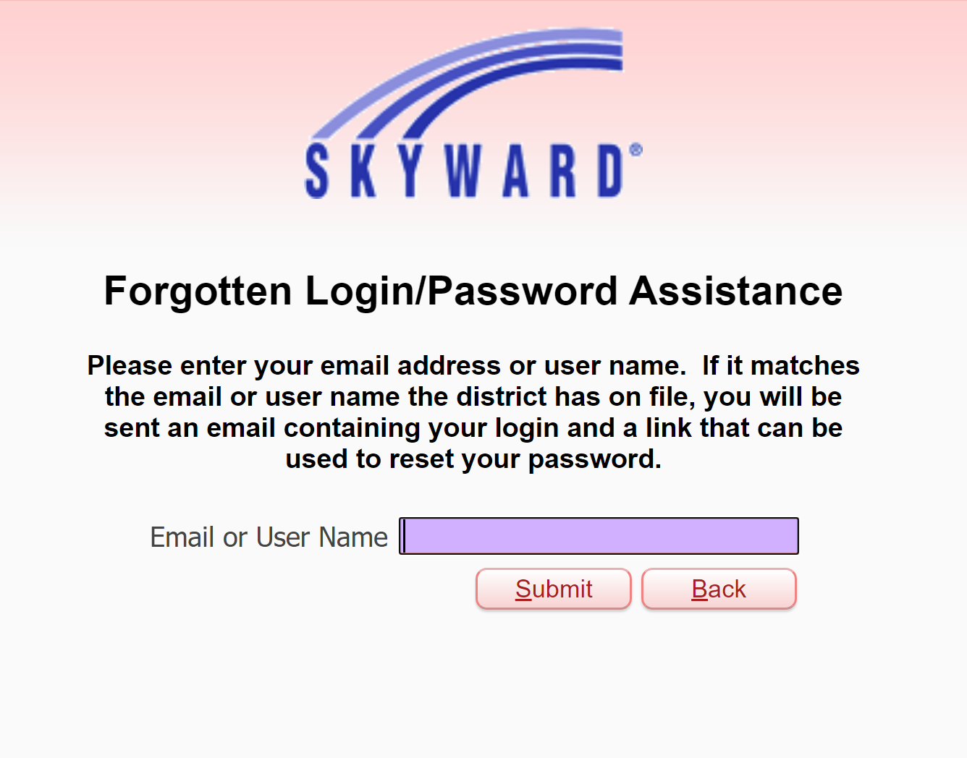
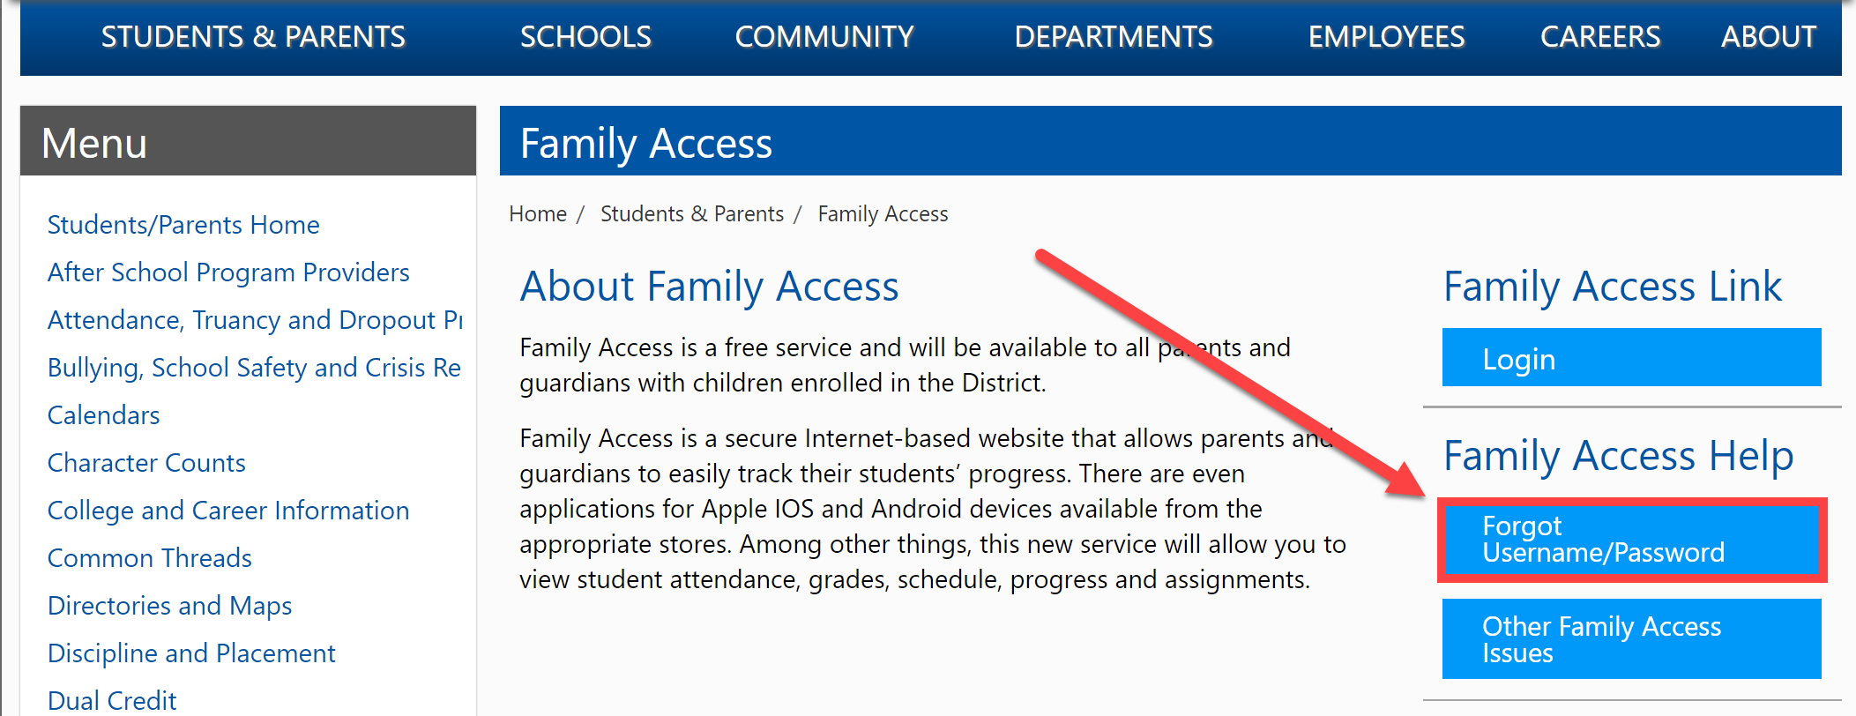
Need Additional Assistance?
Visit www.LCISD.org
Select Students and Parents
Scroll down and click Family Access link on the left navigation.
Choose Forgot Username/Password

Slide 7
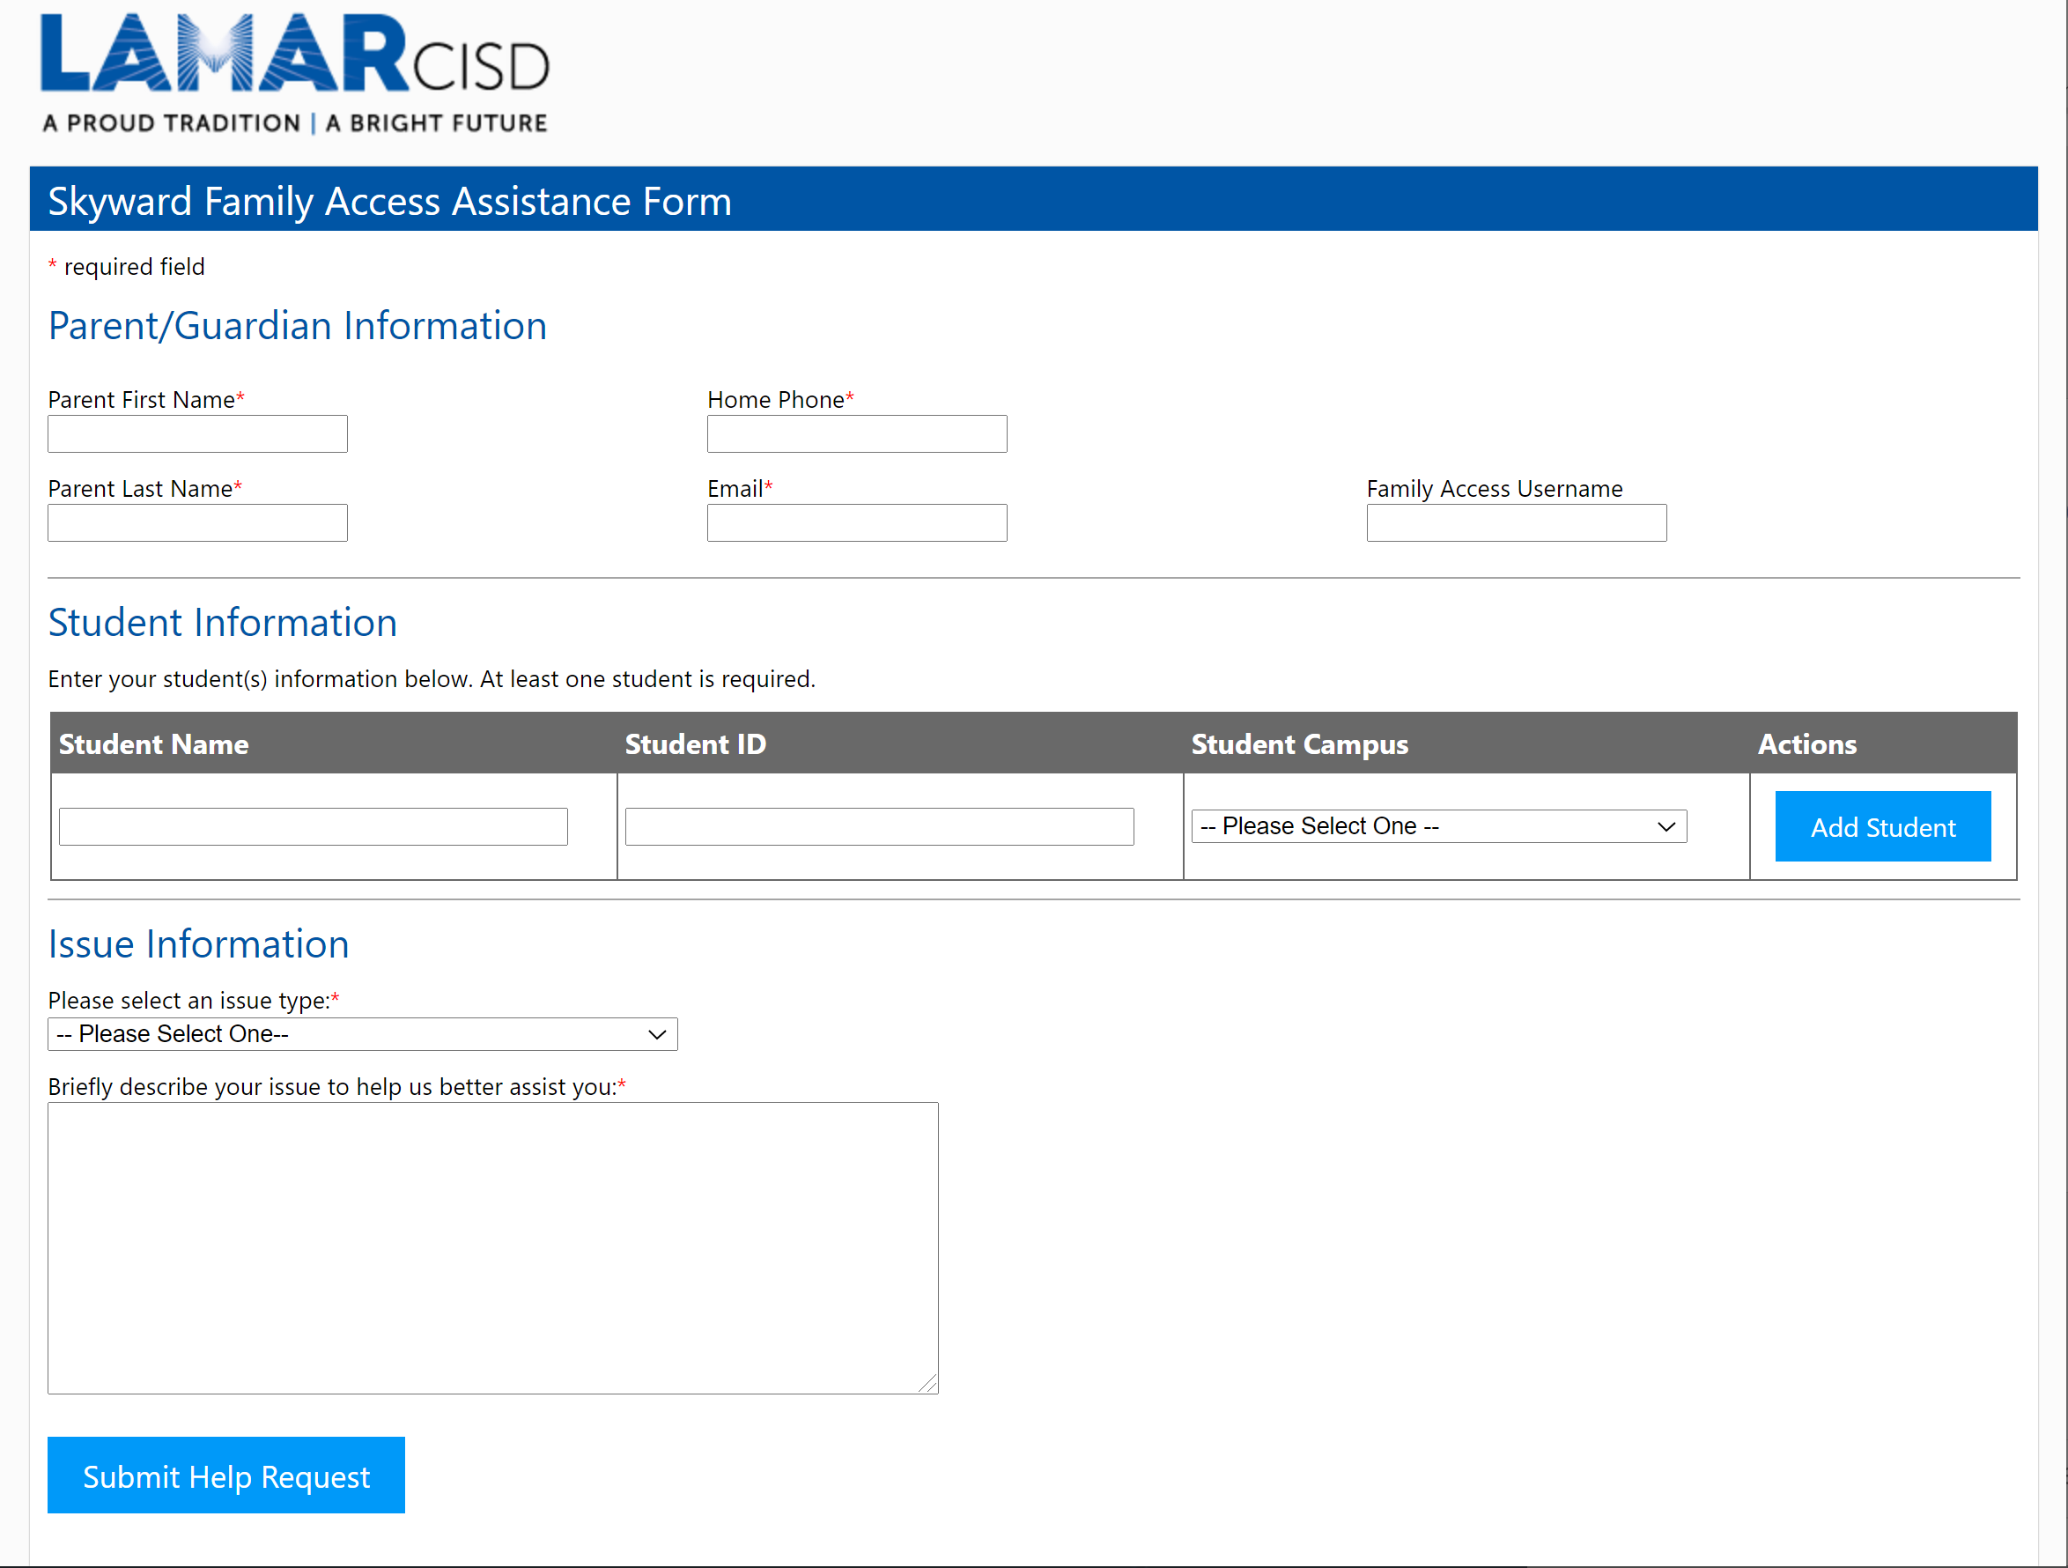
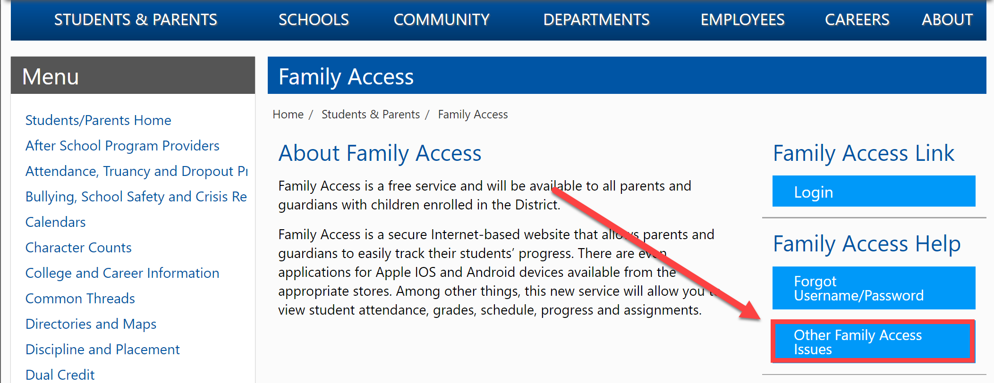
Need Additional Assistance?
Visit www.LCISD.org
Select Students and Parents
Scroll down and click Family Access link on the left navigation.
Choose Other Family Access Issues on the right

Slide 8
Skyward Family Access

Slide 9
Canvas Parent/Guardian Access Presentation Developed by Paul Wagner, LCISD Digital Learning Team

Slide 10
What is Canvas?
Canvas is a digital tool that provides teachers, students, and guardians a platform for accessing a variety of educational resources online, all from one location.
A course is created for each class that a student has.
Parents/Guardians can access these courses using an Observer Account

Slide 11
Accessing Canvas for the First Time
Your Canvas Access email is the email address that you provide in your Skyward contact information. This is not your Skyward username.
Use your entire email address, not just the first part.
Parent.email
Parent.email@yahoo.com

Slide 12
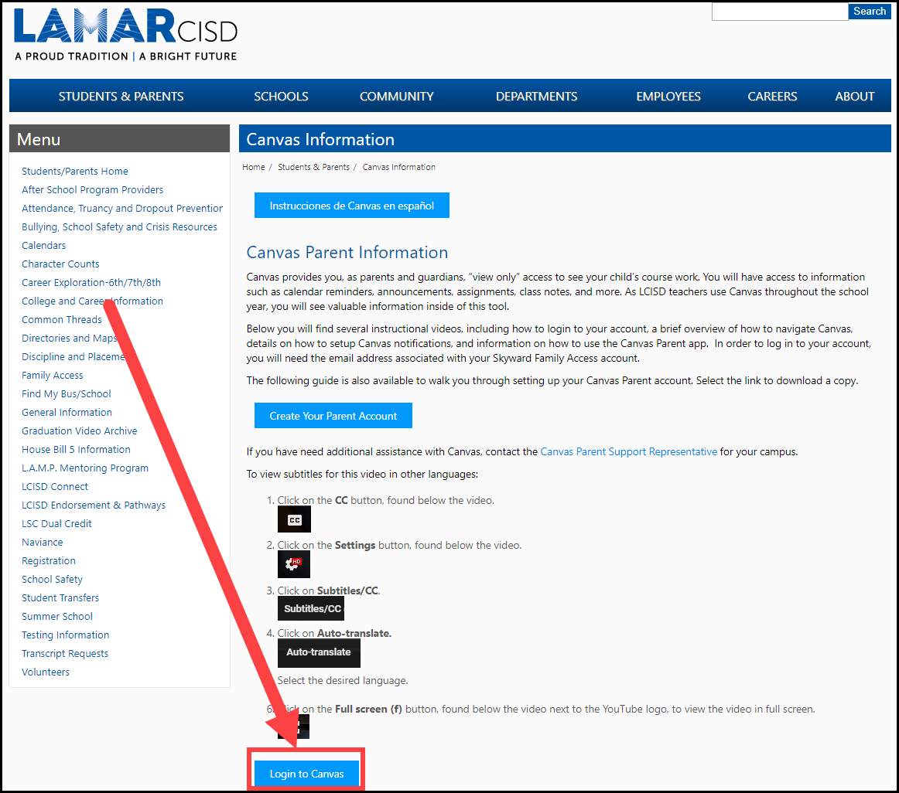
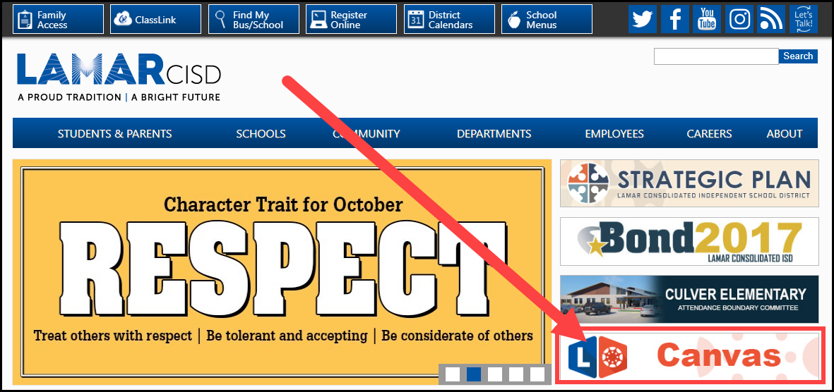
Accessing Canvas for the First Time
EITHER visit canvas.lcisd.org
OR
1. Go to the LCISD home page and choose the Canvas option.
2. Select the Login to Canvas button
1
2
2
1

Slide 13
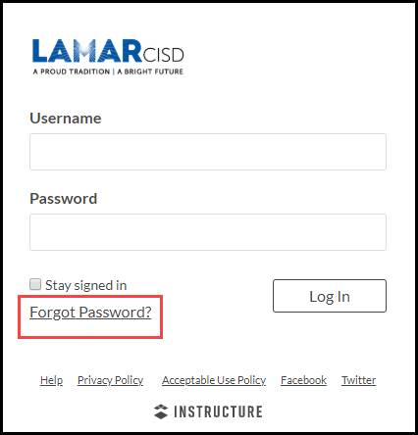
Accessing Canvas for the First Time
Select Forgot Password?

Slide 14
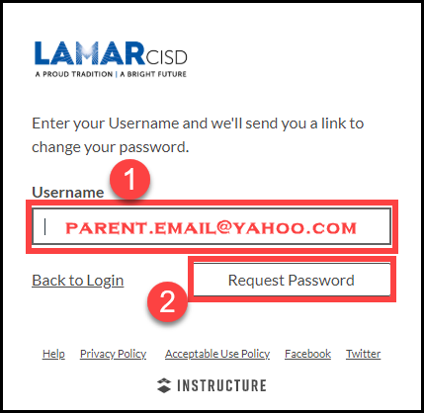
Accessing Canvas for the First Time
Enter your entire email address
Select Request Password

Slide 15
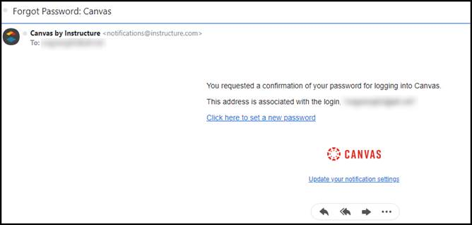
Accessing Canvas for the First Time
Check your email inbox for a message from Canvas by Instructure: notifications@instructure.com
It may be in your junk folder.
Depending on requests, etc., it may take a number of hours to arrive in your inbox

Slide 16
Notifications
You can choose what type of notifications you receive, how often you receive them, AND where you receive them!

Slide 17
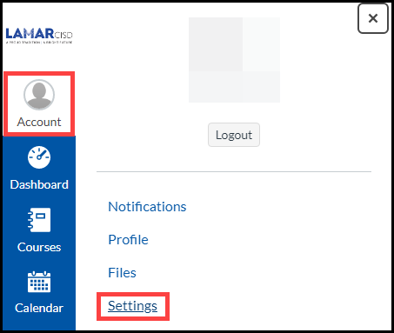
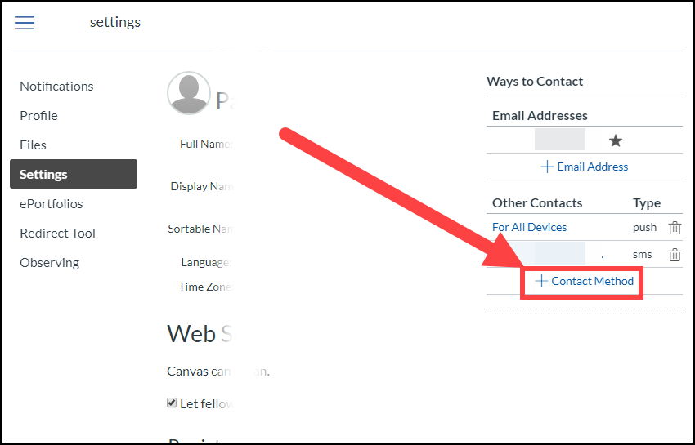
Add Contact Method
Add a Contact Method to receive notifications as text messages if you like:
Account > Settings
+ Contact Method
Add cell number and carrier
Follow prompts

Slide 18
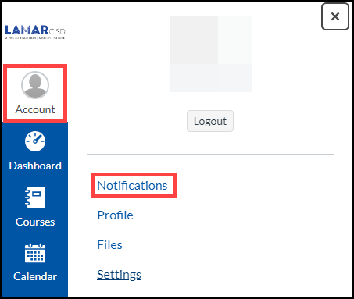
Recommended Settings
Determine what you wish to receive
Account > Notifications
Recommended
Announcement
Conversation Message
Determine how often to receive

Slide 19
Navigating Canvas
A Canvas course is created for each of your child’s classes. We will take a look at different features in Canvas:
Dashboard
Courses
Calendar
Inbox

Slide 20
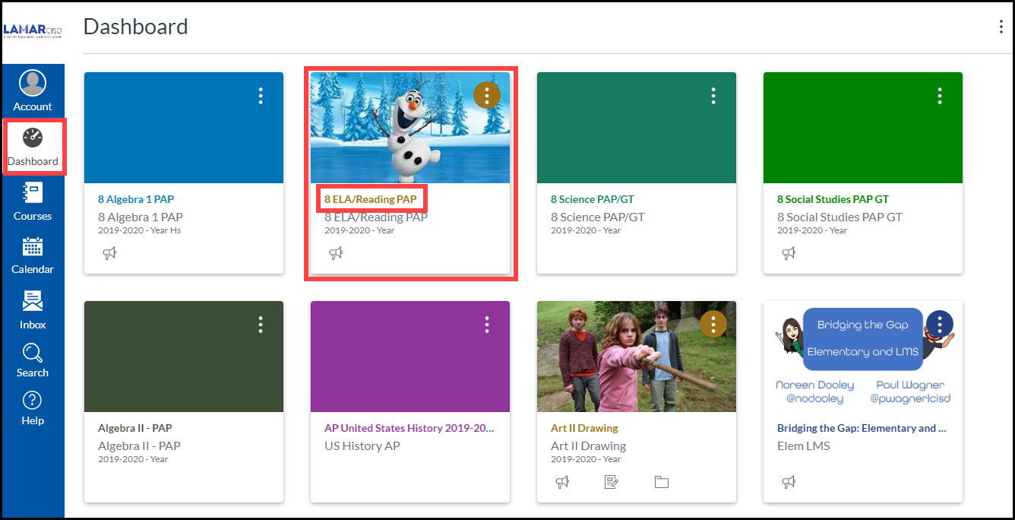
Global Navigation - The Dashboard
The Dashboard is what you see when you log in
Each course has its own course card
Select a card to visit that course

Slide 21
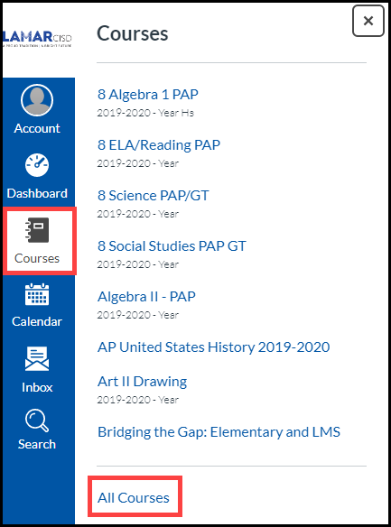
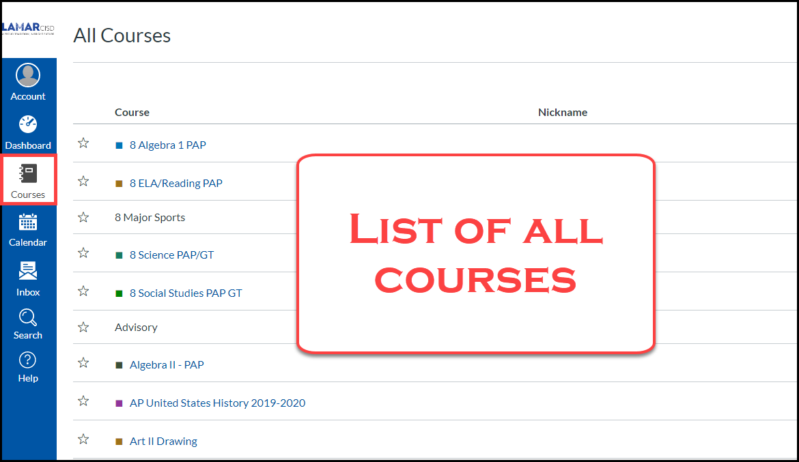
Global Navigation - Courses Option
Select the Courses option to see a list of favorited courses, usually the current courses.
Select a course to go to it immediately.
Select All Courses at the bottom of the pop up to see a list of all courses.
Courses in blue are published. Courses in gray are not.

Slide 22
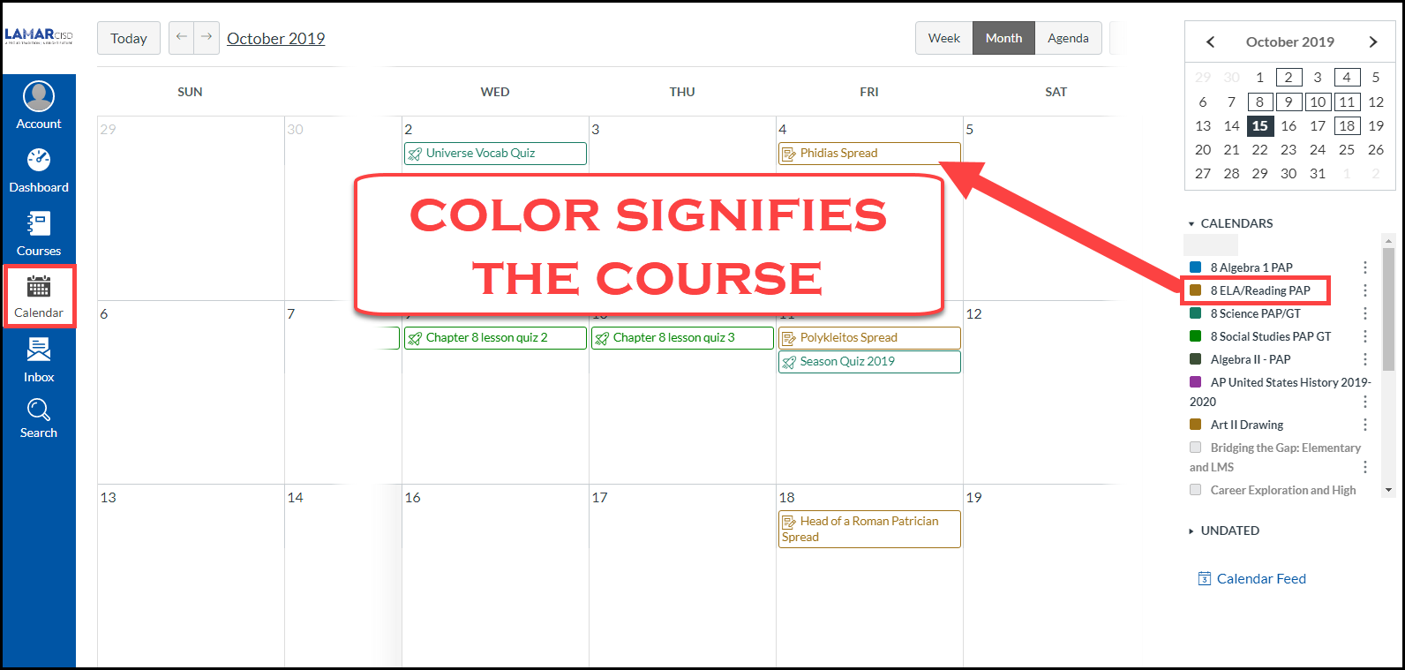
Global Navigation - Calendar Option
All courses represented on one calendar
The color of event matches the color of the course

Slide 23
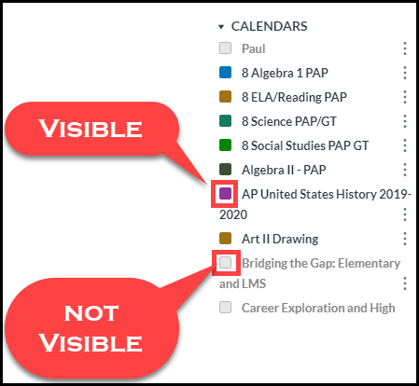
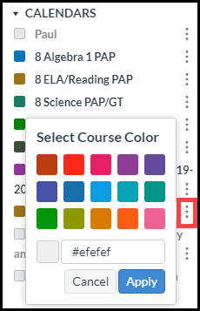
Global Navigation - Calendar Option
Change the view of the calendar
Color in box = visible calendar
Change the color by clicking “…”

Slide 24
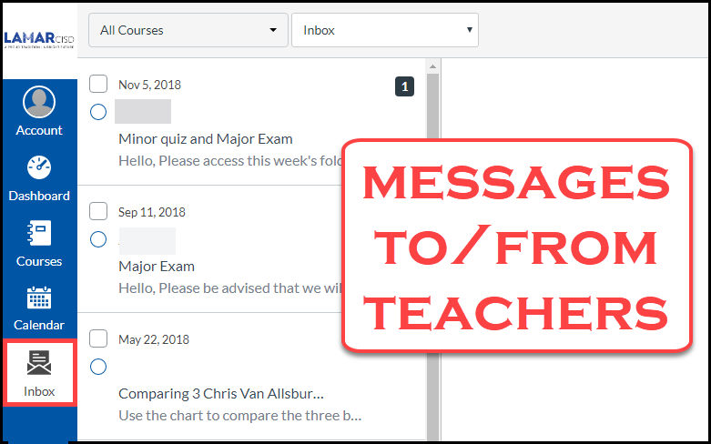
Global Navigation - Inbox Option
Send to and/or receive messages from teachers
Works much like email

Slide 25
Inside a Course

Slide 26
Syllabus (Home) Page
Syllabus page – This should be your course home page
Recent Announcements will display on top
Teacher Information
Course Navigation

Slide 27
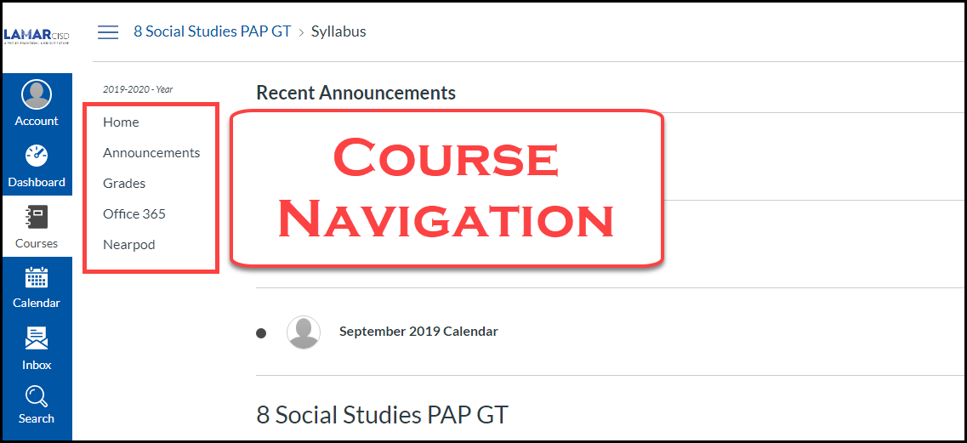
Course Navigation
Course navigation will look different for each course (teacher discretion)
Home page
Announcements – view all announcements, not just recent
Modules – like a table of contents. Use this to access learning experiences
Grades – NOT THE OFFICIAL GRADEBOOK – Check Skyward

Slide 28
Download the App
We recommend downloading the Canvas Student app from the app store on your device.
The student app offers many more options than the Parent app.
Notes:
https://community.canvaslms.com/t5/Canvas-Basics-Guide/What-is-the-Canvas-Student-app/ta-p/31

Slide 29
Resources
Resources
for Assistance
with Canvas

Slide 30
The Canvas Toolbox
A Resource for Students and Observers
Provides resources to help with performing tasks and troubleshooting within Canvas

Slide 31
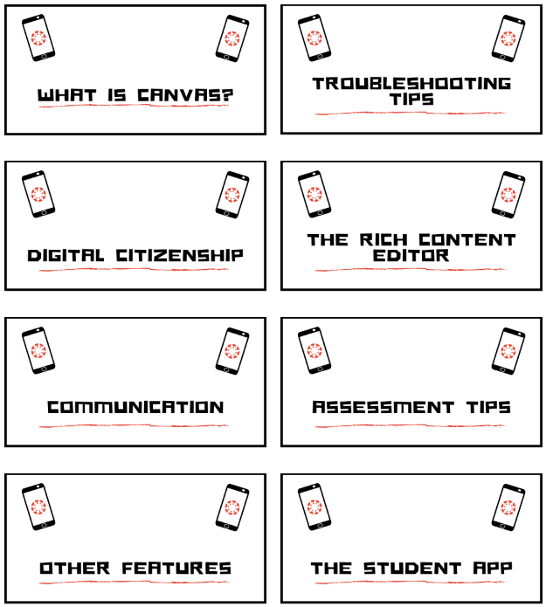
The Canvas Toolbox
Categorized for easy navigation
“The Rich Content Editor” is for adding text, etc. to a response in Canvas
Changing settings and notifications is part of “What is Canvas”
Canvas Inbox and Calendar is under Communication

Slide 32
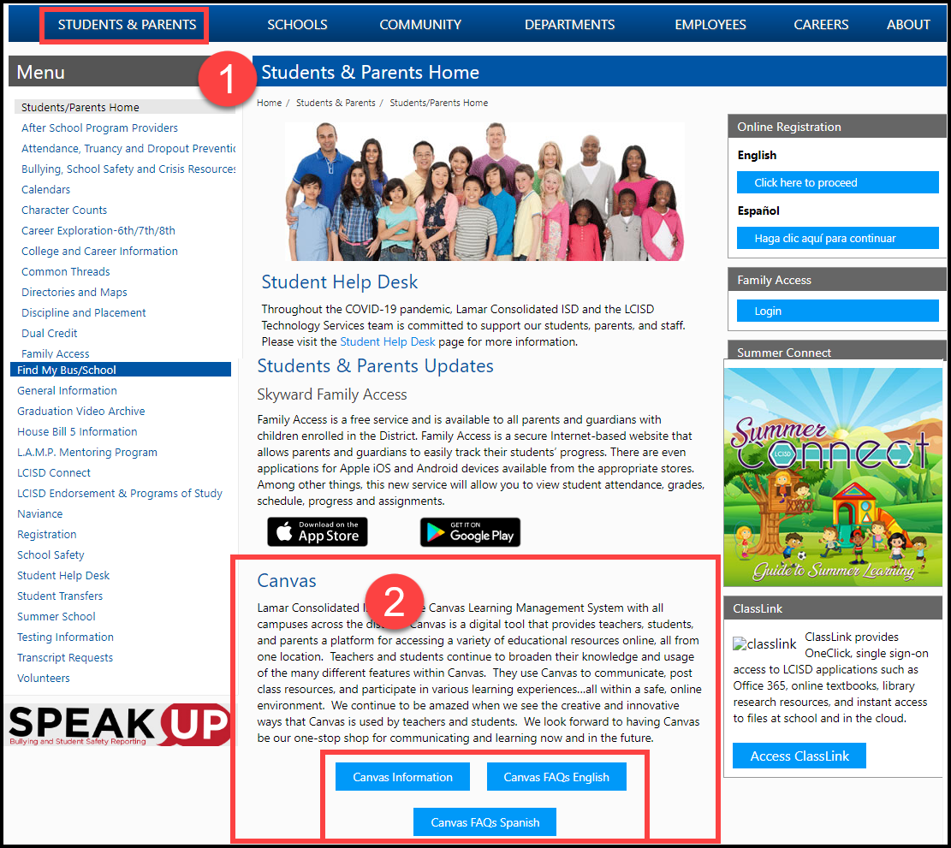
The LCISD Website – More Information
Visit www.LCISD.org
Select Students and Parents
Scroll down to Canvas section
Canvas Information
Download a paper guide
Access the Canvas login page
Watch the video guides to review different features
Frequently Asked Questions (FAQs)

Slide 33
Canvas Parent Access

