Slide 1
Curriculum Night
2020-21
1st Grade

Slide 2
FRIENDS
Better Together!
4th Grade

Slide 3
Welcome to Curriculum Night
1st Grade Teachers
Jeanette Baines jeanette.baines@lcisd.org
Isabella Gonzales isabella.Gonzales@lcisd.org
Claudia Larkin claudia.larkin@lcisd.org
Lindsey Dante-Smith lindsey.dantesmith@lcisd.org
Whitney Garner whitney.garner@lcisd.org
Sasha Walker sasha.walker@lcisd.org

Slide 4
Nine Week Behavior Expectations
Infraction chart by grade level:
Conduct grades will include infractions received for no homework. Office referrals will be counted as 9 infractions. Therefore, a student will receive no better than an “N” in conduct in nine weeks where behavior has resulted in an office referral.
Grade Level | Expectations
Kindergarten | S = 0-8 color changes/infractions N = 9+ color changes/infractions
All other grades 1st-5th | S = 0-8 color changes/infractions N = 9-12 color changes/infractions U = 13+ color changes/infractions

Slide 5
Daily Folder Conduct Chart
Teachers will mark daily conduct in the Daily Folder. Please check this each night, sign and return.
Students that are on green for the day will have a green dot, a sticker, or an empty box.
Other color changes will be noted in the folder.
The behavior charts are stapled in each Daily Folder.

Slide 6
Consequences
GREEN – Excellent Behavior…positive reinforcement
YELLOW – a reminder to check behavior….will walk 2 laps during recess
BLUE – will want to make behavior changes…..will walk 5 laps during recess
RED – automatic office referral….will walk the track during all of recess
Students that receive a color change after recess will walk the track the following day.

Slide 7
Guided Reading
As part of our Balanced Literacy curriculum, teachers will differentiate reading instruction through Guided Reading.
Teachers will use assessment data to plan and adjust small group Guided Reading lessons. Groups will be flexible and will focus on specific strategies and skills needed by students.
Students will rotate between literacy-based activities, independent reading, and meeting with the teacher as part of our Reader’s Workshop approach.

Slide 8
1st Grade GRA Reading Assessment
Teachers will administer the GRA reading assessment for the 1st, 2nd and 4th nine weeks.
Reading levels will be recorded on the report card.
Minimum Reading Levels for First Grade
1st Nine Weeks | 2nd Nine Weeks | 3rd Nine Weeks | 4th Nine Weeks
8 (E) | 10 (F) | 14 (H) Running Record | 16 (I)

Slide 9
Raz-Kids
https://www.raz-kids.com/main/VideoLibrary/id/670
Soon all Frost students will have access to Raz Kids at school and at home.
Keep an eye out for log-in information in your child’s Tuesday folder.
Notes:
Play video to introduce families to Raz Kids.

Slide 10
Home Readers
Home readers will be sent home with students beginning October 5th.
Book bags will go home every night. Please read the book with your child. This is a book they have already read twice with their teacher in guided reading. The book bag should be returned daily.
A $5.00 fee will be charged for all lost books. It is a good idea to keep the book in the bag when your child is not reading it.

Slide 11
Sight Words
The newly revised Texas Essential Knowledge and Skills (TEKS) require that first graders identify and read at least 100 high-frequency words. We have added additional words to support their continued growth in reading and writing.
A folder with your child’s sight words for the year will come home soon. The folder should be returned to school at the end of each nine weeks.
Students will be assessed each nine weeks.

Slide 12
Writer’s Workshop
Daily Writer’s Workshop Schedule
Shared/Modeled Writing
Teacher thinks aloud while modeling writing.
Conferring/Independent Writing
Student led. Conferring with teacher
and writing independently
Sharing
Reflect on process/ students share writing

Slide 13
Reading Ninja Program
First Grade students can participate in the Reading Ninja Incentive Program.
Complete reading homework at home every week and return it to school.
Earn brag sticks and a special treat.
Meet the goal 3 out of the 4 nine weeks and get a ticket to the end of the year party!

Slide 14
Guided Math
Implementation of guided math consists of:
Whole group instruction: 3-4 days a week, primarily to introduce a new concept or topic
Small group instruction: 3-4 days a week so that teachers can effectively monitor student understanding and tailor instruction to meet needs of all students
Math workstations: 3-4 days a week during the guided math cycle
Fact Fluency: 3-4 days a week during the guided math cycle

Slide 15
LCISD Problem Solving Model
In mathematics, students continually use problem-solving, language and communication, and reasoning (justification and proof) to make connections within and outside mathematics. The LCISD problem solving model is a method in which students can read a problem, rewrite it, decide who or what the problem is about, draw a model and then solve the problem.

Slide 16
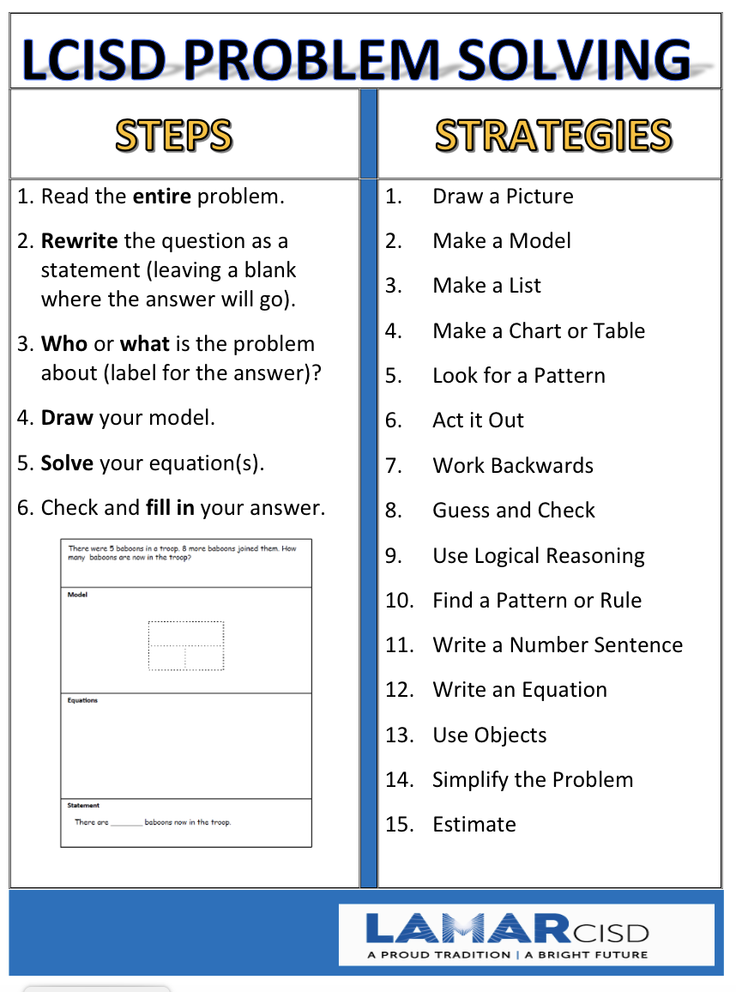

Slide 17
Problem Solving at Frost Elementary
At Frost, teachers will implement problem solving with fidelity.
Students will have time for guided and independent practice in the classroom.
For assessments, students will only be required to practice and master the sections of the LCISD problem solving method that have been taught previously by the classroom teacher.

Slide 18
Prodigy
Each child will have access to Prodigy, a math program that connects in-class learning to at-home math practice.
Students are engaged as they explore the math game world, where they answer questions to complete epic quests and earn in-game rewards.
Educators and parents can visualize student progress, align in game questions with current math skills and motivate math.
Prodigy tournaments will be held District-wide and campus-wide!
Prodigy log in information is coming soon!

Slide 19
ELEMENTARY Virtual Instruction
Zoom Expectations
Background distractions should be limited
Students should be dressed appropriately (LCISD Dress Code)
Students should have a work space with needed materials and should be sitting up during Zoom lessons
No toys during Zoom lessons
Virtual students must have video on and be muted during Graded Assignments, as Teachers are required to monitor
On Campus and Virtual students have the same number of Minor and Major Grades
Daily Assignments are for practice and reinforcement (do not contribute to grades)
.

Slide 20
Virtual Tips for Success
Technology issues such as printers not working, etc., should be reported to the Help Desk.
Please print everything from the print module prior to meeting on Monday.
Online behavior issues will be addressed the same way as in-person learning.
Assessments and assignments should be completed on the date they're available. Assessments must be completed over Zoom.

Slide 21
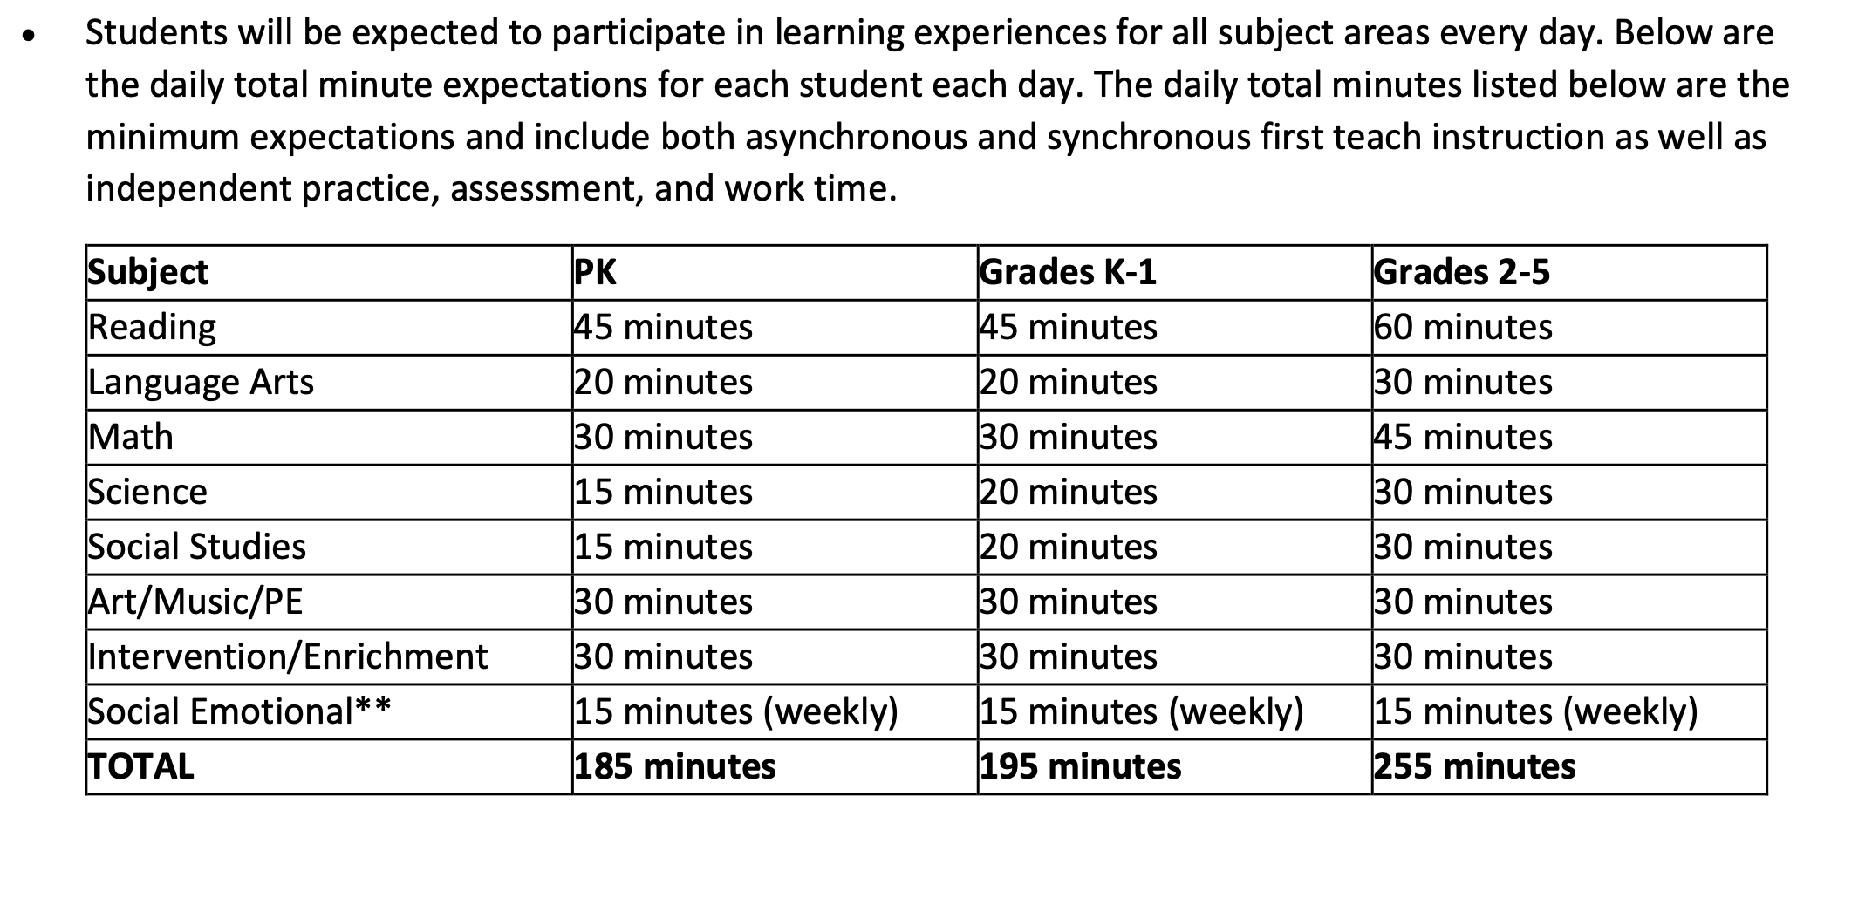
Sample Daily Virtual Schedule

Slide 22
LCISD Grading Policy
All graded work must be completed at school.
Any work that is to be graded will not be sent home for completion.
Students will not be given make-up work ahead of time when parents remove their children for trips during school days.
Late Work Policy – classwork will be accepted late within the current grading period with these guidelines in place:
One (1) day late = 0 points off
Two (2) days late = 10 points off
Three (3) days late = highest grade possible is a 70
Extenuating circumstances will be reviewed by campus policy.

Slide 23
Grading – Reading, Math, Science & Social Studies
8 Minor Grades at 70%
2 Major Grades at 30%
Grading – Language
5 Minor Grades at 70%
2 Major Grades at 30%

Slide 24
Reassessment (Major Grades)
The teacher shall provide ONE reasonable opportunity to reassess failure to master the TEKS on each major grade.
The teacher will provide an alternate assignment for reassessment of major grades.
The highest possible grade that can be earned and recorded on the reassessment is a 70.
There will be no reassessment based on lack of effort.
The teacher will make a note in the electronic grade book of the date and grade of the reassessment. Original grades will be recorded in the notes section.

Slide 25
Skyward Family Access
Allows parents to track student grades and progress
Go to www.lcisd.org and click on the Family Access button at the top of the page.
Sign in with your username and password.
Update all email addresses associated with your account.

Slide 26
Parent Conference Dates
Teachers will meet with parents to review student progress for the first nine weeks.
Conferences will be held on October 29th and 30th.
The first nine weeks report card will be distributed at the conference.

Slide 27
Birthday Guidelines
In accordance with district policy, we discourage food being brought in by parents/grandparents for the following reasons: protect instructional time; student food allergies (peanut, gluten, eggs); student medical conditions (diabetes); liability assumed by person bringing in food
Foods brought in must be store purchased and individually wrapped
Flowers, balloons, pencils, invitations and any other treats in honor or recognition of a child’s birthday cannot be delivered or distributed at school.

Slide 28
Tardy Policy
Students are counted as tardy if they are not in the classroom by 7:30 a.m.
Students with excessive tardiness will be referred to the attendance committee for consideration of ISS and a home visit by the social worker.
Three or more tardies in a 9 week period will disqualify students from attendance awards.

Slide 29
Attendance Policy
Excused absences include Holy Days, death in the immediate family, medical appointments, and personal illness.
If absent, send a signed note on the day the child returns to school. Medical verification from a doctor may be required.
Parents of students with excessive absences will attend a meeting with the Attendance Review Committee.
Three or more early check outs during the school year will disqualify students from receiving Attendance Awards.

Slide 30
On Campus Attendance
Official attendance taking time is at 9:30 a.m. each day
When absent, a student must bring a note signed by parent or medical professional giving the date(s) of the absence(s) and describing the reasons for the absence.
The absence will be documented as excused or unexcused.
A student absent for more than five consecutive days because of personal illness, must bring a statement from a doctor.
A student is considered tardy if they are not in the building by the 7:30 bell.

Slide 31
Virtual Present (On Campus Absence)
In the event a student is absent from On Campus instruction:
The student will complete asynchronous instruction in Canvas.
The classroom teacher will monitor completed & submitted in Canvas.
Upon completion of asynchronous instruction, the student’s absence will change to virtual present.
Note:
Major and minor assessments will be completed when the student returns to campus.

Slide 32
Response to On Campus Absences
Response to On Campus
Tardies
3 Unexcused absences Skyward parent letter & phone call
5 Unexcused absences Parent meeting with Attendance Review Committee
6 Unexcused absences Social Worker visit
8 Unexcused absences Parent meeting with Administrator (notification of truancy at 10 unexcused absences)
10 Unexcused absences Truancy filed
3rd Tardy Parent phone call
4th Tardy Detention at recess *Subsequent tardies will result in ongoing detention
5th Tardy Parent meeting with Administrator
6th Tardy Attendance Review Committee
7th Tardy In-school suspension
8th Tardy Social Worker Visit

Slide 33
*Virtual instruction students will be counted as present if they meet the criteria below for engagement. *Otherwise students will be counted as absent

Slide 34
Uniform Dress Code
Red, white, light blue or navy blue collared shirts & 2020-2021 Spirit shirts are allowed. Tops may not have any visible logos.
Viewable undershirts should be one of the uniform shirt colors.
Shirts purchased before 2020-2021 are not valid for the current school year. This includes Field Day shirts, 2015-20 Spirit Shirts, 2015-20 Club Frost Shirts, etc. and are not in dress code.
Sweaters and jackets must be solid red, navy, black, khaki or white.
Khaki, navy, black, blue denim slacks, shorts, skirts, skorts and jumpers are permitted.
School shirts and sweatshirts are allowed.
Leggings and tights should be red, black, blue, white or khaki.
No backless shoes, flip flops, overalls, hats, caps, scarves, skate shoes, sweat pants, or rolling backpacks are allowed.

Slide 35
Transportation Changes
If your child requires a transportation change, please send a note to the classroom teacher.
Do not email the teacher regarding these changes.
You may also call the front office but no changes will be made after 2:00 p.m.

Slide 36
Safety Awareness
A campus crisis team is in place at all campuses in the district. The Frost team consists of administrators, office staff and facilitators/specialists.
Campus Emergency Procedures Training was completed with the staff on 9/2/20.
District staff training is underway
Staff will complete district training requirements by 9/30/20
Blood Borne Pathogens
Child Abuse
Emergency Go Kit Training
Suicide Prevention
Bullying
FERPA - Confidentiality of Records
Texas Cybersecurity
Health Emergencies
Fire Drills will take place monthly
Additional drills are conducted each semester such as Lockdown, Duck and Cover, Evacuation, & Shelter-in-Place

Slide 37
Personal Items
Please make sure your child's name is on all personal items, such as supplies, lunch kits, sweaters, jackets, etc.

Slide 38
End of Year Awards
Principal’s Award – must have an A in all subject areas (medal awarded)
A/B Honor Roll – must have an A or B in all subjects all year (medal awarded)
Citizenship – must have all S’s in conduct (medal awarded)
Science Expo Participant – Trophy

Slide 39
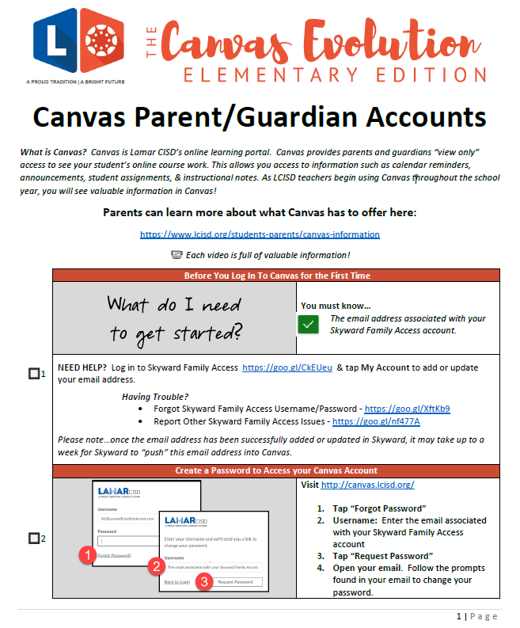
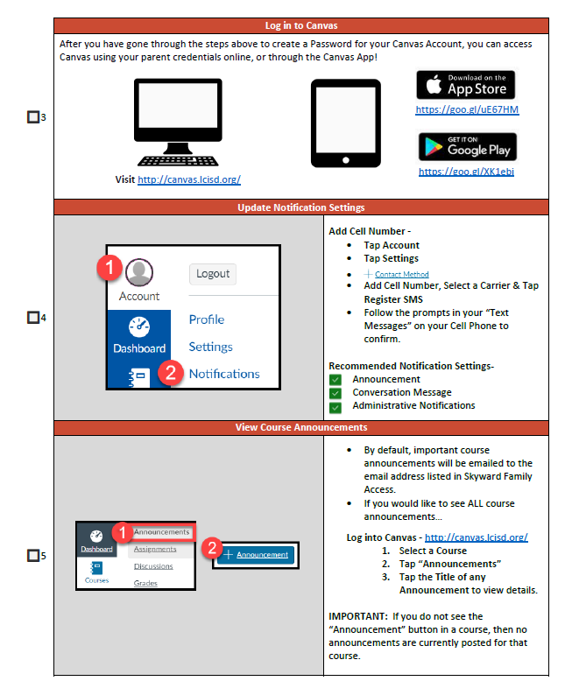
Newsletters
Newsletters can be accessed through Canvas this year. Canvas is the Lamar CISD online learning portal. Newsletters will be uploaded to Canvas as an announcement for you to view.

Slide 40
School Health Guidelines Covid-19
LCISD-Frost Elementary

Slide 41
Symptoms of Covid-19
Feeling feverish or a measured temperature greater than or equal to 100.0 degrees Fahrenheit
Lose of taste or smell
Cough
Difficulty breathing or shortness of breath
Headache
Chills
Sore Throat
Shaking, exaggerated shivering
Significant muscle pain or ache
Diarrhea

Slide 42
Parent/Guardian Expectations
Parents/guardians are expected to screen their children each day for Covid-19 symptoms prior to sending their children to school.
If students display one or more symptoms, he/she should not attend school and must be evaluated by a medical provider. A letter of good health from a healthcare provider must be submitted to the School Nurse before the student returns to school.

Slide 43
Acceptable Face Coverings In Lamar CISD
Non-medical and medical grade disposable face masks
Cloth face coverings (over the mouth and nose)
Neck gaiters that cover the nose, mouth, and neck
Students in Pre-K through 3rd grade will wear a face covering in common areas and during arrival and dismissal during HIGH, MODERATE, and LOW risk levels
Students in 4th and 5th grade will wear face coverings, especially when social distancing is difficult, including in classrooms during HIGH, MODERATE, and LOW risk levels
Students’ individual needs will be addressed on a case-by-case basis. Parents who request an accommodation will need to submit a note from a physician to the School Nurse exempting the student from wearing a face covering

Slide 44
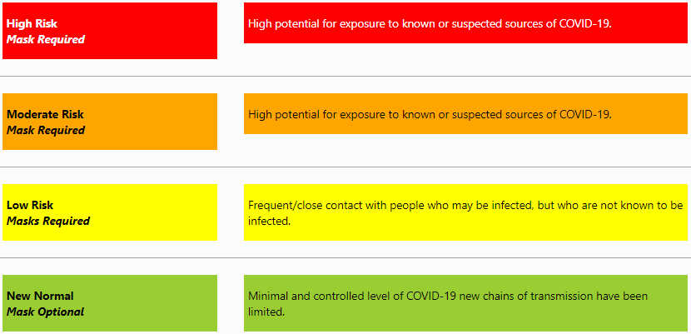
COVID-19 Risk Levels

Slide 45
Protect Yourself Against COVID-19

Slide 46
Thank you for coming!

