Slide 1
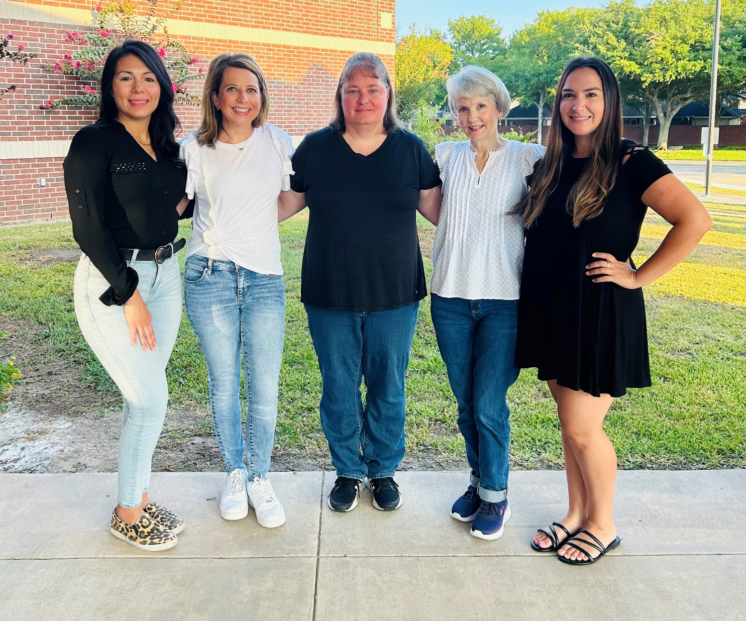
Meet the First Grade Team

Slide 2

Welcome to dickinson Elementary
2023-2024

Slide 3
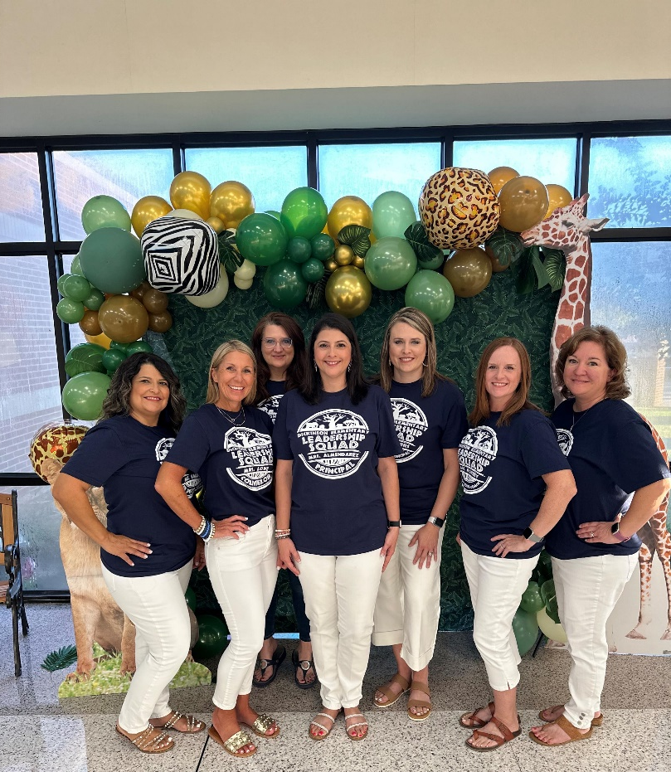
Meet the Instructional Leadership Team
Principal: Channon Almendarez
Assistant Principal: Angela Peters
Counselor: Suzanne Lowe
Instructional Coach: Lisa Morrey
EB Specialist: Yadi Salinas
Reading Interventionist: Leslie Norra
Librarian: Joanne Bromonsky

Slide 4
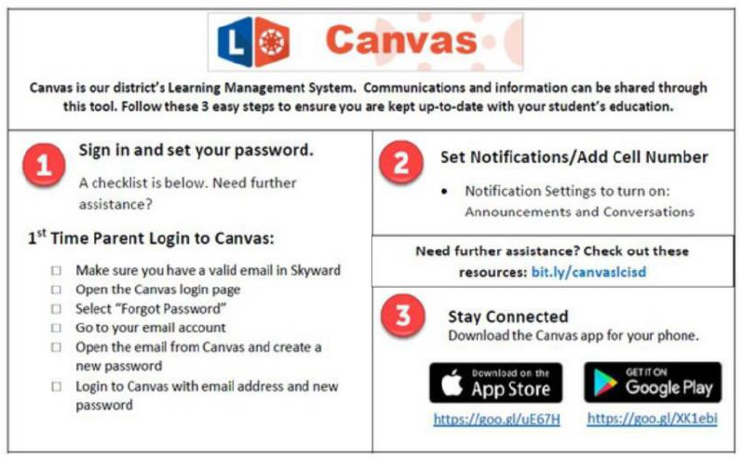
WEEKLY NEWSLETTER
The newsletter will be electronically distributed every Monday through Canvas.
Newsletters will include events, objectives, upcoming major grade dates, and other information deemed necessary by the grade level.
Please make sure that you are signed up and have access to Canvas

Slide 5

Communication
Tuesday Folders
  sent home every Tuesday
  Contains graded work from the week before and papers from the front office.
  Please check these folders each Tuesday and review papers.
Daily take home folder
  expectation page inside – currently blue
  Daily homework will be in the back pockets
  please initial weekly and return to school daily

Slide 6
Lcisd Student code of conduct Updates

Slide 7


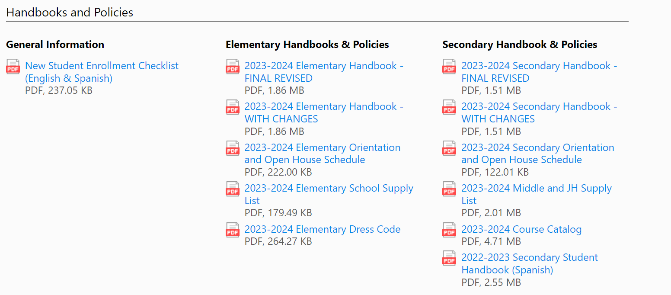

2023-2024 Handbook
The Student Code of Conduct can be found within the 2023-2024 Student Handbook.
Secondary – pg. 149
Elementary – pg. 91
The updated handbook can be found on the LCISD webpage at the bottom right-hand side under the Student & Parent section
Spanish version will be uploaded
once they are completed.

Slide 8
Cell Phone Policy
Changes

Slide 9
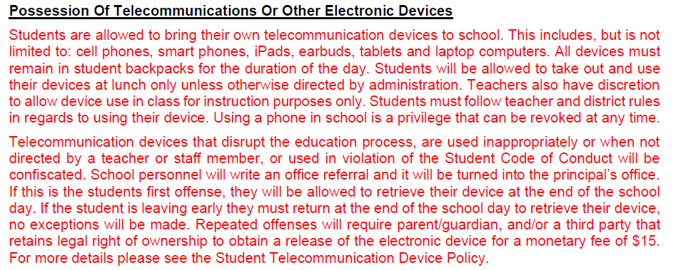
Possession of Telecommunications or Other Electronic Devices
Notes:
This slide is one of the recommendations indicated in RED to be added

Slide 10
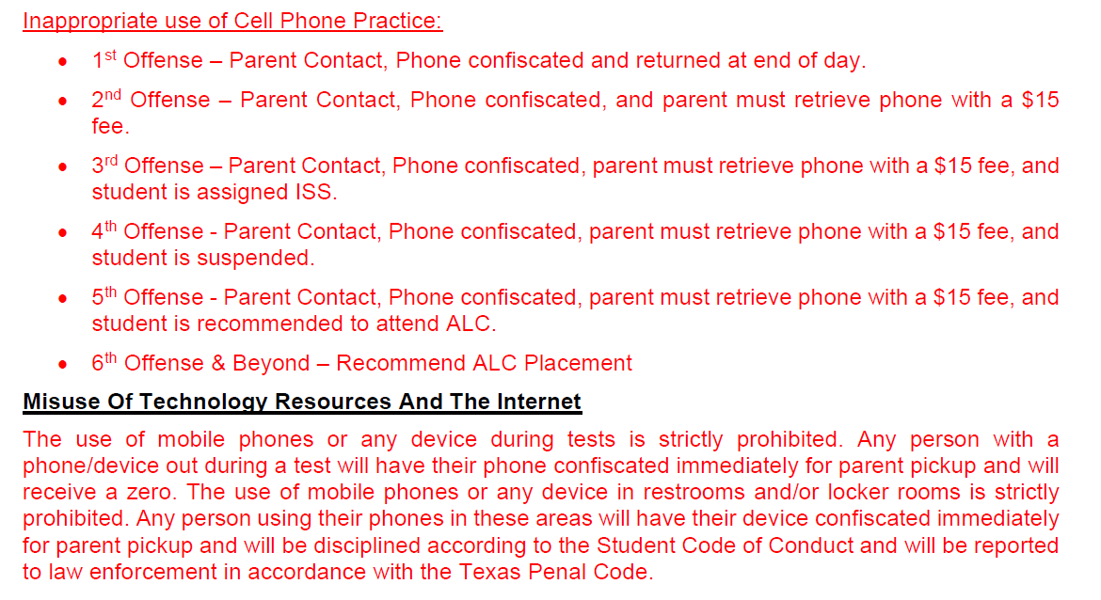
Inappropriate Use of Cell Phone Practice
Notes:
Click Twice This next slide is a list of additional updates that we are recommending since the May meeting.

Slide 11

Please keep cell phones and smart watches in backpacks turned off.
“Technology will never replace great teachers, but in the hands of great teachers, it’s transformational.” – George Couros

Slide 12
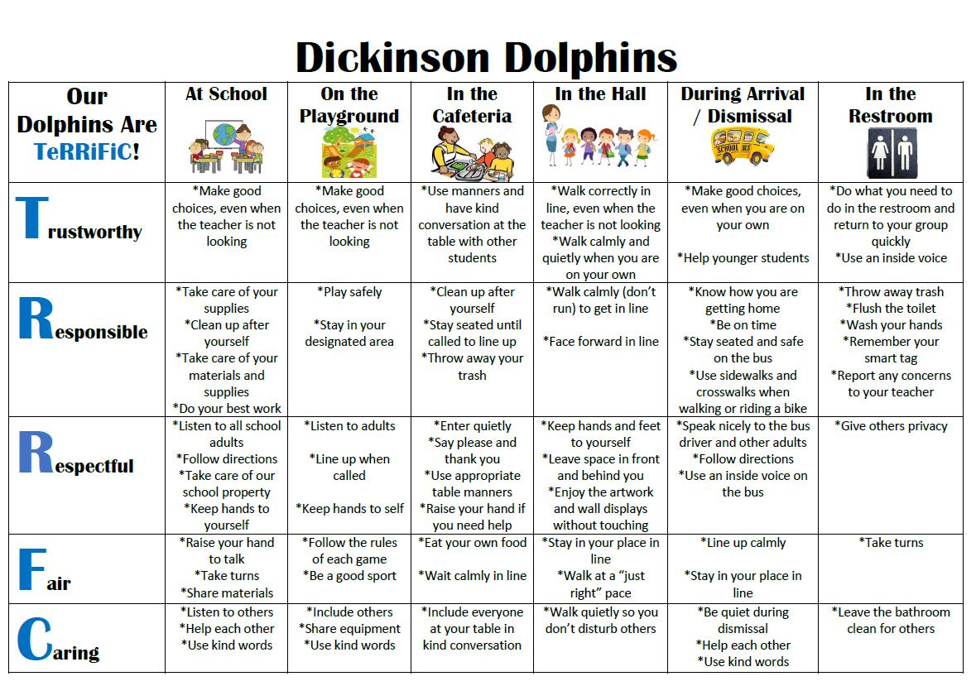
Dickinson's Expectations

Slide 13

Ron Clark House System
This school year we will sort our students and staff into four different houses. They will remain in the same house throughout their elementary school experience. The goal is to build community within the school.
Each nine weeks we will have a school pep rally to celebrate good character and review high expectations for learning. At the pep rally, we will share who the winning house is for the nine weeks. PTO will be sponsoring the shirts this first year.
Our first House Pep Rally will be on October 4th. Parents will be able to participate through Facebook Live.

Slide 14
Classroom Rewards
Dolphin Dollar
Class Dojo Points

Slide 15
Classroom Consequences
Steps that will be taken by the teacher:
  Signal (hand gesture)
  Verbal reminder
  Private conversation with student
  Signing on Expectations Card in Daily Folder
  Note/email home

Slide 16
Grades
Math, Science, and Social Studies:
  Math: 9 grades (7 minors and 2 majors)
  Science: 7 grades (5 minor and 2 majors)
  Social Studies: 7 grades (5 minor and 2 majors)
Reading & Language Arts:
  minimum of 9 grades (7 minor and 2 major)
Go to LCISD.org. Click “Family Access” to view your child’s grades at any time through Skyward.
  You can also adjust your settings to get daily/weekly grade alerts on skyward.

Slide 17

Cheating
A student will receive a zero if caught cheating on an assignment. If a major assignment, they will have the opportunity to reassess with the highest grade being a 70.

Slide 18
Reassessment Guidelines
A teacher shall provide corrective instruction and a reasonable opportunity to reassess failure to master TEKS on major grades.
The highest possible grade that can be earned and recorded on the reassessment is a 70.
The teacher will make a note in the electronic gradebook when grades are reassessments.
Minor grades, district exams, compositions, and student projects are NOT subject to reassessment guidelines.

Slide 19

English Language Arts
  Science of Reading
  Small group instruction
  Reading assessments
  GRA testing
  Writing across all content areas
  Phonics

Slide 20

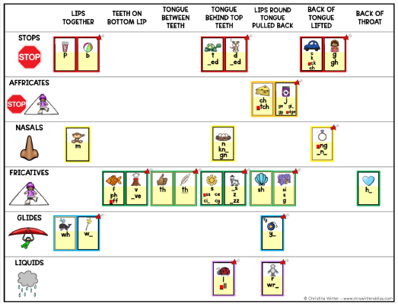
Sound Walls

Slide 21
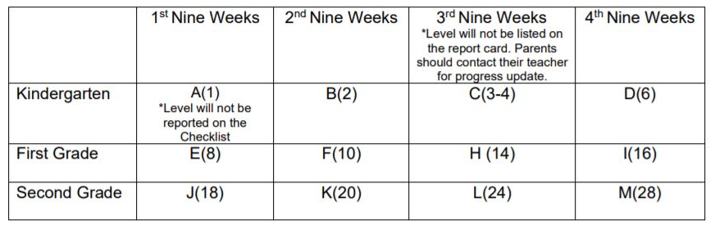
Guided Reading Assessment Levels (GRA)

Slide 22
ACADEMICS Cont.
-Math
Fact Fluency
Problem Solving with real world application
Hands On Experiences
Guided Math Instruction (small group)
-Science
Content Knowledge
Lab (Safety Contracts)
Real Life Application
-Social Studies
Community Connections

Slide 23
Our Daily Schedule
7:45am-9:30am- ELAR (Phonics/Reading Workshop)
9:30am-10:00am- Dolphin TIME
10am-11am- Recess/Lunch
11am-11:45am-ELAR (Writing Workshop)
11:45am-1:15pm-Math Workshop
1:15pm-2:05pm-SPECIALS
2:05pm-2:40pm-Science
2:40pm-3:10pm-Social Studies

Slide 24
HOMEWORK
Monday | Tuesday | Wednesday | Thursday | Friday
Typing Club for 20 minutes. Sign in through Class Link | Science Homework page | Read 20 minutes and practice High Frequency words located in daily folders | Math Homework page | Math and Science Homework pages need to be turned in.
Complete 5 Dreambox lessons by Friday.

Slide 25

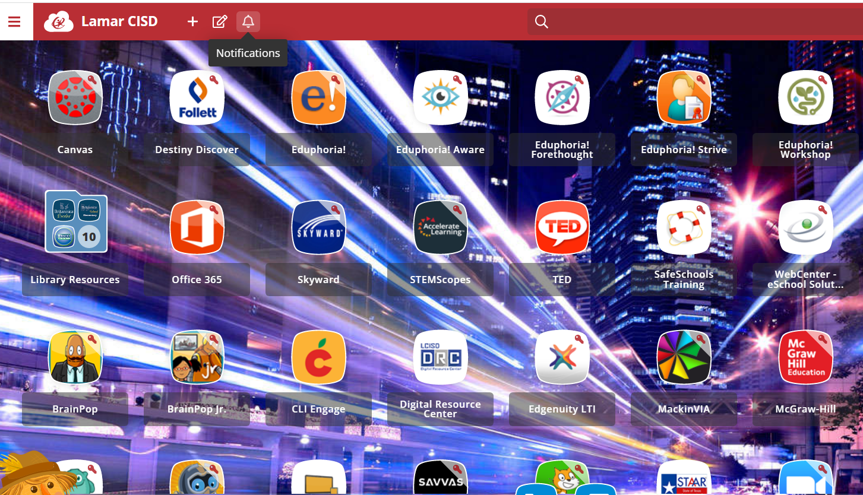
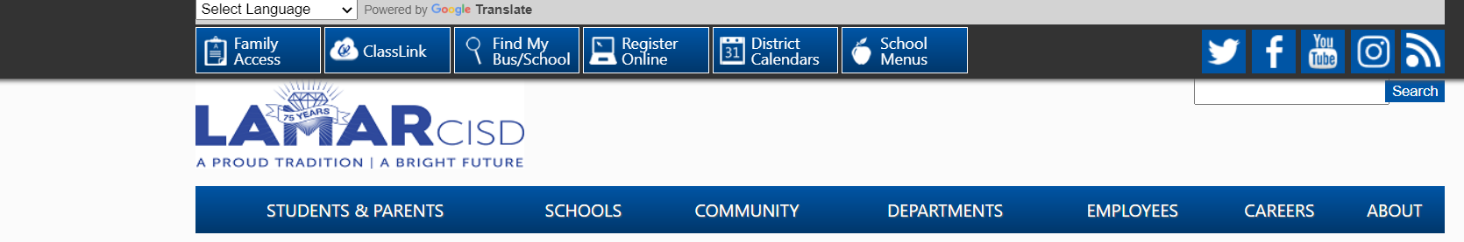
Class Link: Free to LCISD Students (www.lcisd.org)
Many programs are available to use at home to enrich learning!
Please encourage your children to use typing club to practice keyboarding. This will help with online testing. THANK YOU! ☺

Slide 26
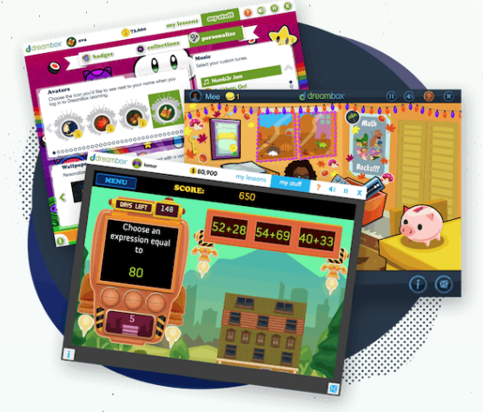

Dreambox
Dreambox is a math learning environment that adapts to your student’s needs.
Students see practice units and lessons dependent on how they perform on assessments.
Dreambox heavily incorporates manipulatives.
Since Dreambox is adaptive, teachers have little control over what unit students are working on.
Dreambox decides what skills your student needs to practice and when they are ready for new lessons.

Slide 27
District/ campus Expectation
FOR STUDENTS TO MAKE PROGRESS
IT IS RECOMMENDED THAT STUDENTS
COMPLETE 5 LESSONS PER WEEK.

Slide 28


How To Access Dreambox
To access on a PC,
your student needs to log in to Classlink and click on the Dreambox icon.
To access Dreambox on an iPad,
download the Classlink app and the Dreambox app.
Login the Classlink app. Click on the Dreambox icon.
It will prompt you to launch the Dreambox app. The program will automatically open in the app.

Slide 29
WHAT INFORMATION IS AVAILABLE TO ME AS A PARENT?
Your Parent Dashboard allows you to see lessons/stories completed, tokens earned, a basic log of the time spent on DreamBox, a total time on task, and progress on curriculum categories.
To create a Parent Dashboard have your student log-in to his/her DreamBox account. Then, click Setup Parent Access at the bottom of the screen. Then, go to play.dreambox.com to see your Parent Dashboard.

Slide 30
TIPS FOR PARENTS
Encourage students to FINISH a full lesson.
Encourage them to use the
“Help” (K-8) and
Use only the program.
No pencil, paper, or calculator
Don’t help students answer problems.
Encourage a growth mindset. It is okay for students to make mistakes and try their own ideas!

Slide 31

Birthday Treats
Birthday treat guidelines are in the 2023-2024 Elementary Student Handbook on page 24: Because of the time constraints, the treat is limited to one item per classmate, and it must be store purchased, single serve item (i.e. cupcake, cookie, etc.) so that it can be served, eaten, and cleaned up within a reasonable time.
The 2023-2024 Elementary Student Handbook states that gifts, balloons, treat bags, and flowers are prohibited at school. Invitations to individual parties may not be distributed at school. Thank you for your understanding! ☺

Slide 32


Classroom Snack
Bring healthy snacks that are NOT messy
  No liquid items and things that will not stain their fingers and papers.
  Please Do not send drinkable snacks or juices.
The only liquid allowed in class is water.
Candy is not permitted for snack time
Please send water bottles each day.
  Make sure it is spill proof in case it accidently gets tipped over.

Slide 33
Lunch Procedures
Breakfast and lunch are not free this school year.
We will begin selling snacks soon. They are extra. If you want to limit their snack purchases, please add that information to their account online.
You are always welcome to drop lunch off in the front office for your child.
Students need to wear their smart tags in order to expedite lunch.
Parents are welcome to eat at the first two tables once you walk in.

Slide 34
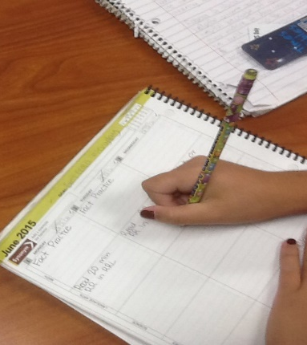
Students Head to class at 7:30 am
Students have the opportunity to unpack their backpack and get prepared for the day.
Allows them time to get focused for the day and be ready to begin learning.
Students who are in class by 7:45 do not miss the announcements.

Slide 35
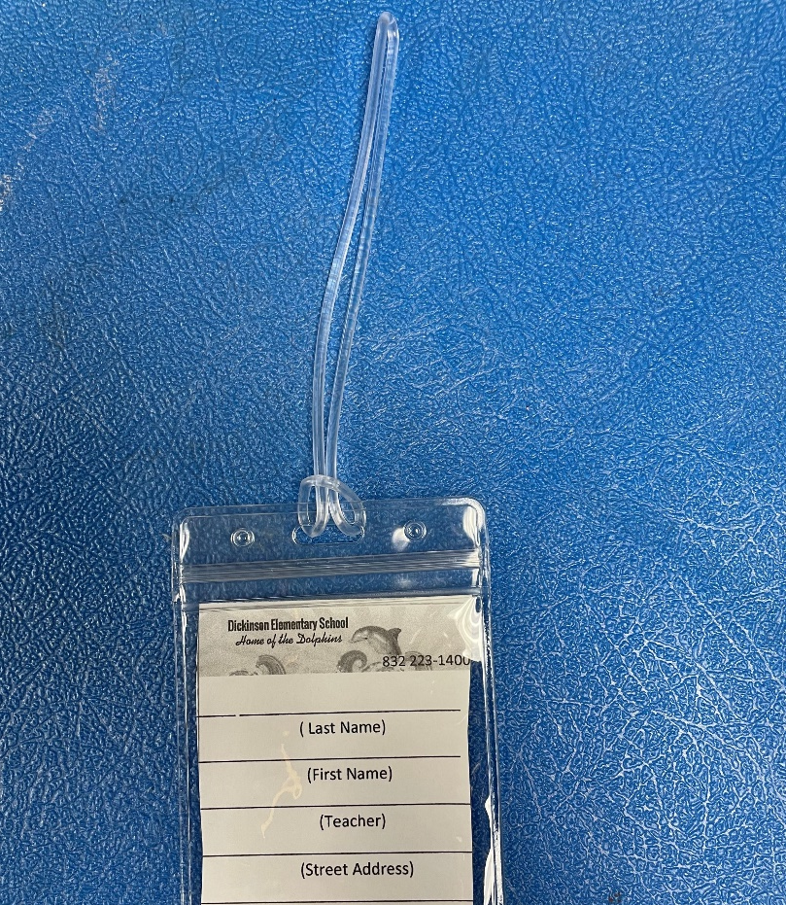
Leave on backpack please!
Name & Dismissal Information
Replacements is $2 at front office
STUDENT TAGS

Slide 36
Dickinson Dress Code
Collared solid navy blue, light blue, red or white short or long-sleeved shirt with no logo.
School spirit shirts and denim-type clothing will be permitted on Fridays:
Shoes: Safe for school, athletic shoes with closed toes and tennis shoes preferred.
Hair: Clean, well groomed, out of eyes, and non-distracting
Khaki, navy blue or black slacks, dresses, skirts, skorts, jumpers or shorts not of denim or denim-type fabric.

Slide 37
Absences/Attendance
Please arrive on time each day.
Attendance is taken at 8:45.
If an absence is necessary, send a written excuse with your child the day they return in their daily folder.
Five or more consecutive absences requires a doctor's note.
Attendance is factored into our accountability rating.

Slide 38
Every Day Counts!
1 or 2 days a week doesn’t seem like much but …
If your child misses. . . | That equals . . . | Which is . . . | And over 13 years of schooling that’s . . .
1 day every 2 weeks | 20 days per year | 4 weeks per year | Nearly 1-1/2 years of school
1 day per week | 40 per year | 8 weeks per year | Over 2-1/2 years of school
2 days per week | 80 days per year | 10 weeks per year | Over 5 years
3 days per week | 120 days per year | 24 weeks per year | Nearly 8 years

Slide 39
How about 10 minutes late a day? Surely that won’t affect my child!
He/she is only missing just . . . | That equals . . . | Which is . . . | And over 13 years schooling that’s . . .
10 min. per day | 50 min. per week | Nearly 1-1/2 weeks per year | Nearly ½ year
20 min. per day | 1 hr. 40 min. per week | Over 2-1/2 weeks per year | Nearly 1 year
30 min. per day | Half a day per week | 4 weeks per year | Nearly 1-1/2 years
1 hour per day | 1 day per week | 8 weeks per year | Over 2-1/2 years

Slide 40

Transportation Changes
Best practice is to send a written note to the school with your child.
If you need to make a last-minute emergency change, call the front office prior to 2:15 PM.
832-223-1400
Please do not email the teacher changes; they are busy teaching students.

Slide 41
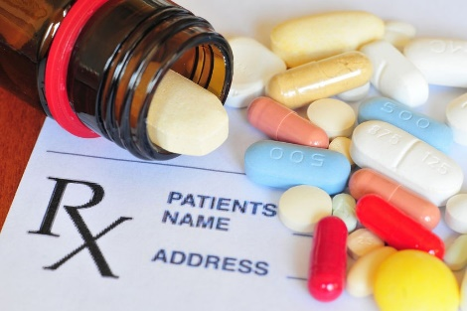
Medications
All medication must be kept in nurse’s clinic—this includes cough drops
All medication must be in original container—if prescription, must have label with student’s name and information on it
Over the counter, short term medications, such as cough drops or antibiotics also need appropriate paperwork, which can also be found on website under nurse’s notes and is called “Parental Permit to Administer Medication At School For 6 Weeks Or Less” –if unable to print this copy , you may send a dated note listing student’s name, name of medication, reason for giving, time/frequency and duration that it is to be given—parent signature is also needed
If your child has a life-threatening allergy or asthma, please get with Nurse Jarvis to discuss and provide appropriate paperwork and medication on campus for those “in case” moments for your child’s safety.
If you have any questions, please feel free to contact the nurse at 832-223-1406 or email at ajarvis@lcisd.org.

Slide 42
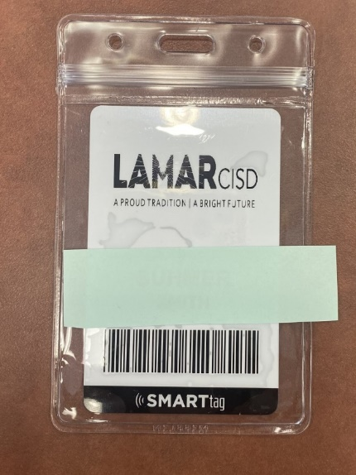
Smart Tags
Every child will have a smart tag which is used to: ​
Track when a student is on the bus​
purchase breakfast and lunch​
check out books in the library​
Notes:
All students must wear their smart tags to and from school each day. They need them throughout the day for various reasons. If your child loses their tag, you may purchase a new one for $5. Send the money with your child and they will be ordered and delivered within 7-10 bus

Slide 43
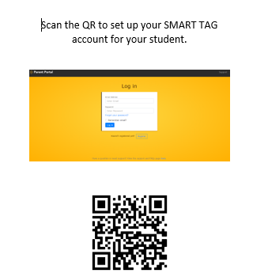
Register your SMART TAG

Slide 44
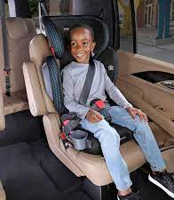
Car Riders
Students are picked up at the front ONLY.
The lines may be long, so pack your patience and cooperative spirit.
For the safety of the children, you may not park and walk up to get your child.
Car Tag-display your student number where it can easily be seen
Child needs to enter on the passenger side of car
Notes:
You may not drop off along the side. Less traffic between 7:00-7:15. Students should be ready to get out of the car. Parents that do not have car tags for pick up will be required to park and come in the school to be cleared to pick up the child.

Slide 45

Peanut Free Classrooms
Classrooms are to be peanut free. A child with serious peanut allergy can potentially suffer a reaction merely by touching or smelling a food with peanut or peanut butter
Please do not send any peanuts, peanut butter or foods containing these items as snacks. They will not be allowed to be eaten in the classroom
Any food sent to share in classroom i.e., birthday cupcakes, cookies etc, is to be store bought, in original container with ingredient list that is peanut free
The above does not apply to lunches, children will still be able to eat food of their choice in lunchroom as we have ensured areas that will remain peanut free zones.
Thank you in advance for your cooperation. We are trying to ensure the safety of all of our children. We are striving to promote a safe environment for all of our students, and in working together we can work to keep our students safe.

Slide 46

How to purchase school lunch
Go to www.schoolcafe.com to create a lunch account online for your student
You may add money to their lunch account from your online School Café account
You may also apply for free or reduced lunch at www.schoolcafe.com

Slide 47




dickinson Elementary PTO https://dickinsonpto.membershiptoolkit.com/Home
How you help your school?
“We make a LIVING by what we GET,
but we make a LIFE by what we GIVE. “ -Winston Churchill
Notes:
Parents & Teachers working together = successful students.

Slide 48

Thanks for being a great audience!

