Slide 1
Course Selection
For additional information, please visit the Counselors’ Corner outside of the cafeteria.

Slide 2
Tonight’s Agenda
General Session:
Course Selection Information
Endorsements
Advanced Academics Overview
Career & Technical Education (CTE)
Career and College Planning Resources [SchooLinks] Intro
Dismissal to Workshop Sessions
Wanting more information? Please attend this evening’s workshop sessions:
Programs of Study and CTE: Cafeteria
Dual Credit & Advanced Academics (PAP, AP, OnRamps): Library
College and Career Planning (College Board, Khan Academy, SchooLinks): Room 1500
Explore courses, contents, clubs, etc.: Hallways
Counselors’ Corner (endorsements, graduation plans, course selection): Outside of the cafeteria
Notes:
Add rooms and any additional sessions/topics as desired [by campus]

Slide 3
Counselors & Principals
Counselors
A-Carr Mrs. Kacy Warren
kacy.warren@lcisd.org
Cart – Garw Mrs. Christy Tucker
ctucker@lcisd.org
Garz – Leo Ms. Tien Davis
tidavis@lcisd.org
Lep – Olz Mrs. Karla White
Karla.white@lcisd.org
Om – Sez Mrs. Charlene Henderson
Charlene.henderson@lcisd.org
Sha – Z Mrs. Wendy Howe
Wendy.howe@lcisd.org
504/Dual Credit/AP Ms. Monica Farrell
Monica.Farrell@lcisd.org
Principals
Mr. Brian Forshee
bforshee@lcisd.org
Ms. Kassandra McCann
kmccann@lcisd.org
Mr. Quantas Floyd
qfloyd@lcisd.org
Mrs. Tracey Williams
Tracey.williams@lcisd.org
Mrs. Groce – Ryans
Allison.groce@lcisd.org
Mr. Matthew Tomas
mtomas@lcisd.org
Mr. Christopher Wood
Christopher.wood02@lcisd.org
Mrs. Mary Saville – College & Career Facilitator
masaville@lcisd.org
Mrs. Kimberly Parker –
Counselors’ Assistant
Kimberly.parker@lcisd.org
Mrs. Jennifer Kipping – Registrar
jkipping@lcisd.org
Notes:
Add Admin info and pics

Slide 4
Course Selection Process
Parent Course Selection Night – September 24th
October 15th – 31st : Enter course choices online in Skyward (completed through English classes for current CFHS students). The window closes on the 31st @ 5:00 pm!
November 11th and 12th: Counselors will meet with current LJH 8th graders individually to review courses & endorsement
November 7th, 8th, and 13th – 21st: Counselors will meet with all current Fulshear students individually to review courses & endorsement
Course verification form will be given to you at your individual meeting – will need to be signed and returned by December 2nd!
Please work together on these with your family – schedule changes are rare once the school year starts!

Slide 5
LCISD
Programs of Study By Endorsement 2025-2026
Multidisciplinary
PUBLIC SERVICES
Arts & Humanities
Business &
Industry
Public Service
STEM
Multidisciplinary
Art
Agriculture, Food & Natural Resources:
Animal Science
or
Agricultural Technology & Mechanical Systems
Business, Marketing & Finance:
Business Management
or
Marketing & Sales
Human Services: Cosmetology and Personal Care Services
Engineering
Four credits in each of the four foundation subject areas to include English IV , Chemistry and/or Physics
Drones
(Unmanned Vehicle)
Band
Education & Training: Teaching & Training
Programming & Software Development - AP
Choir
Architecture & Construction: Carpentry
or
Plumbing & Pipefitting
or
Electrical
or
HVAC – Dual
Hospitality & Tourism: Culinary Arts
JROTC
Programming & Software Development: Cyber Security - Dual
Four Advanced courses that prepare students to enter workforce or postsecondary education without remediation from within 1 endorsement area or among endorsement areas that are not in a coherent sequence
Dance
Manufacturing: Welding - Dual
Health Science:
Diagnostics and Therapeutic Services
Programming & Software Development
English
Transportation, Distribution & Logistics: Automotive - Dual
or
Diesel & Heavy
Equipment – Dual
or
Automotive and Collision Repair
or
Distribution, Logistics, and Warehousing
Languages other than English
Robotics
Law & Public Service:
Law Enforcement
Science
Mariachi
Arts, Audio/ Video Technology & Communications:
Design & Multimedia Arts
or
Digital Communications
Mathematics
Four credits in AP or dual credit selected from English, math, science, social studies, economics, LOTE or fine arts
Orchestra
STEM:
Combination
(4 or more STEM courses + 3 additional electives)
Social Studies
Theatre
Business & Industry:
Combination
(4 or more B&I courses + 3 additional electives)

Slide 6
Advanced Academics
Advanced Placement (AP)
1.3 Multiplier
College Credit based on exam score
HS gradebook only
Grades 9-12
Dual Credit and Dual Enrollment
1.3 Multiplier
College credit based upon college grade
HS and College Gradebooks
Grades 11-12
PAP
1.2 Multiplier
No college credit
PAP are Pre-Advanced Academics courses (non-College Board)
Grades 6-12
*For campus specific course questions please visit the Counselor Corner during workshops

Slide 7
Join us in workshops for additional information.
Dual Credit & PAP/AP
Workshop with College & Career Facilitator
Room 1500
Assistance with College applications, TSIA, College Board, and much more.
Library
Notes:
Add Workshop Room Numbers

Slide 8
SchooLinks
•LCISD’s College and Career Exploration Tool for grades 6-12
•It is a modern College & Career Readiness platform with over 80 experiences such as career interest inventory assessments, college and career search, internship matching, portfolio, scholarships, and more.
College and Career Readiness Platform

Slide 9
Workshops:
CTE Workshop
Room: Cafeteria
Learn more about the numerous courses within Lamar CISD's Programs of Study.
Dual Credit & Advanced Academics:
Room: Library
Learn about enrollment, courses offered, and the benefits of Dual Credit Programming
Learn about courses, exams, and the benefits of PAP/ Advanced Placement courses.
Counselors’ Corner:
Outside of the Cafeteria
Get your endorsement, course selection, and graduation planning
questions answered.

Slide 11
What does CTE offer to students?
Agriculture, Food, & Natural Resources
Agricultural Technology & Mechanical Systems
Animal Science
Architecture & Construction
Carpentry
HVAC & Sheet Metal (Dual Credit through TSTC)
AAVTC
Graphic Design
Digital Communications
Business, Marketing, & Finance
Business Management
Marketing & Sales
Education & Training
Teaching & Training
Health Science
Dental
Pharmacy
Patient Care
Hospitality & Tourism
Culinary Arts
Law & Public Service
Law Enforcement
Manufacturing
Welding (Dual Credit through TSTC)
STEM
Cybersecurity (Dual Credit through TSTC)
Engineering
Programming & Software Development
Transportation, Distribution, & Logistics
Automotive Technology (Dual Credit through TSTC)
Diesel & Heavy Equipment (Dual Credit through TSTC)
Notes:
Dual Credit Opportunities
Industry-Based Certifications
CTSOs (i.e., DECA, FFA, HOSA, SkillsUSA, TAFE, TSA)
National Technical Honor Society

Slide 12
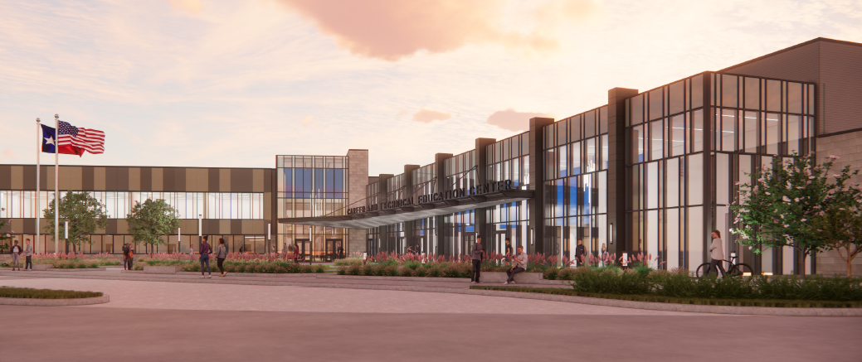
Coming August of 2026! LCISD Career & Technical Education Center

Slide 13
What will be offered at the CTE Center?
Architecture & Construction
Carpentry
HVAC & Sheet Metal
Plumbing & Pipefitting
Electrical
AAVTC
Graphic Design
Digital Communications
Engineering
Drones
Robotics
Human Services
Cosmetology
Health Science
Dental
Pharmacy
Patient Care
Hospitality & Tourism
Culinary Arts
Transportation, Distribution, & Logistics
Automotive Technology
Distribution & Logistics
Paint & Body

Slide 14
Have additional questions?
Come to the CTE Question & Answer Session in
the Cafeteria!

