Slide 1
9th Grade COURSE SELECTION 2024-2025

Slide 2
Counselors and Principals
Counselors
A-CI -- Mrs. Kacy Warren
kacy.warren@lcisd.org
CJ-HER -- Mrs. Christy Tucker
ctucker@lcisd.org
HES-MOE -- Mrs. Karla White
karla.white@lcisd.org
MOF-ROC -- Ms. Charlene Henderson
charlene.henderson@lcisd.org
ROD-Z -- Mrs. Wendy Howe
wendy.howe@lcisd.org
504/AP Testing/Dual Credit -- Ms. Monica Farrell
monica.farrell@lcisd.org
College & Career Facilitator -- Mrs. Mary Saville
masaville@lcisd.org
Counselors’ Secretary – Mrs. Kimberly Parker
kimberly.parker@lcisd.org
Registrar -- Mrs. Jennifer Kipping
jkipping@lcisd.org
Principals
Mr. Brian Forshee
bforshee@lcisd.org
Mr. Trey Watkins
jwatkins@lcisd.org
Ms. Kassandra McCann
kmccann@lcisd.org
Ms. Allison Groce-Ryans
allison.groce@lcisd.org
Mr. Matthew Tomas
mtomas@lcisd.org
Mr. Christopher Wood
christopher.wood02@lcisd.org

Slide 3
Course Selection Timeline
Jan 16th – Feb 4th → Course selection window is open
January 18th → Students will receive course selection materials
Week of January 22nd → 8th Grade Counselors will meet with students to enter their course choices in Skyward
Week of February 26th → Fulshear Counselors will meet with each 8th grader individually to review choices. Course verification sheet will be given to each student.
March 1st → Course verification sheet needs to be signed and returned to your 8th grade Counselor
Select your classes carefully as schedule changes are rarely granted after the deadline!

Slide 4
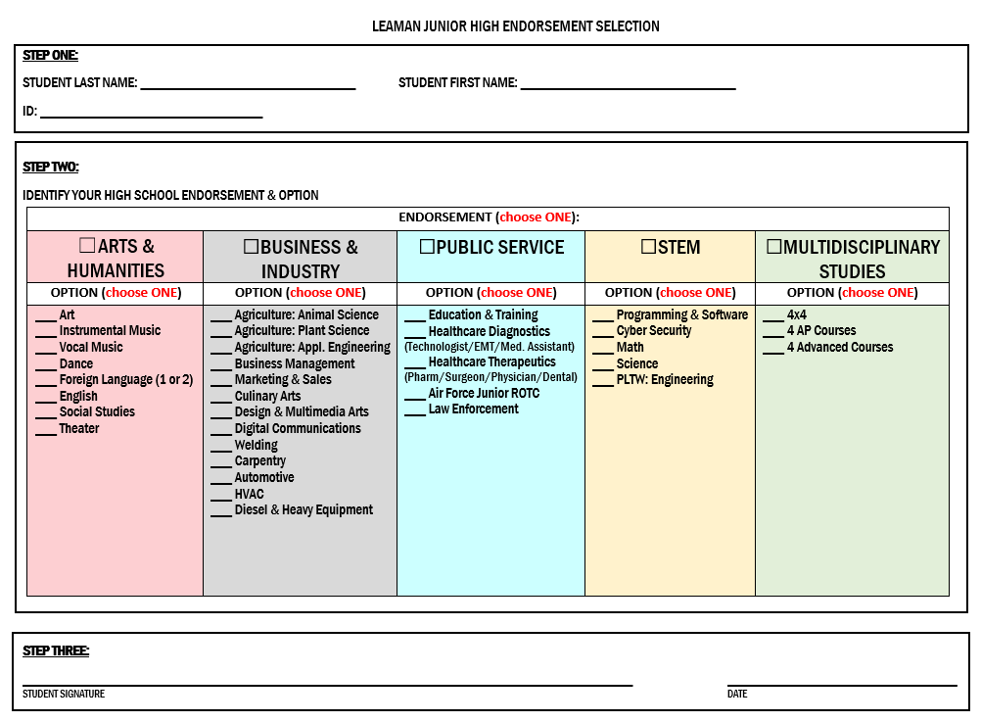

Slide 5
Course Selection Sheet – Page 1

Slide 6
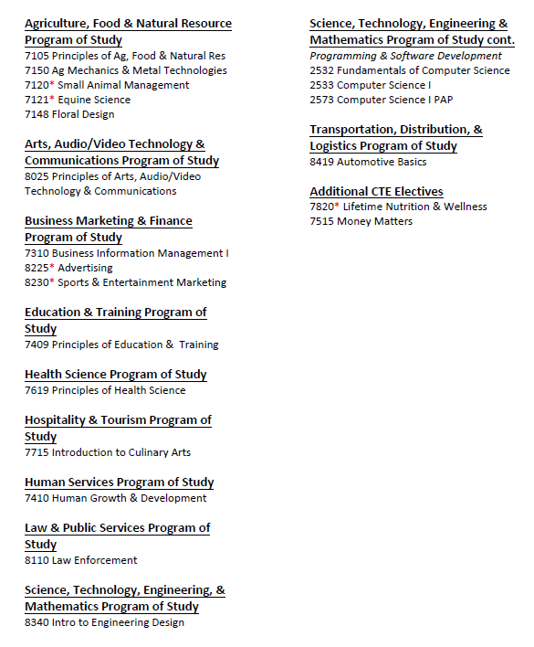
Page 2 – CTE Courses
8373 Intro to CADD

Slide 7
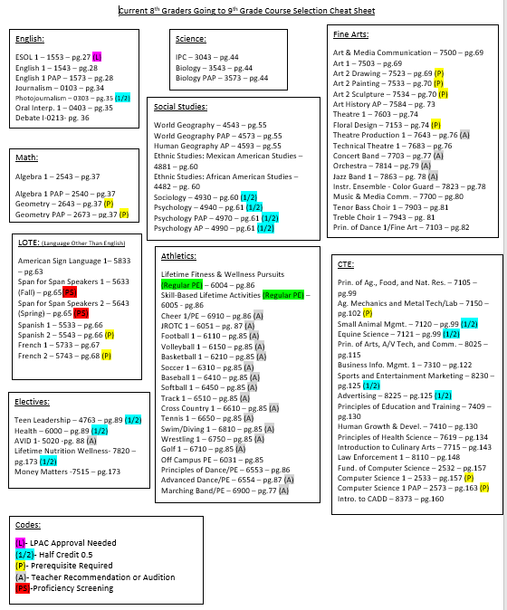
Course Selection Sheet

Slide 8
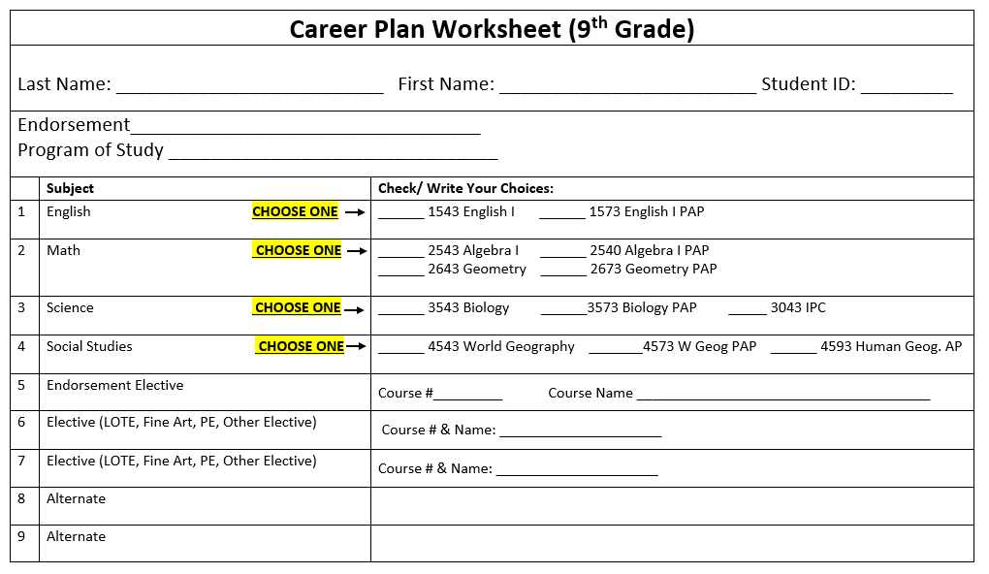
Course Selection Sheet

Slide 9
Tips for Course Selection
You must select 7 classes in Skyward!
4 of them must be core classes:
English: English 1 Academic or English 1 PAP
Math: Algebra 1 Academic or Algebra 1 PAP
If you are currently enrolled in Algebra 1, you will pick Geometry Academic or Geometry PAP
Science: Biology Academic or Biology PAP or IPC Academic
Social Studies: World Geography Academic or World Geography PAP or Human Geography AP
Which level (Academic, PAP, AP) I should take?
Ask your current teachers for their recommendations!

Slide 10
Tips for Course Selection
What other courses should I select?
For the remaining 3 classes, consider this:
Do you play a sport? If so, pick that sport as a class!
Are you in band/theater/dance/etc.? If so, pick it!
Be sure to pick your endorsement class
Pick electives (you need 7 of them to graduate!)
YOU NEED THE FOLLOWING IN ORDER TO GRADUATE:
1 year of PE/Athletics (Dance, Band, ROTC can count as a PE too)
1 year of Fine Art (Art/Band/Choir/Dance/Theatre/Orchestra)
2 years of the same foreign language (Spanish/French/Sign Language)
26 total credits
If you pass the entire year of a class, you will earn one credit
If you only pass one semester of a class, you will only earn half a credit and will have to retake the half that you failed

Slide 11
Information for our Athletes
If you want to play a sport in high school, you will select that sport as one of your classes. Tryouts/coach approval will determine if you remain in that class.
**NOTICE** Football, Cross Country, Volleyball, and Tennis typically start around August 1st. That’s a few weeks before the start of the school year. Keep that in mind when planning vacations.
Students must have a completed physical and all Rank One paperwork on file to begin.

Slide 12
Additional Resources
LCISD Website
Course Selection (HB5) Information link found under Students/Parents tab
Course Catalog (course descriptions, prerequisites, schedule change policy, PAP/AP course expectations, etc.)
Endorsement Flowcharts
Fulshear High School Website
Your Current Leaman Counselor
Your Current Leaman Teachers for course level suggestions (Academic, PAP, or AP)

Slide 13
Questions?
All questions from Leaman students and parents should be directed to the Leaman Counselors.
Please consult the Fulshear HS website for extensive course selection information.

