Slide 2
A strategic plan is part of a school district’s planning & goal-setting system
5-year
Strategic Plan
Defines 3-5 key priorities for the District—where we want to be in 5 years
Articulates the key goals that will help us realize the key priorities
Is not—an operating plan that outlines all of the District’s tactics over a five year period of time

Slide 3
A strategic plan is part of a school district’s planning & goal-setting system
5-year
Strategic Plan
Annual
District Improvement Plan
Annual
Superintendent Goals

Slide 4
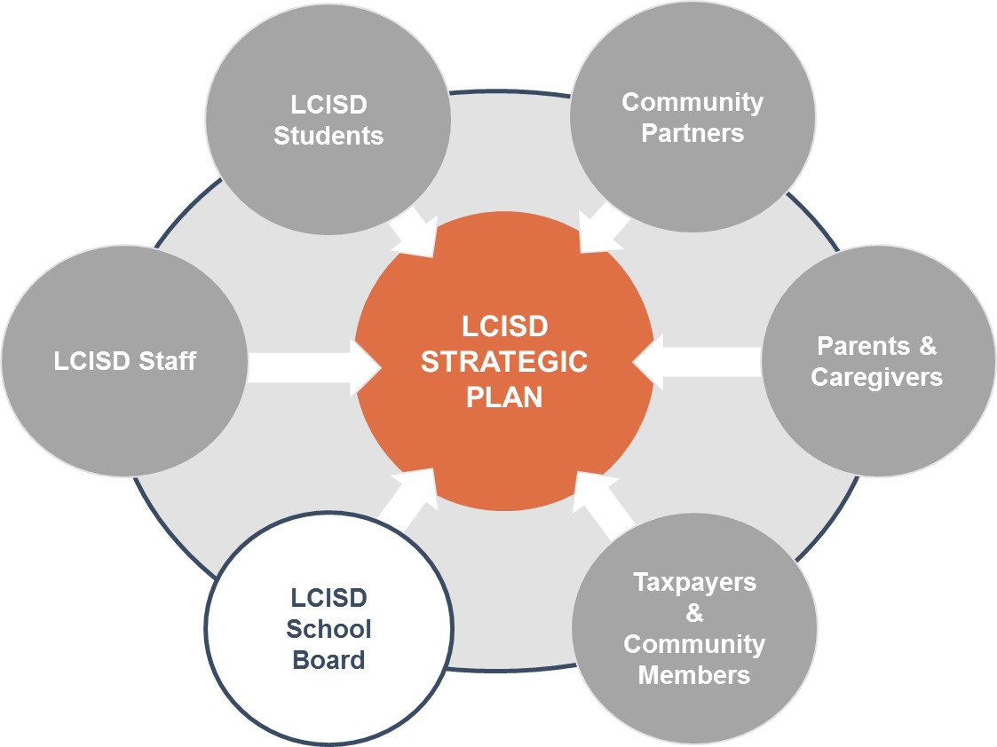
We designed a process to generate a sense of shared ownership in the Strategic Plan

Slide 5
Lamar CISD’s Strategic Plan was crafted through a three step process
Listening Tour
Strategic Visioning & Goal Refinement
Feedback and Adoption

Slide 6
The District engaged several thousand stakeholders through the Listening Tour
Community Meetings
Strategic Planning Survey
3,233
10 meetings
(2 per color track)
345 total attendees
Parents
2,841
Staff
18,063 Total Respondents
Staff Meetings
11,892
Students
One at each campus
One in each CO Department
97
Community Members

Slide 7
Several clear themes emerged based on stakeholder input
Evolving the Student Learning Experience
Community Meetings
Equipping Students with Knowledge and Skills to Succeed in a Changing World
Staff Meetings
Survey
Promoting a Safe and Healthy Environment for Students
Planning for Rapid Growth While Preserving District Culture
Focus on Talent

Slide 8
A Strategic Planning Committee was formed to shape the Listening Tour feedback into clear strategies
Committee Goals & Purpose
1
Review and consolidate feedback from the listening tour to create targets aligned to each priority
2
Prepare a draft of the plan for board approval, with support from Holdsworth & District staff

Slide 9
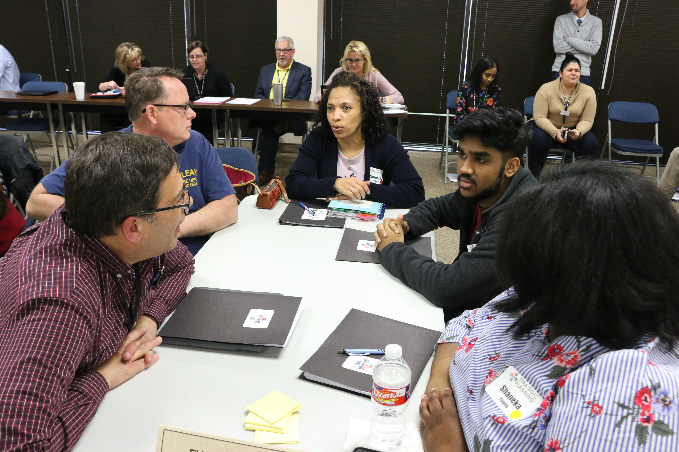
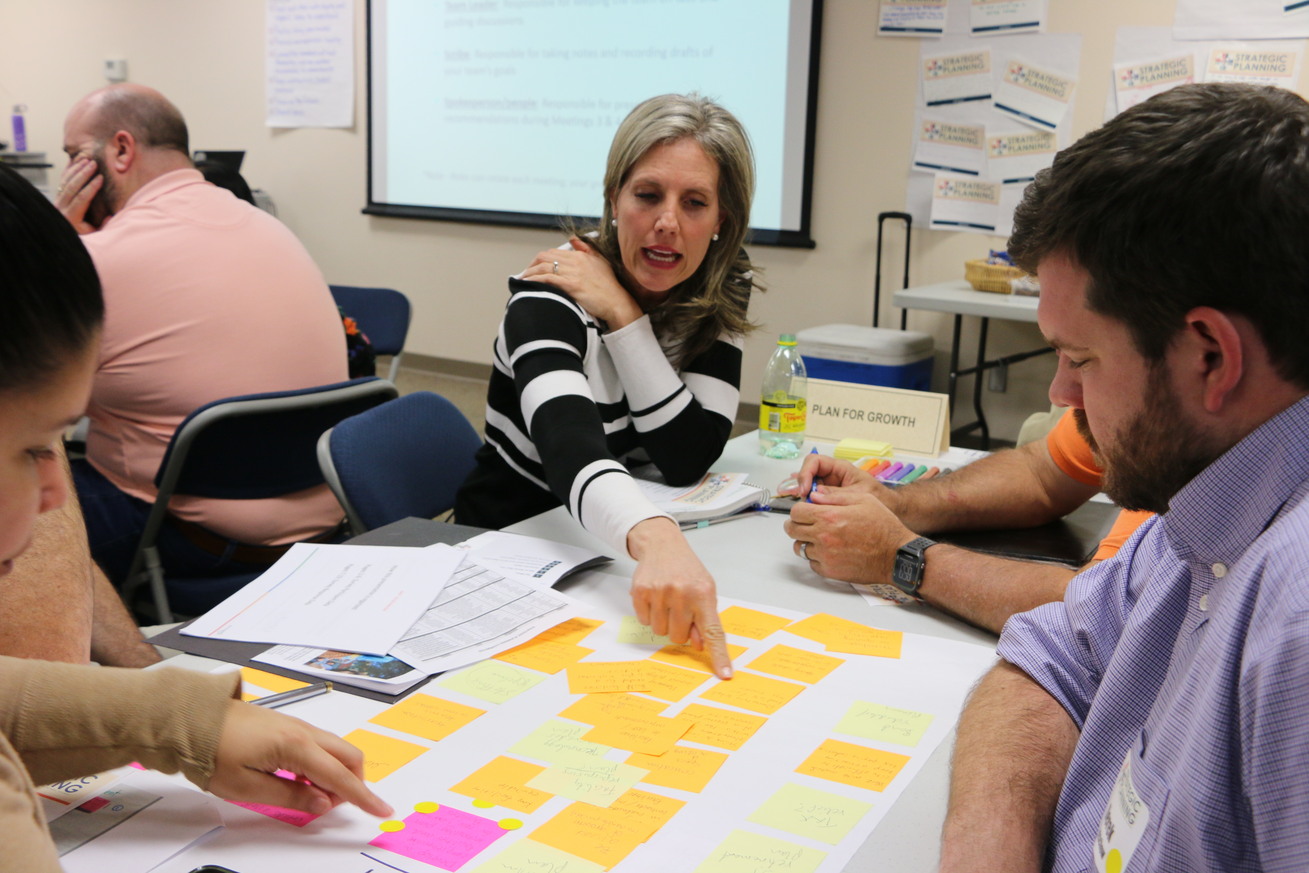
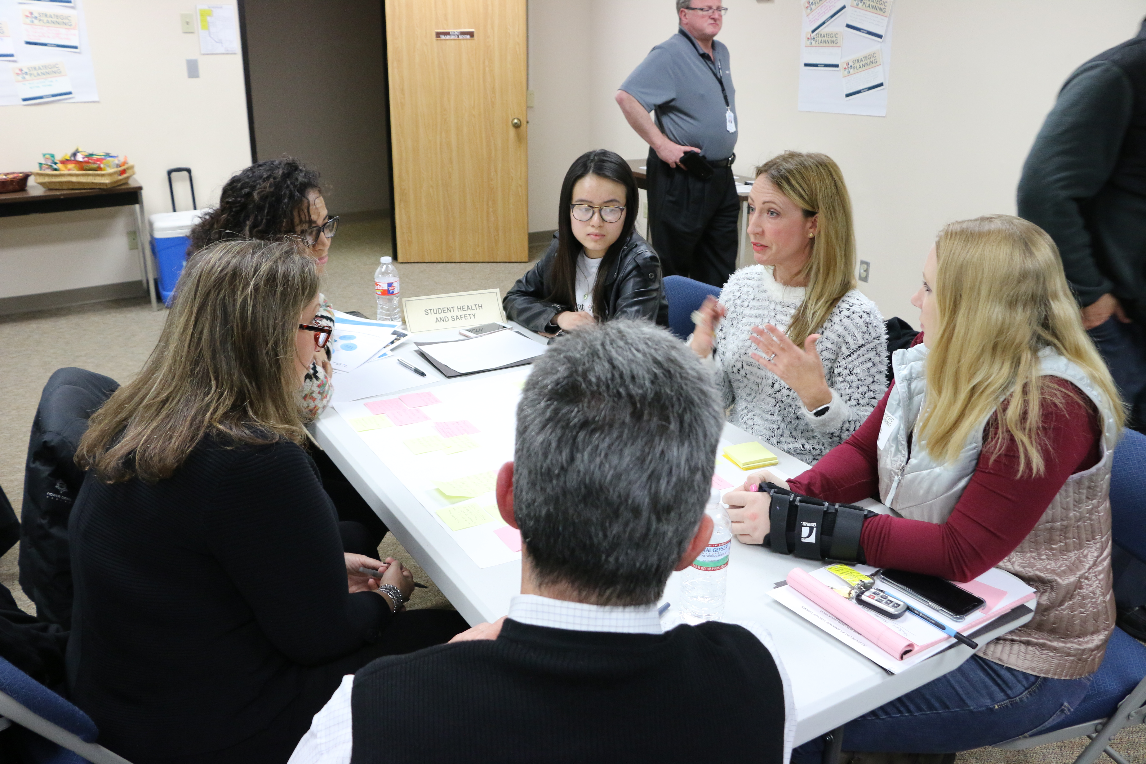
The committee included 30 diverse and engaged parents, staff, students, and community members

Slide 10
The Strategic Plan contains
five strategic priorities
Evolve the Student Learning Experience
Equip Students with Knowledge and Skills to Succeed in a Changing World
Promote a Safe and Healthy Environment
Plan for Rapid Growth While Preserving District Culture
Focus on Talent

Slide 11
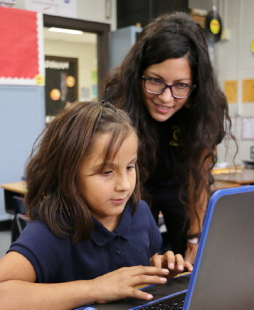
Evolve the Student Learning Experience to prioritize innovative changes in how students learn
As the needs of employers continue to evolve, it is critical that our educators are equipped with the best possible tools, technology, and resources to prepare LCISD students for their future life and careers as critical thinkers and leaders.
1
Ensure access to engaging, rigorous, real-world learning opportunities and up-to-date technology.
2
Equip all parents and guardians with the tools to support student learning and growth.
3
Expand resources available to provide learning that is personalized to each student’s interests and abilities in order to eliminate gaps in achievement.

Slide 12
Equip Students with Knowledge and Skills to Succeed in a Changing World no matter their desired career path
Students in LCISD should be equipped with knowledge and skills that prepare them to be successful global citizens, and the District should expand access to rigorous career and college preparation programs equitably through all parts of the District.
Ensure LCISD graduates have effective critical thinking, problem solving, and communications skills in order to be successful in professional and personal relationships.
1
Ensure the curriculum equitably prepares students to achieve their preferred career aspirations by enhancing both rigorous career and technical education (CTE) and college preparatory programs.
2
3
Increase students’, families’, and community members’ awareness of and access to all available academic programs.

Slide 13
Promote a Safe and Healthy Environment that includes physical safety and emotional well-being
Everyone at Lamar CISD must feel safe and supported both emotionally and physically in order to achieve at the highest levels.
1
Increase mental and emotional health supports and resources to improve socioemotional well-being among students and staff.
Ensure that disciplinary interventions consistently address the root causes of behavioral issues and staff understand how to implement disciplinary practices in a clear and equitable way for the well-being of all students.
2
3
Ensure facility safety remains a priority through up-to-date technology and that all facilities provide a safe, inclusive, and effective learning environment for all.

Slide 14
Plan for Growth While Preserving District Culture with a focus on equity
The District’s projected growth is one of its greatest challenges and opportunities. As such, leaders should continue to prioritize initiatives that ensure that students and staff continue to feel equitably supported.
1
Maintain neighborhood school structure and a unified community feeling during rapid growth and expansion.
2
Actively seek to engage and involve all stakeholder groups as community partners in the district’s growth.
3
Continue to build and maintain equitable campus buildings and shared district support facilities commensurate with the district’s growth.
4
Ensure that budget and staffing plans equitably meet the changing student and staff needs as the district grows.

Slide 15
Focus on Talent to ensure LCISD
continues to be an employer of choice
The faculty and staff in LCISD are key to students’ success – now and in the future. The District should ensure that they are attracting and retaining top talent to meet the staffing and leadership needs that LCISD’s growth will demand.
1
Prioritize competitive compensation and benefits for all employees using available resources.
2
Expand access to differentiated professional development and coaching for all staff based on experience and need.
3
Provide career pathways and advancement opportunities throughout the organization in order to attract and retain talented personnel.
4
Increase awareness of LCISD as a destination of choice to live, work, and learn.

Slide 16
What’s next? The Superintendent’s SMART Goals, the DIP and CIPs should align to the Strategic Plan
5-year
Strategic Plan
Annual
District Improvement Plan
Annual
Campus
Improvement
Plans

Slide 17
We’ll continue to engage the community and other constituents as we make progress on this plan

Slide 18
Strategic Plan
Review this document and identify at least one Strategic Priority that resonates with you.
Discuss with elbow partner.

Slide 19
The Strategic Plan is a direction—
NOT a directive.

