Slide 2
A District Improvement Plan (DIP) is part of a
school district’s planning & goal-setting system
5-year
Strategic Plan
Annual
Superintendent
Goals
Annual
District Improvement Plan
Annual
Campus
Improvement Plans

Slide 3
District Improvement Plan
Under provisions of the Texas Education Code (TEC), every district is required to develop a district plan to improve student performance.
District and campus plans are developed annually to be mutually supportive of the state goals and objectives under TEC, Chapter 4.
These plans are living documents that are utilized and adjusted throughout the school year.
District and Campus Improvement Plans are aligned to the Board-approved Lamar CISD Strategic Plan.

Slide 4
The Lamar CISD Strategic Plan
includes five strategic priorities
Evolve the Student Learning Experience
Equip Students with Knowledge and Skills to Succeed in a Changing World
Promote a Safe and Healthy Environment
Plan for Rapid Growth While Preserving District Culture
Focus on Talent

Slide 5
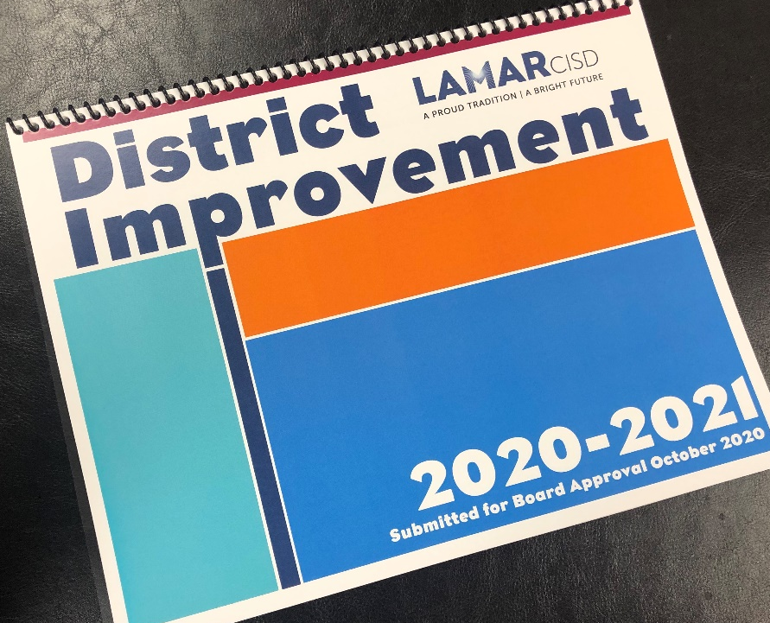
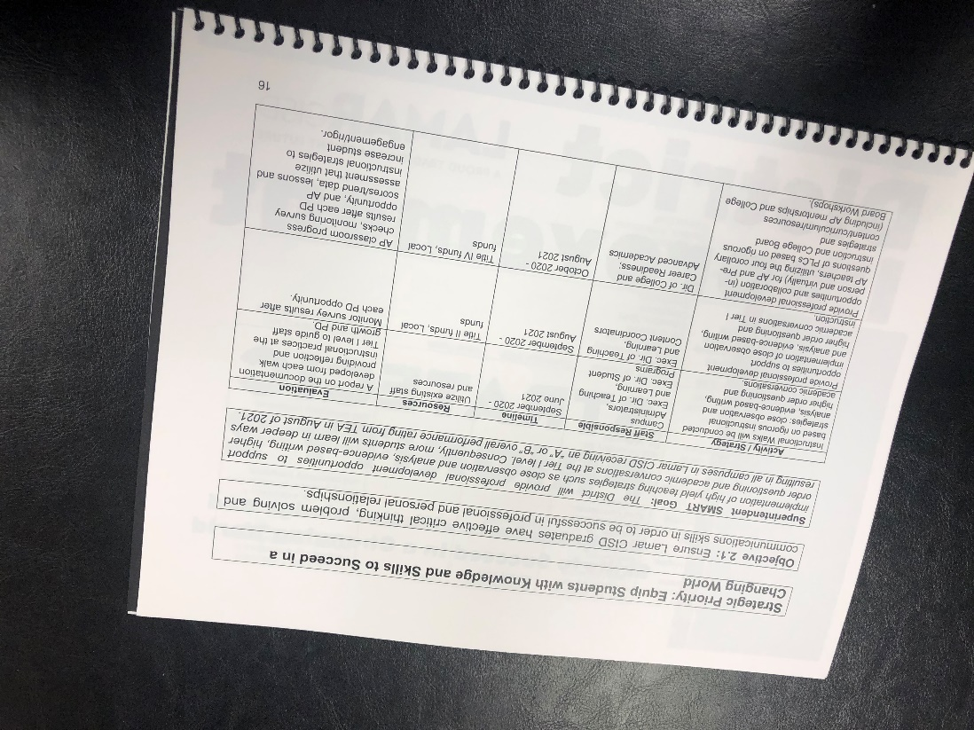
District Improvement Plan
Strategic Priorities
Strategic Objectives
Superintendent SMART Goals
DIP Activities/Strategies

Slide 7
Objective 1.1: Ensure access to engaging, rigorous, real-world learning opportunities and up-to-date technology.
Superintendent SMART Goal: The District will cultivate expertise in teaching and learning as a means for improving student achievement through high-quality professional development, therefore teaching will become strengthened and more students will learn in deeper ways. In August of 2021, all campuses in Lamar CISD will receive an “A” or “B” overall performance rating from TEA.

Slide 8
Update:
Elementary coaches, facilitators and administrators participated in professional development on the coaching cycle from the Jim Knight Instructional Coaching Group in October. Secondary coaches and administrators will have the same opportunity in January.
Thirty-six staff members, representing 11 campuses and central office, participated in an Instructional Rounds Virtual Academy with Dr. Shelia Maher in October.
Lamar CISD teachers have received training through online tools including Canvas Studio, Zoom Best Practices, Proctorio, Nearpod Intro and Basics and Nearpod Lesson Design.
Guided reading and guided math training occurred in October.

Slide 9
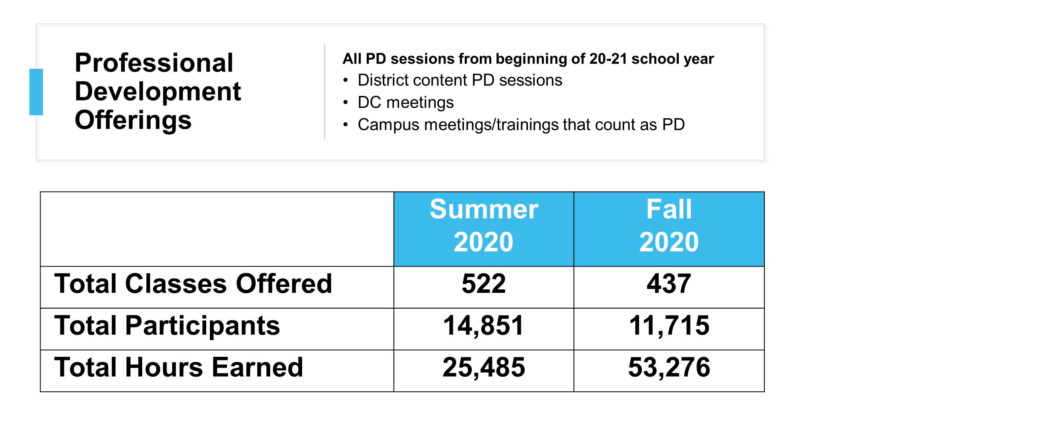

Slide 10
Objective 1.2: Equip all parents and guardians with the tools to support student learning and growth.
Superintendent SMART Goal: Full implementation of all-day Pre-K is being implemented in the 2020-2021 school year and the District will seek a 10% increase in participation in parent and family engagement opportunities including Project Learn, Pre-K and EL Family Engagement events and Summer Connect.

Slide 11
Update:
Our Title I campuses have offered 18 different family engagement sessions, as well as a variety of campus-specific sessions to meet their community’s needs.
In October, the “Connect” web portal for families was launched, providing educational and parenting resources to support the school-to-home connection.
Project Learn had multiple events with community partners, including ESL classes, Houston Food Bank parent/child nutrition classes, Memorial Hermann Parenting Tidbits and more. More than 765 individuals participated in these events.
Additionally, eight virtual family events were offered to Seguin Early Childhood Center virtual learners during the fall, where 122 families participated.

Slide 12
Objective 1.3: Expand available resources to provide learning that is personalized to each student’s interests and abilities in order to eliminate gaps in achievement.
Superintendent SMART Goal: Highly effective professional learning communities will be utilized as a vehicle for examining school, classroom and individual student progress. As a result, intervention opportunities for students receiving special education will be targeted in more focused ways, resulting in a 5% decrease in failures in special education at the elementary and secondary levels.

Slide 13
Update:
Based on the beginning-of-the-year universal screener results, campuses are successfully implementing the tiered systems of support.
A total of 1,120 students are receiving Tier 2 skill-building intervention and 402 students are receiving Tier 3 intensive intervention supports across all campuses.
Identified elementary and secondary campuses participated in two half-day coaching sessions with David LaRose during the fall semester.
Thirty-one percent of campuses had a reduction in the percentage of special education failures from the first nine weeks (elementary) or first semester (secondary) from 2019-2020 to 2020-2021.

Slide 15
Objective 2.1: Ensure Lamar CISD graduates have effective critical thinking, problem solving and communications skills in order to be successful in professional and personal relationships.
Superintendent SMART Goal: The District will provide professional development opportunities to support implementation of high yield teaching strategies such as close observation and analysis, evidence-based writing, higher order questioning and academic conversations at the Tier I level. Consequently, more students will learn in deeper ways resulting in all campuses in Lamar CISD receiving an “A” or “B” overall performance rating from TEA in August of 2021.

Slide 16
Update:
SS working through PLCs and department chairs have provided guidance and facilitated the implementation of close observation and analysis.
Math team meetings and PLCs have focused on pre-planning higher order questioning and academic conversations.
Multiple Zoom training and professional resources were provided in the fall, including:
Close Reading with Mentor Text and mentor text kits
Using and Encouraging Higher Order Questions
Using Quickwrites as a Response to Reading
Using Bulb to Take Reader Writer Notebooks to Next Level

Slide 17
Objective 2.2: Ensure the curriculum equitably prepares students to achieve their preferred career aspirations by enhancing both rigorous Career and Technical Education (CTE) and college preparatory programs.
Superintendent SMART Goal: The District will cultivate expertise in teaching and learning as a means for improving student achievement, so teaching will become strengthened and more students will learn in deeper ways resulting in a 5% increase in the number of students receiving college credit in dual credit and dual enrollment programs, AP Scholar and NMSQT honors and CTE industry certification passing performance by August of 2021.

Slide 18
Update:
The Canvas Collaboration Course was developed in August for AP and Pre-AP teachers to collaborate on College Board resources, strategies and AP classroom enrollment for all AP students.
In CTE, professional development centered on developing strong PLCs is scheduled for the spring semester. Certification exam data will be reviewed to drive instruction and adjust curriculum as needed.
Advanced Placement PLCs will be conducted in January to analyze data to drive instruction and adjust curriculum as needed.
Two teachers have achieved dual credit credentialing in 2020-2021, through the Lamar CISD Plus-18 program. Recruitment, informational sessions and Plus-18 applications will take place in January 2021.

Slide 19
Objective 2.3: Increase students’, families’, and community members’ awareness of and access to all available academic programs.
Superintendent SMART Goal: Secondary campuses will inform parents and guardians about the SchooLink program through parent and guardian training opportunities. Participation in these trainings will increase by 10% when compared to Naviance and Xello parent/guardian events in the 2019-2020 school year.

Slide 20
Update:
SchooLinks training for counselors, CCFs and registrars was completed in the fall.
Each secondary campus hosted a Zoom Parent/Guardian SchooLinks engagement session. SchooLinks information nights were held in multiple languages and had a total of 348 attendees, an increase from 242 (Xello/Naviance) in 2019-2020.
Each campus CCF met with students (individually and by class) to complete student onboarding and grade-level tasks in SchooLinks during the fall semester.
Title I secondary contacts were provided with SchooLinks training resources. Parent training will occur in February.

Slide 22
Objective 3.1: Increase mental and emotional health supports and resources to improve social and emotional well-being among students and staff.
Superintendent SMART Goal: Professional school counselors will provide two faculty and two assistant principal solution focused skill-building trainings and monthly Character Counts classroom guidance lessons for each pillar (trustworthiness, respect, responsibility, fairness, caring and citizenship) by June of 2021.

Slide 23
Update:
Social Emotional Inventory was implemented in September 2020. A total of 17,476 students (5th – 12th grades) have responded as of December 2020.
Administrators received initial training in August 2020 and a second training in December 2020.
Principals will receive additional training for the Solution Focused Approach in 2021.
Character Counts lessons are being conducted throughout the District for on-campus and virtual students, and are on track for 100 percent completion by end of school year.

Slide 24
Objective 3.2: Ensure that disciplinary interventions consistently address the root causes of behavioral issues and staff understand how to implement disciplinary practices in a clear and equitable way for the well-being of all students.
Superintendent SMART Goal: Highly Effective MTSS (formerly RTI) processes will be utilized as a vehicle to determine high-quality disciplinary interventions at each campus resulting in a 5% decrease in placements at the Alternative Learning Center (ALC) for persistent misbehavior.

Slide 25
Update:
Campuses have documentation of at-risk students with multiple discipline infractions and the progress of MTSS interventions is provided to each student.
Additionally, campus administrators receive regular updates on research-based MTSS strategies.
The number of students in ISS has declined by 83.3 percent (383 in fall 2020 v. 2,299 in fall 2019).
The number of students in OSS has declined by 66.2 percent (359 in fall 2020 v. 1,062 in fall 2019).

Slide 26
Objective 3.3: Ensure facility safety remains a priority through up-to-date technology and that all facilities provide a safe, inclusive and effective learning environment for all.
Superintendent SMART Goal: Campuses will maintain 100% monthly compliance with the updated pandemic safety drill guidance by June of 2021.

Slide 27
Update:
Drill schedules and compliance are tracked in the Raptor system.
All campuses completed their annual drill schedules and entered them into the Raptor system prior to the start of the 2020-2021 school year.
All campuses achieved 100 percent compliance for their updated pandemic safety drills through December 2020.

Slide 29
Objective 4.1: Maintain neighborhood school structure and a unified community feeling during rapid growth and expansion.
Superintendent SMART Goal: The District will provide a comprehensive review of the Lamar CISD Master Plan Principles by June of 2021.

Slide 30
Update:
The Board reviewed the District’s Master Plan Principles during the October Board meeting. After Board discussion, the following footnote was added to the Master Plan Principles document:
“The Lamar CISD Master Plan Principles were initially created in 1994, approved in 2003 and reaffirmed via review by the School Board in 2006, 2011, 2014, 2017 and 2020.”

Slide 31
Objective 4.2: Actively seek to engage and involve all stakeholder groups as community partners as the District grows.
Superintendent SMART Goal: The District will create a webpage with information specifically for realtors/developers in the area by June of 2021. This will include information pertinent to realtors such as enrollment information, District statistics, new student information, a District map, attendance zones and more.

Slide 32
Update:
Community Relations is gathering existing information and creating additional resources for the realtor/developer webpage on the District’s website.
This webpage is projected to be available in March of 2021.

Slide 33
Objective 4.3: Continue to build and maintain equitable campus buildings and shared District support facilities commensurate with the District’s growth.
Superintendent SMART Goal: The District will create a voter information campaign that will result in the successful passage of all four propositions that comprise the $792.5 million bond referendum on November 3, 2020.

Slide 34
Update:
The District implemented print and digital information campaigns to ensure the Lamar CISD community was informed of the 2020 Bond and the four propositions on the November ballot.
On Nov. 3, the community passed the largest bond referendum in the District’s history, approving Propositions A and D at $666,810,864. The community passed 236 out of the 239 projects included in the 2020 Bond.

Slide 35
Objective 4.4: Ensure that budget and staffing plans equitably meet the changing student and staff needs as the District grows.
Superintendent SMART Goal: The District will partner with TASB to conduct a Staffing Review study during the 2020-2021 school year. The study will compare Lamar CISD staffing with a group of peer districts.

Slide 36
Update:
The TASB Staffing Review has been conducted and District staff are in the preliminary phase of reviewing the information.

Slide 38
Objective 5.1: Prioritize competitive compensation and benefits for all employees using available resources.
Superintendent SMART Goal: As recruitment and retention of top talent becomes more challenging and competitive, Lamar CISD will conduct two surveys by June of 2021 to obtain insight from current and prospective teaching candidates to enhance the way top talent is incentivized to teach and lead in the District.

Slide 39
Update:
The initial survey was sent out on Jan. 15 to 430 recent hires and 164 recent applicants—which also includes recent university graduates.
The deadline for their responses is Jan. 31.

Slide 40
Objective 5.2: Expand access to differentiated professional development and coaching for all staff based on experience and need.
Superintendent SMART Goal: The District will continue and expand the implementation of the New Teacher Support Network composed of campus mentors, District mentors and campus administrators providing coaching on the qualities of effective teaching resulting in an 85% retention of first year teachers in the 2021-2022 school year.

Slide 41
Update:
Staff Development sent a survey to first-year teachers in December looking for insight into their first-year experiences.
Responses from the survey will be analyzed and used to enhance retention efforts.

Slide 42
Objective 5.3: Provide career pathways and advancement opportunities throughout the organization in order to attract and retain talented professionals.
Superintendent SMART Goal: Internal candidates who demonstrate strong competencies for leadership roles are highly sought after as they are well positioned to address specific District needs. Lamar CISD will provide opportunities through our Talent Identification Cohort to facilitate the transition of internal assistant principals into 75% of open principal roles for the 2021-2022 school year.

Slide 43
Update:
The District’s Chief HR Officer, Deputy Superintendent and Chief Academic Officer have been meeting with current Lamar CISD assistant principals interested in moving into a principal role.
Meetings consist of individualized goal setting and career planning in order to develop an AP-to-principal pipeline.

Slide 44
Objective 5.4: Increase awareness of Lamar CISD as a destination of choice to live, work and learn.
Superintendent SMART Goal: To increase awareness of Lamar CISD as a destination district, the District will increase community subscribers to the monthly external eNewsletter to 37,000 by June of 2021.

Slide 45
Update:
The District currently has 35,643 subscribers to The Link, an increase of more than 600 since the beginning of the school year.
Community Relations continues to promote The Link through social media, on the website and through printed publications.

