Slide 1





DIGITAL STOREFRONT (DSF) AND THE PRINT SHOP PROCESS
2022 - 2023

Slide 2
PRINT SHOP HOURS
4901 Avenue I Rosenberg, Texas 77471 - 832.223.0343
Regular School Year
August – May - Monday – Friday 8am – 4:30pm
Summer Schedule
June – July - Monday – Thursday 7:30am – 5:30pm
Basic Jobs: 2 - 5 days - Rush items completed if ordered before noon Specialty Jobs: 5 – 10 days – turnaround time depends on job complexity
Turn-around times do not include weekends, holidays, or
non-district business days. These turn-around times are standard; however, they may be affected by peak season requests, i.e., beginning and end of semesters.
Jobs requiring design and layout may require additional time.
All print requests will be delivered to your campus via inter-campus mail.
Busy Season April and November are the busiest months due to Graduation and winter break. Please keep this in mind and submit your jobs early during these months to avoid delays Graphic Arts will send out email to remind everyone of deadline dates.
Please visit us
https://lcisd.org | community | graphic-arts

Slide 3

DIGITAL STOREFRONT FEATURES
Web Based Solution Available wherever internet access is available. No district computer required
Graphic vs Text based Interface (WYSIWYG) Environment What you see is what you get! Preview of job on screen
Powerful Search tool
Budget Display Most current Balance always displayed. Munis Balance behind o month
Cost Estimates Obtain the cost of your job prior to submitting
User Profiles Access to account usage, saved jobs and files and order history
  Order history & Re-Ordering Lists all jobs placed, order#, Status, including links to previous orders placed
Status updates provided via email at each stage of the process. Check your junk mail or clutter inbox

Slide 4
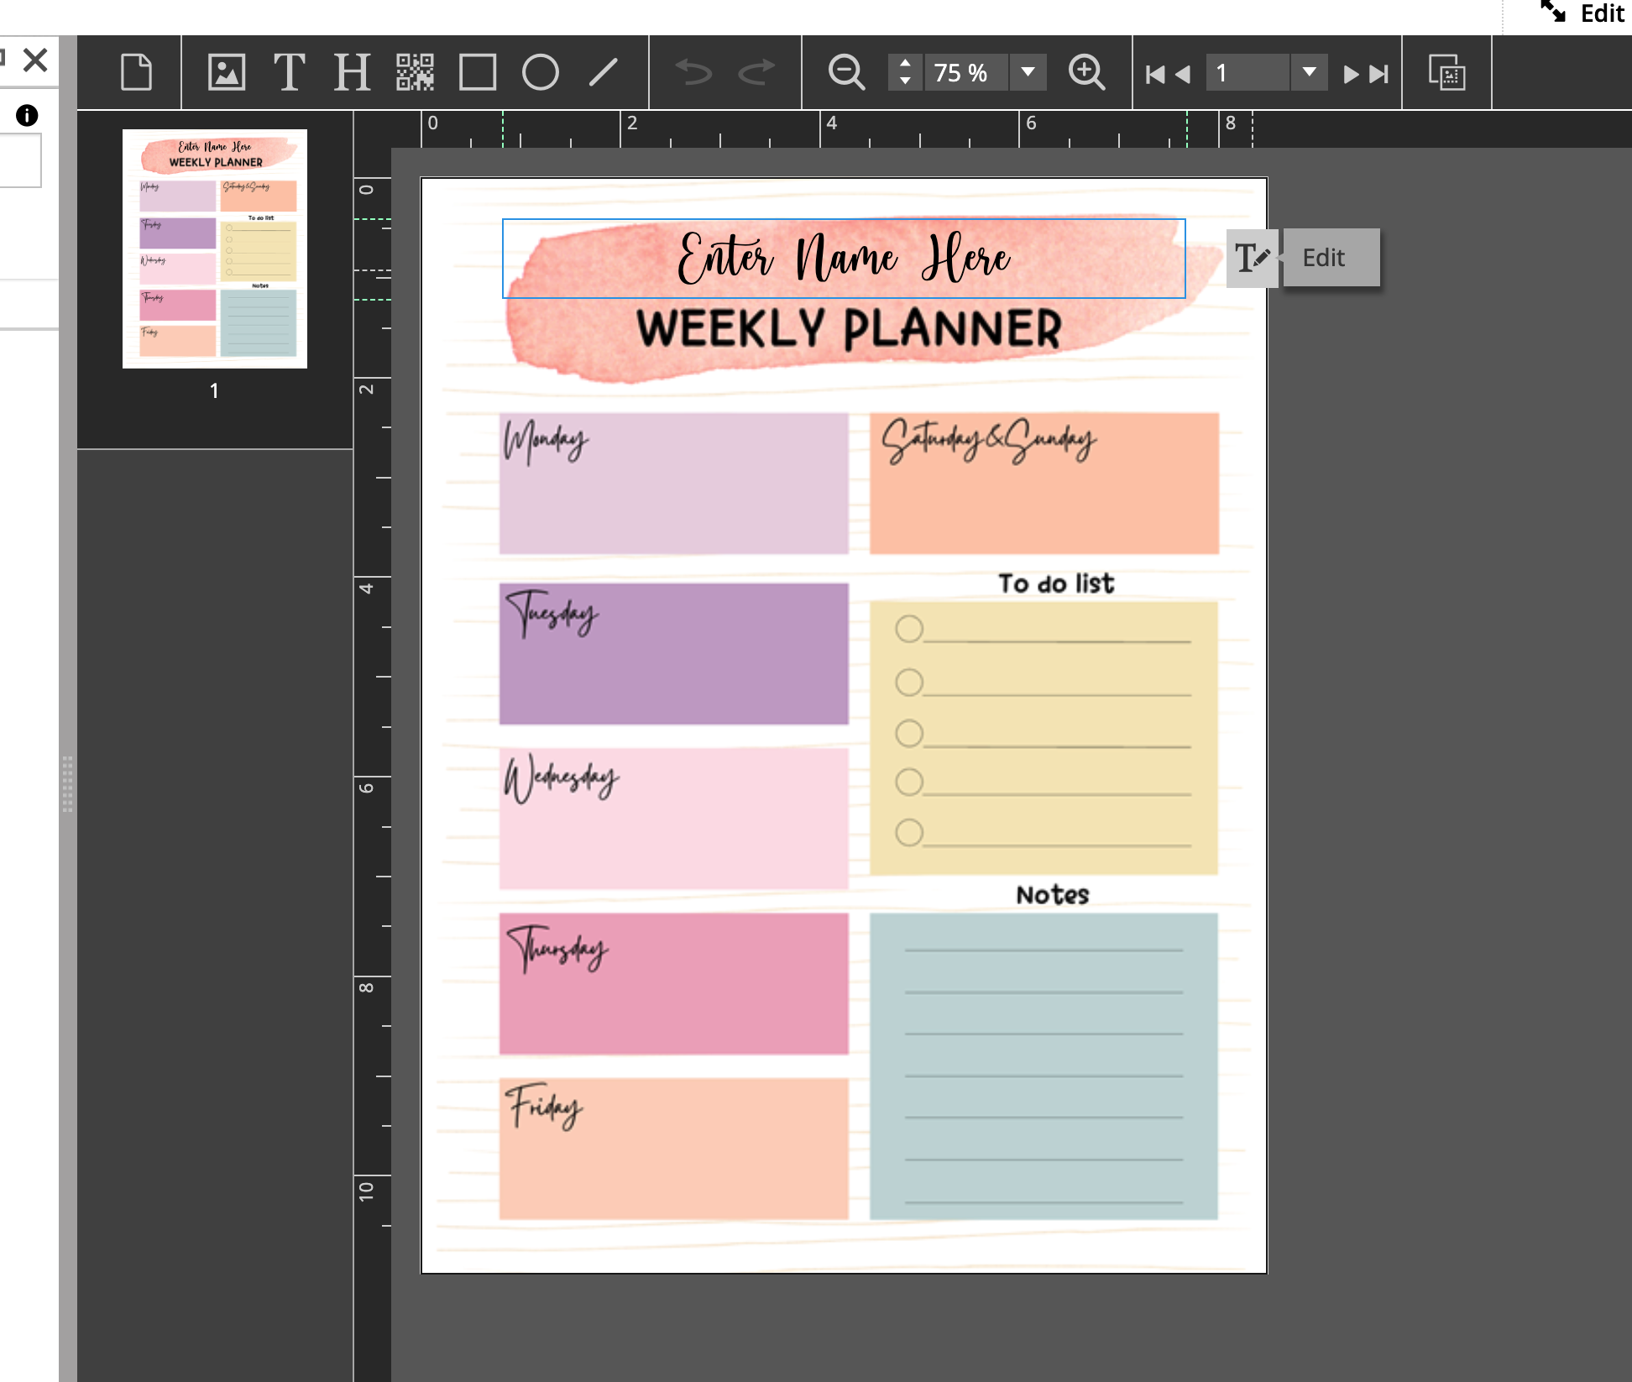
DIGITAL STOREFRONT FEATURES
Digital file submission All jobs require a digital file to be submitted with job. Jobs cannot be processed without attached file
Organized by Categories All categories are designed to simplify order process
District/Department Forms, Printing, etc.
Store Items designed to simplify ordering Options limited to what is relevant only
  Order history control & re-Ordering Similar to online shopping, Amazon, ebay
Editable SmartCanvas Templates You control the Text information and layout

Slide 5
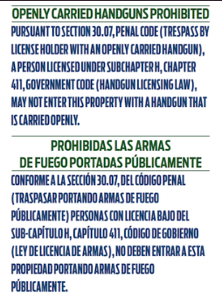

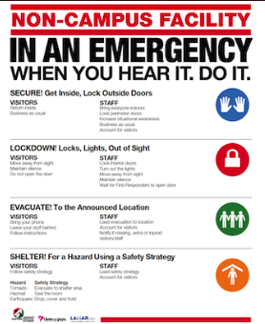

WHAT’S NEW FOR 2022-2023
New Storefront Look
DEPARTMENT SPECIFIC CATEGORIES Leveled Books A-Z, Rigby readers, Communications, LCISD Police, ROTC and Technology specific items for these departments only. Readers requires proof of license to order
SRP Posters and Guide Located in District/Department Forms Category. Posters and Guide were updated May 2021
Variable Printing Capabilities Excel file must be attached with job (.xlsx or .csv)
LCISD Graphic Arts Intranet Page includes documents and contact information Link to Digital Storefront
https://www.lcisd.org | community | graphic-arts

Slide 6

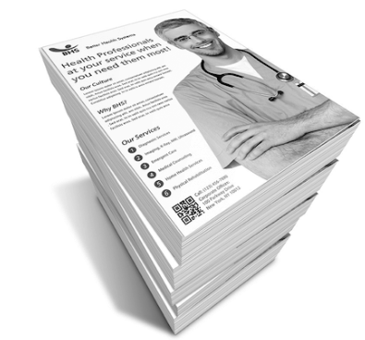

WHAT’S NEW FOR 2022-2023
New District Business Cards
Special Printing Available due to District Toner Shortage.
For Testing Material only.
B&W & Staple only options available Printed in order received. No Rush!
Door Hangers New synthetic media available upon request. Based on vendor availability.
Upcharge added.

Slide 7
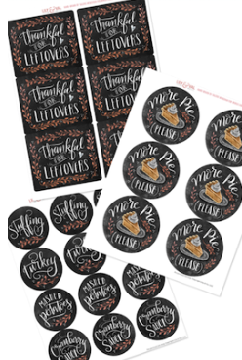


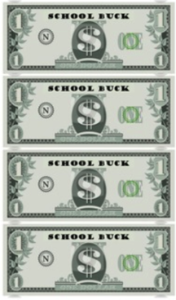
WHAT’S NEW FOR 2022-2023
Label Printing Peel off labels. Contact Graphic Arts for design options before ordering. www.avery.com/templates Available in the following shapes
Bookmarks Available in Regular and Custom sizes. Contact Graphic Arts for design options before ordering.
School Bucks Mini: 1.75 x 4.25
Regular: 2.5 x 5
Contact Graphic Arts for design before ordering.

Slide 8
WHAT WE WILL LEARN
What Graphic Arts can do for you Design & Printing Services
Printing items must be designed and approved before orders are submitted.
How to Navigate Digital Storefront Categories and Items. Differences between items
How to Place orders Choosing Options Understanding the interface How to attach Copyright forms to a job Editing a placed order
How to Customize your orders Managing Special Pages Formatting Documents Editable Templates
  How to order Custom Pads Available in three sizes: Small(4.25x5.5) Medium(5.5x8.5) Large(8.5x11)
  How to order School Bucks Available in two sizes: Mini(1.75x4.25) Standard (2.5x5)

Slide 9
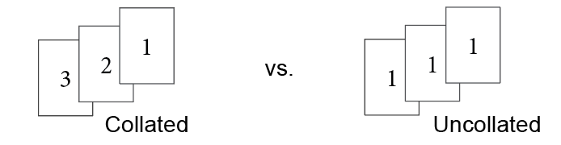
WHAT WE WILL LEARN
  Difference between Collate and Do not collate
How the Budget and Billing Process works Open Year-round. Munis and DSF not linked
Managing your User Profile, Order History & Status
New or Revised Logo Process - Contact Communications, obtain approval to proceed
- Graphic Arts will provide “sketches” of your ideas
- Select your preferred logo
- Graphic arts will develop preferred logo and generate vector file
Final Board Approval required

Slide 10
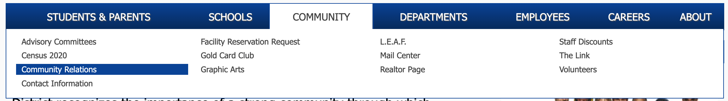
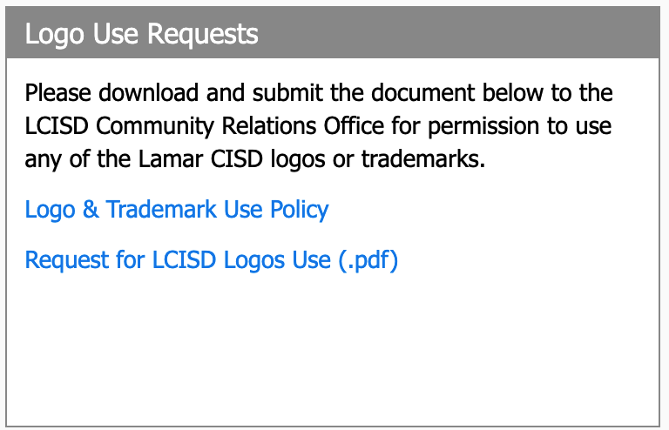
WHAT WE WILL LEARN
Logo Use Policy
For all outside vendors, a Logo use form needs to be filled out and approved prior to Graphic Arts releasing the logos.
Vector files cannot be released to vendors without the
approval. Logo use form is located@ lcisd.org | Community | Community Relations

Slide 11
PLACING YOUR ORDER
1
Sign in (Must be signed in to see all categories and place orders)
Find Category and Select Item All jobs must be entered under the proper category and item Please note: All Large Format items such as Banners, Posters, Yard signs must be designed by our Graphic team before submitting. Please contact Graphic Arts prior to ordering
Attach Digital File (Attach Copyright under Approval Options if necessary) Always attach digital file (word, excel, publisher, etc.) File must include all pages needed and must be formatted correctly.
Enter Job Name and Quantity Enter an appropriate job name and always enter the number of copies required in the Quantity box
Select Print & Finish Options Check all Print & Finishing options required before submitting work order
Preview Job and Review Price Visually check your jobs with the on-screen preview and verify price before submitting job. If you do not see a price. Something is wrong. Contact Graphic arts. Do not Proceed!
2
3
4
5
6

Slide 12
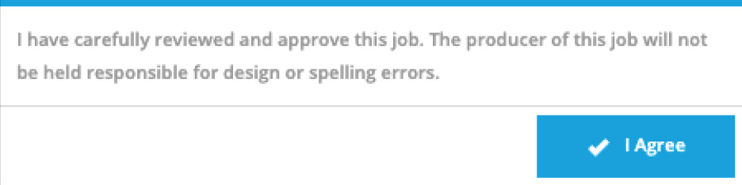
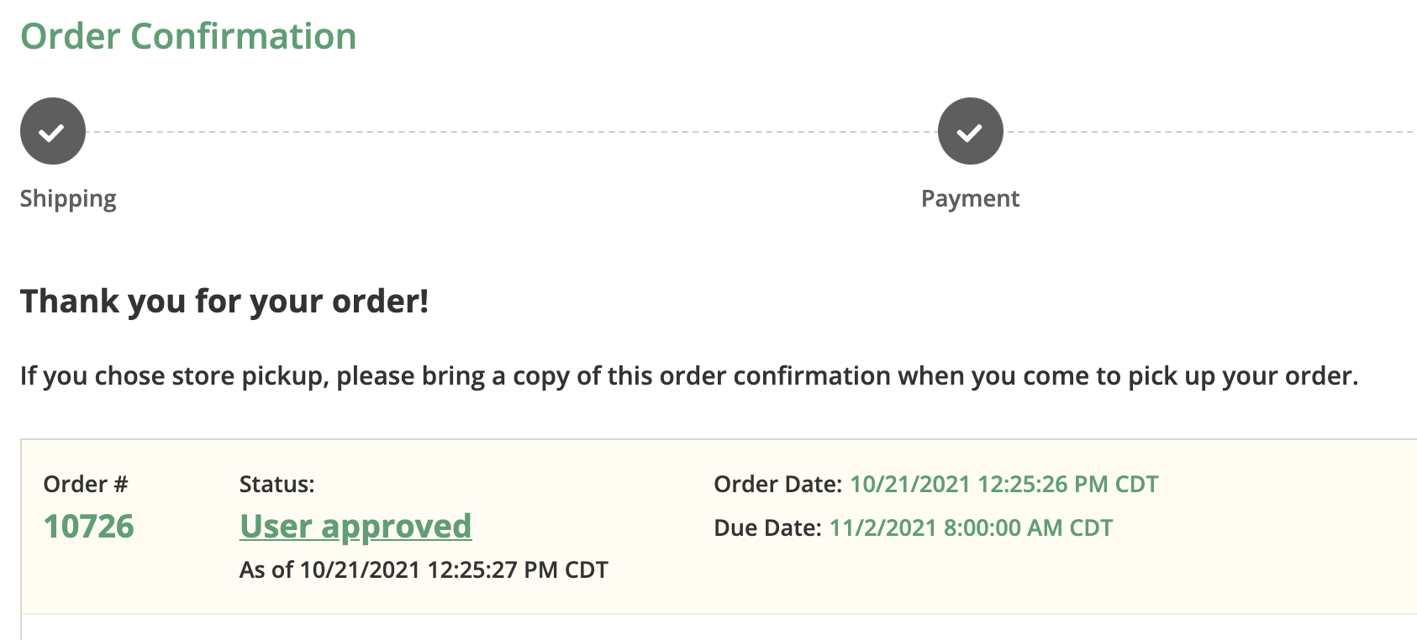
PLACING YOUR ORDER
7
Agreement when submitting job
8
Review Job and Proceed to Checkout If required to select the requested date, select the highlighted day to avoid Rush Fee
Proceed to Payment Cost Center is already entered based on your account information
Place my Order Once order is placed you will see your order receipt
9
10

Slide 13
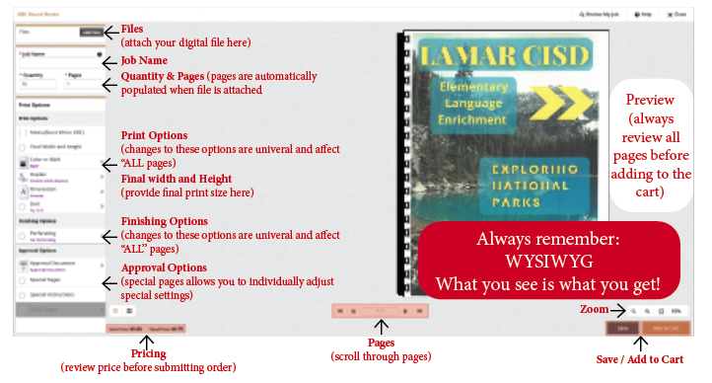
TOP 5 MOST COMMON ERRORS
Wrong Category and/or product selected
It is important that the printed product is entered in the proper Category and the proper Product item is chosen. Since each Product has been designed with specific options that are relevant to what is being ordered ordering should be much more streamlined.
1
2
All options are not chosen Choosing the options is critical as the job will print based on which options are selected. While adding notes is great, it should not be a substitute for selecting all the options.
Please note that adding special instructions is not a substitute for selecting all the options.
All Options must be selected

Slide 14
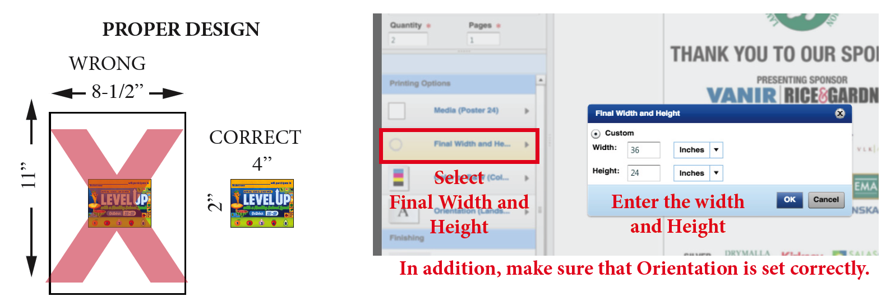
TOP 5 MOST COMMON ERRORS
3
Jobs are not designed to Final Print Size and/or final height and width are not entered “All” print jobs must be designed to the Final Print size! This means if you are preparing a card that is 2 inches by 4 inches when cut, then the file you create for your card must be that size. For example, the card can’t simply be placed on an 8-1/2” x11” sheet.
In addition, to ensure accurate pricing and proper cutting, it is essential that the Final Width and Height be entered.
4
Images scanned are not High Resolution
Unless scanned to a higher resolution the outcome of your print may suffer. For best results scan images to at least 300 dpi, Furthermore, Avoid scanning copies of copies. If possible, using the original file or recreating an original would be preferred.
Jobs not reviewed prior to submittal WYSIWYG) Do not submit order if anything looks off. What you see in your preview is what will print. While DSF includes a preview of your job, it is important that the preview represents what you need printed before submitting the work order.
For example, If you want your document on yellow paper, your preview should show Yellow paper.
5

Slide 15

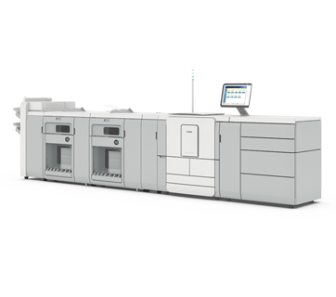
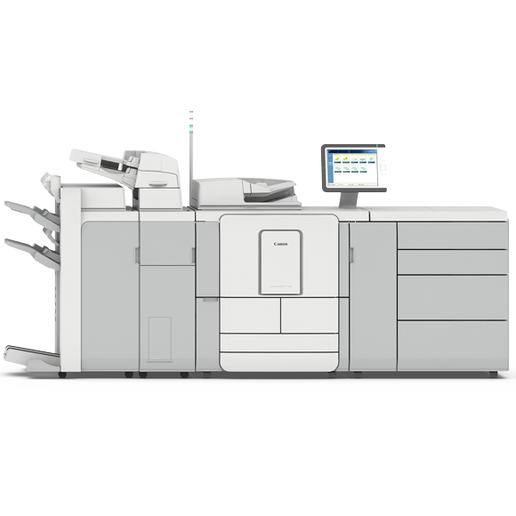
BLACK AND WHITE COPY CENTER
Jacqulyn Cobbin 832.223.0339
High speed B&W Copiers up to 11 x 17 – 320 PPM Backup Copier – 140 PPM Click charge $0.0032 per click + Cost of media
In-line Capabilities: Booklet Maker, GBC and 3-hole Punch Booklet Maker can print up to 220-page book
Electronic file + Copyright form must be attached with all jobs
Ultra+ imagePRESS 6320
VarioPrint DP 140

Slide 16


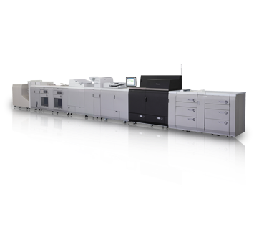
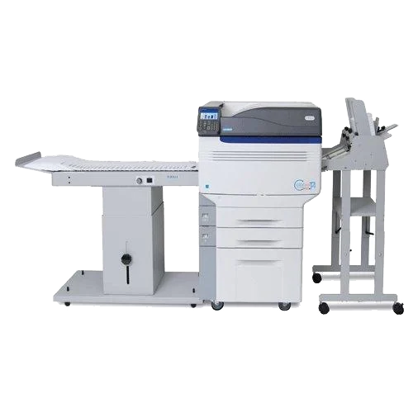
COLOR PRINT CENTER
Jerry Gania 832.223.033
Greg Mikes 832.223.0338
2 High speed Color Copiers up to 12 x 18 – 110 PPM Click charge $0.45 per click + Cost of media
Dedicated Envelope Printer up to 9 x 12 Envelopes
Electronic file + Copyright form must be attached with all jobs
Color printing services and products include:
Magazines, Programs and Booklets
Brochures
Certificates
Business cards and Letterheads
Newsletters and Fliers
Stickers, Bookmarks, Door hangers and Tickets
Canon 10010vp
Formax ColorMAX T4i

Slide 17
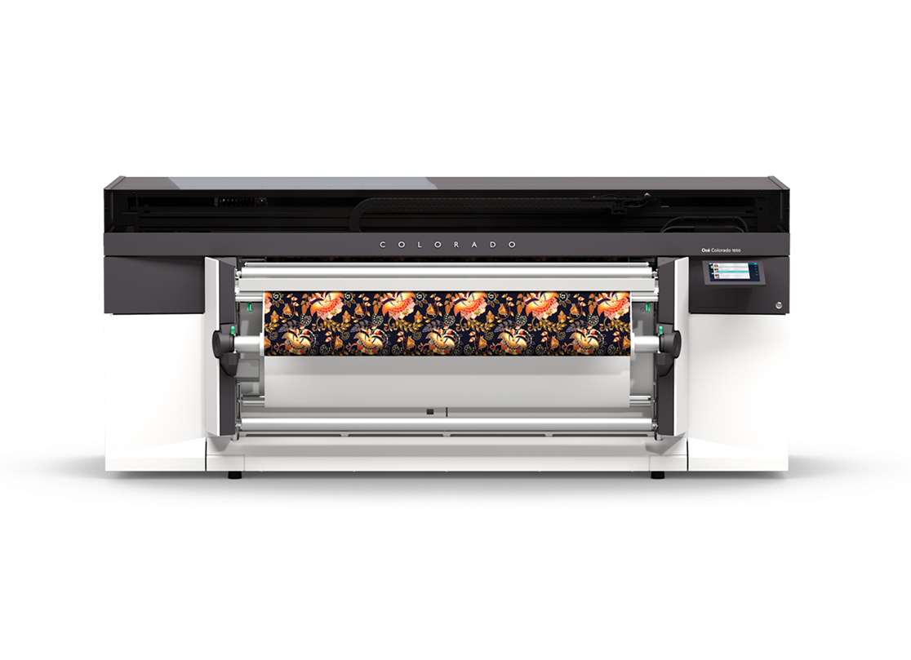
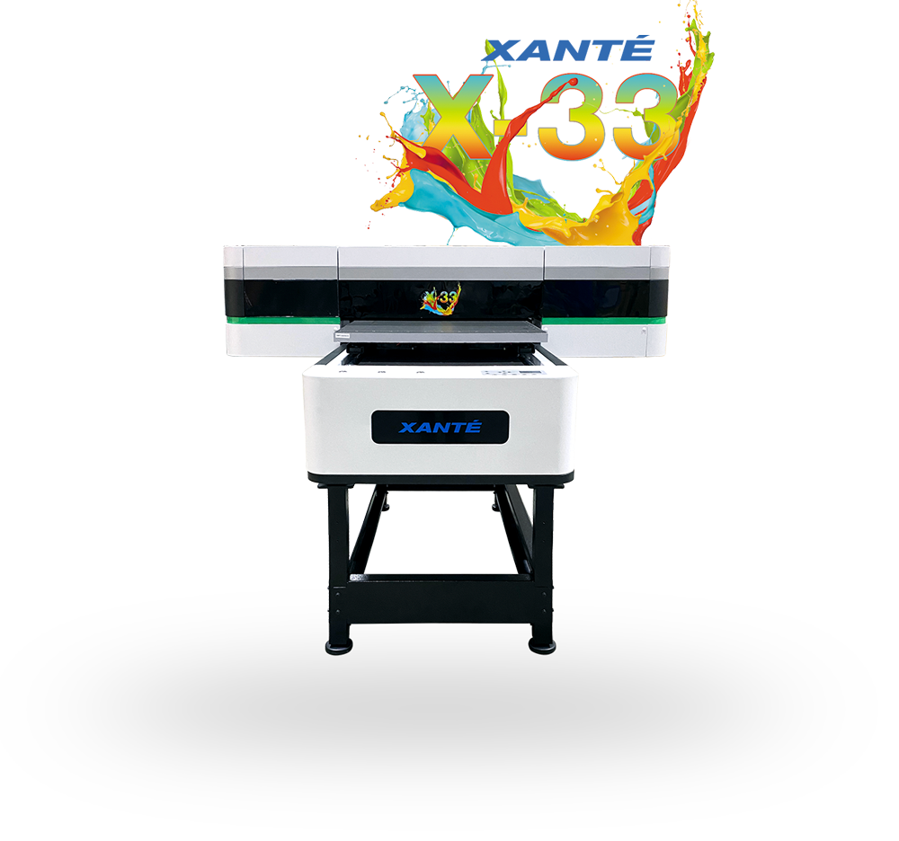


LARGE FORMAT CENTER
Jerry Gania 832.223.033
Large Format Color Printer: Colorado 1650
Prints Posters, Banners, Yard Signs and much more. Print up to 54” wide and length of roll. cost $1.50 Per SF + extras. Foam core mounting available in certain sizes
Display stands available in
Floor Stand (33 1/2” x 88”)
All jobs must be designed to specific sizes before orders are submitted.
Yard Signs
Yard signs are 18x24 and oriented landscape. All orders over 50 must be preapproved and scheduled with the Print shop prior to ordering.
Expect extended turn around times for large quantities
Available by Request Only
Tabletop Stand: 11x17
Utility Stand: 24x36
Colorado 1650
Xante X-33

Slide 18


GRAPHIC DESIGN TEAM
John Garrou . 832.223.036
Mariana Diaz . 832.223.0347
Graphic Arts offers Professional quality design solutions at NO COST Designers will create brochures, booklets, fliers, logos, postcards and more. All images, logos and clipart provided to designers must have copyright approval. Please provide source image when possible.
All text and graphics must be provided to Graphic Arts Word, Excel, or PDF. Please spell check prior to sending
Design work is done on both Mac’s and PC please submit all elements to the designers.( i.e pictures for brochures, clip art you want to incorporate and all text) Note: Graphic Arts is not responsible for any spelling errors.
Design work Only If you require just Design work and only need a digital file with no printing required, please contact Graphic Arts at x0343. 10-day turnaround applies.
PLEASE NOTE, ANY ITEMS CREATED USING CANVA
OR ANOTHER NON-ADOBE SOFTWARE MUST BE
GENERATED PER GRAPHIC ARTS GUIDELINES.

Slide 19

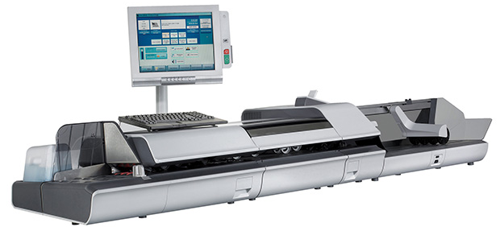
MAIL CENTER
Misty Wiegand 832.223.040
Mail Handling For District and Campuses only.
Services Provided US Postal Service addressing for cards, letters, and envelopes and newsletters. Folding/inserting student handouts and mail outs,
Mail Center Goal
To provide the most cost-effective solutions for all mailing needs meeting the US Postal Service requirements. We provide excellent service and consultation to support Lamar CISD communications throughout its campuses and across the community.

Slide 20


SERVICE CENTER BUILDING
GRAPHIC ARTS PRINT SHOP
4901 AVENUE I ROSENBERG TEXAS, 77471
JORGE CARMONA
Manager
832.223.0343
jcarmona@lcisd.org
JERRY GANIA
Print Production Foreman
832.223.0337
jgania@lcisd.org
GREG MIKES
Print Production Tech 2
832.223.0338
gmikes@lcisd.org
JACQULYN COBBIN
Print Production Tech 2
832.223.0339
jcobbin@lcisd.org
JOHN GARROU
Publication Specialist 2
832.223.0336
john.garrou@lcisd.org
MARIANA DIAZ
Publication Specialist 1 832.223.0347
mariana.diaz@lcisd.org
MISTY WIEGAND
Mail Center Clerk
832.223. 0340
Misty.wiegand@lcisd.org
CARA BRYAN
Graphic Arts Specialist
832.223.0603
cbryan02@lcisd.org

