Slide 1





Lamar Junior High School
Student COde of Conduct
Fall 2024

Slide 2



Your Lamar Junior High School
Administrative Team
Mr. Semmler
Mrs. Fields
Dr. Watson
Mr.Venturini
Principal
Dean of Instruction
8th Assistant Principal
7th Assistant Principal

Slide 3



Lamar Junior High
Counseling Team
Mrs. Boudy
Mrs. Keller
Mrs. Salinas
Counselor (A-Gi)
Counselor (Gh-On)
Counselor (Op-Z)

Slide 4
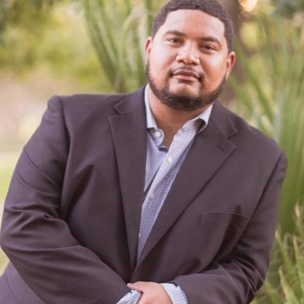


LamAr Junior High
Support Staff
Mr. Porter
Ms. Wagner
Mrs. Maldonado
Behavior Interventionist Coordinator
Librarian
Nurse

Slide 5




Lamar Mustangs Are...
Ready
"What is Right"
Respectful
" Treat Others Well"
Responsible
" Own Your Learning and Action"

Slide 6

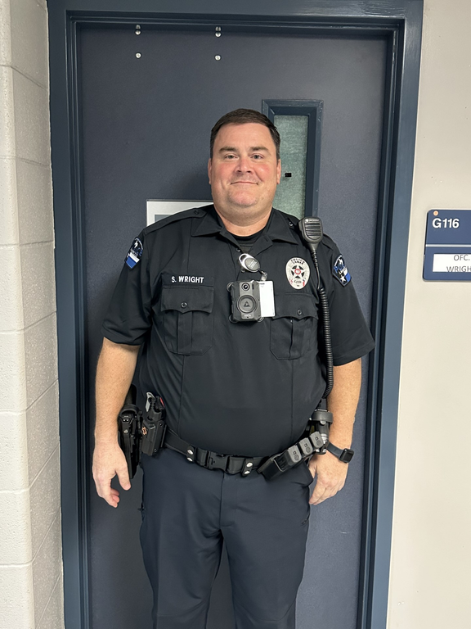


Safety
Maintaing a safe learning environment is the responsibility of our entire CommUnity.
Officer Wright
If you see something, say something
Security Officer

Slide 7

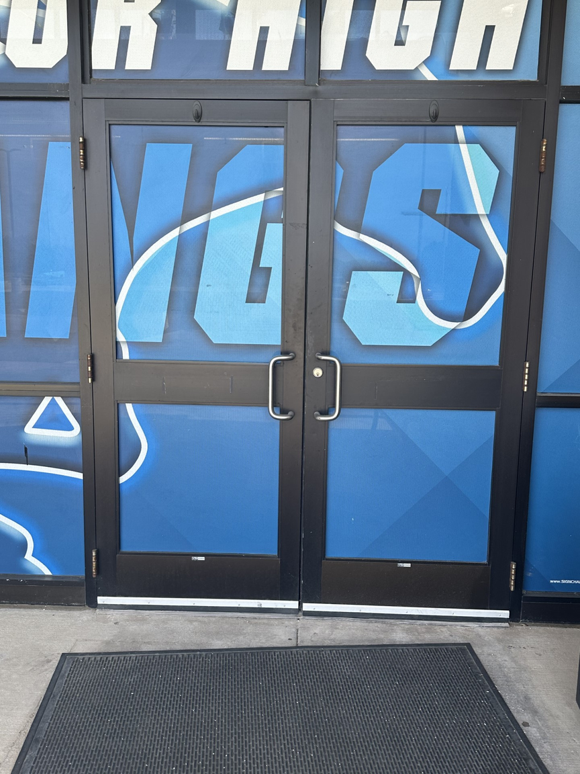
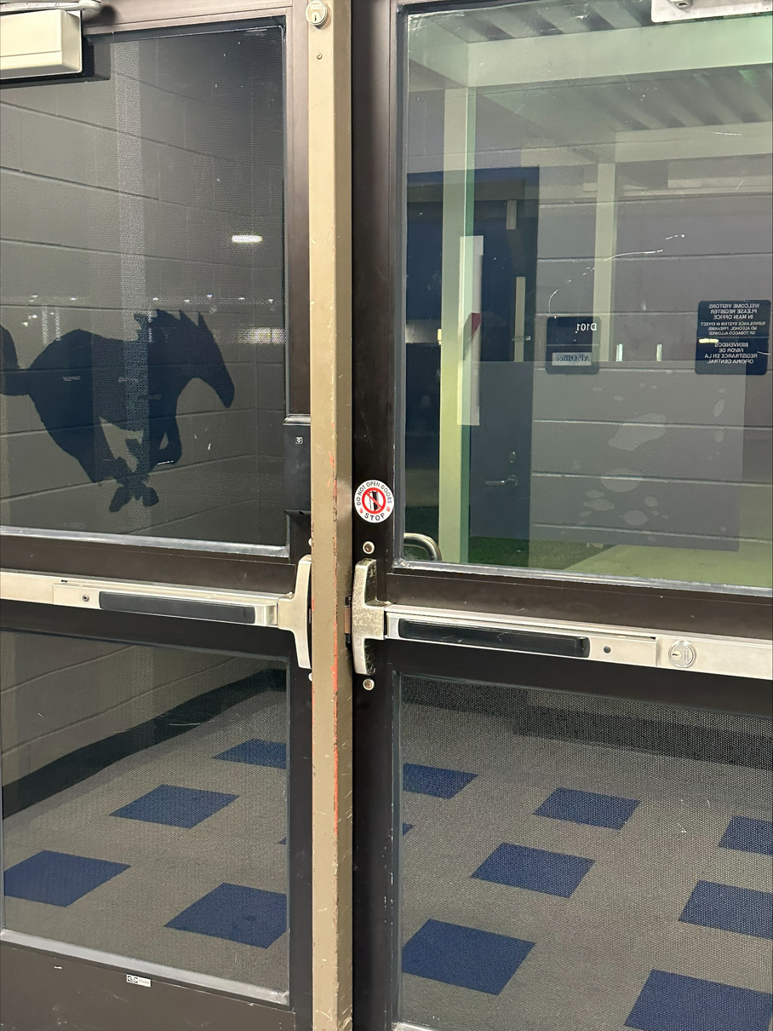


Safety
Exterior Doors
Interior Doors
Keep our building safe. Never let anyone in the building.
(All interior and perimeter doors)
Any student that opens up an exterior door to let anyone in will receive consequence.

Slide 8



Extra-Curricular Bags
Extra-curricular bags
(athletics, band, etc.)
must be taken to those areas prior to 1st period starting.
If you are a band student that needs to pick up an instrument you will be released with walker and wait to be released with motor transportation.

Slide 9


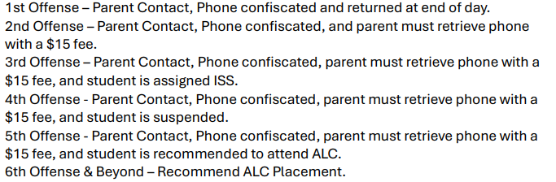
Cell Phones
No Cell phone use In Classrooms, Hallways, and Restrooms
Period!
Any student caught violating the cell phone policy will have their phone confiscated.
24-25 LCISD cell Phone Policy

Slide 10

Safety Conflict
If you are having an issue with another student, let your Assistant Principal know.
Do not try to work it out in the hallway or classroom.
Fighting is a violation of the code of conduct.
Any student who fights will receive consequence in accordance with code of conduct.

Slide 11



Safety Controlled Substance
Possession, under the influence, and delivery of controlled substances are all violations of the Code of Conduct and will result in severe discipline consequences.
Any Student in possession of a vape of any type will receive a mandatory placement at DAEP.
(HB 114)

Slide 12
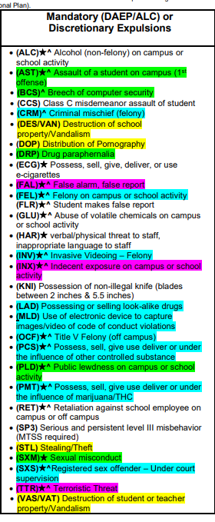
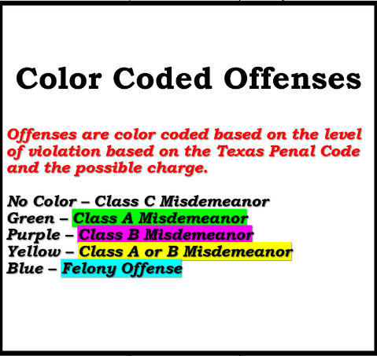
Mandatory (DAEP/ALC) or Discretionary Expulsion

Slide 13
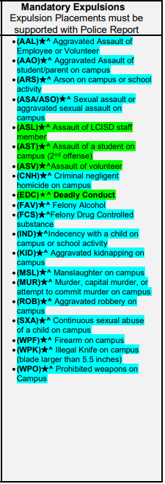
Mandatory Expulsions

Slide 14
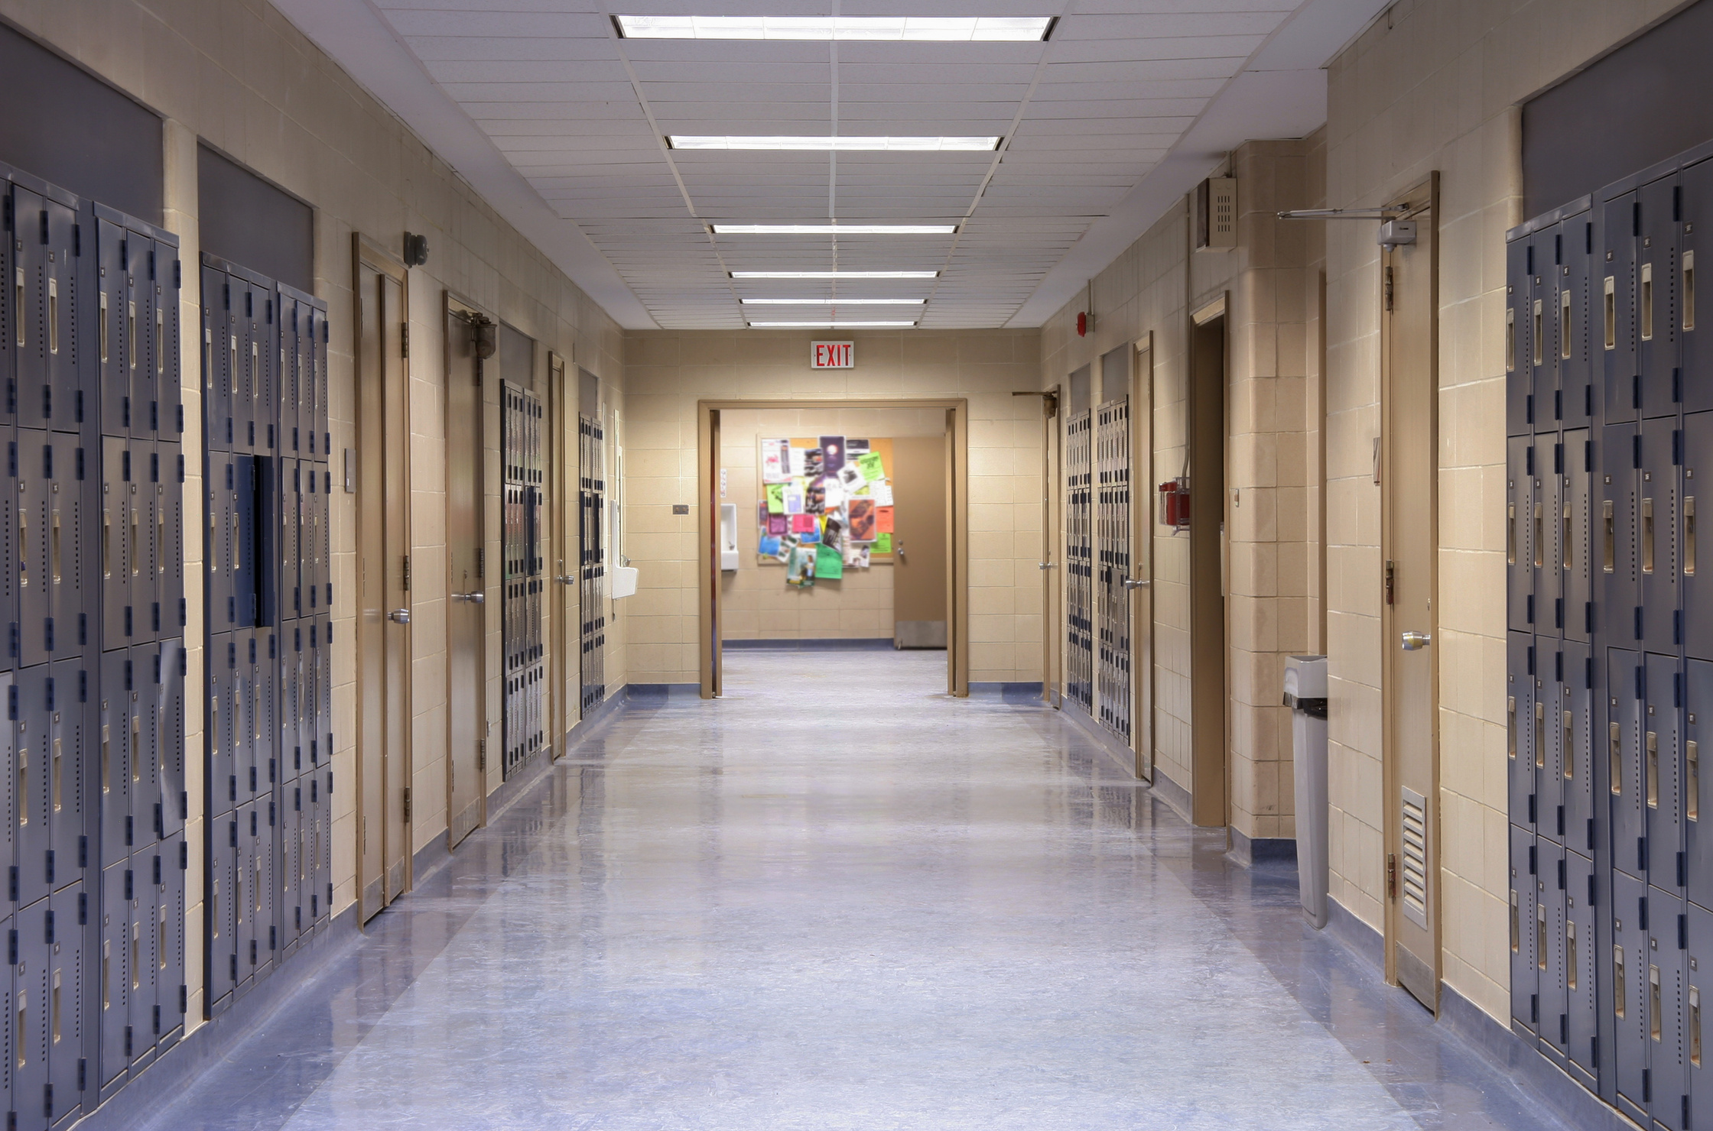
Hallway Expectations
Walk and Talk. Only
Be Polite and Stay to the Right
No running/Horse Playing in the hallway.
Be mindful of those around you.
No cellphones use At all!

Slide 15


Lunch Expectations
You must report immediately to the cafeteria during your lunch period.
While in the cafeteria, students will remain seated until dismissed by an Assistant Principal.
Please take care of your trash. Help us keep our cafeteria clean.
Follow our 3R's Matrix

Slide 16



Restroom Expectations
Have Proper restroom pass (One Student Per Pass)
Keep the restroom safe and clean
No Horse playing
Take care of your business and leave
Report any issues or concerns to an adult
No Cell Phones
Follow the 3R's

Slide 17


Bus Expectations
The bus is an extension of the school. All rules apply.
Keep the bus safe.
Keep body parts inside of the bus at all times.
You will not be allowed to ride without your Smart Tag ID.

Slide 18
LJH Dismissal Expectations
  Walker will be dismissed through the front door via intercom
  Car riders are dismissed through the Boys gym via intercom
  Bus are posted on smart boards and announced via intercom
Need to knows about dismissal
Failure to follow your mode of transportation will result in a consequence
( Ex. Roaming the building/ Going to other teachers classroom/Going to the Bus Porch prior to your bus being called or posted)
Please note that depending on the weather the mode of dismissal might Change!
( This will all be communicated via Intercom)

Slide 19
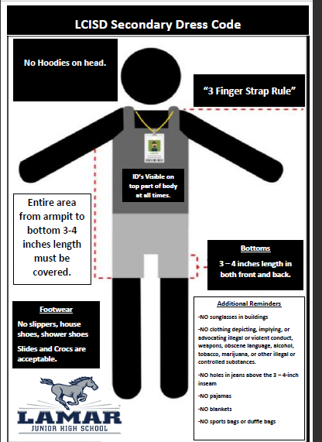







Dress Code
Students in violation of the dress code will be given the option of correcting the violation or parent will have to bring a change of clothing.
Refusal to change will result in A Discipline Consequences!

Slide 20
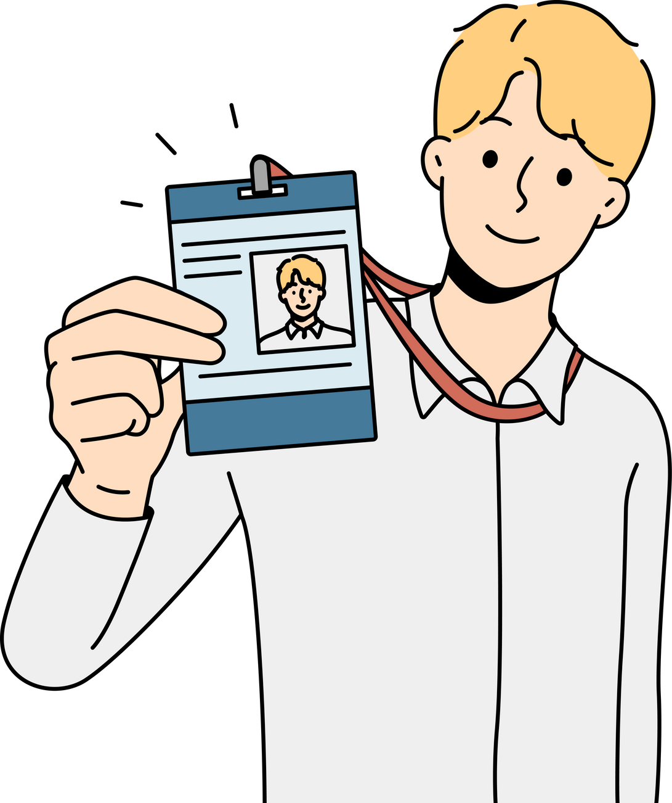
Things you need to know about IDs
  ID checks occur daily as you enter the building
  Temporary IDs will continue to be provided to students without IDs.
(Student will have to Pay $1.00 for Temporary Badge)
  Student must always have an ID on at All Times.
Just a reminder failure to have your ID is a dress code violation.

Slide 21

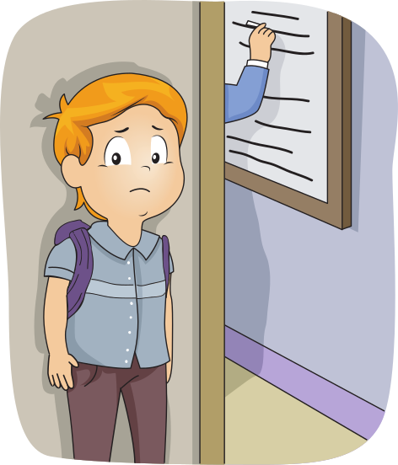
Tardy Policy

Slide 22
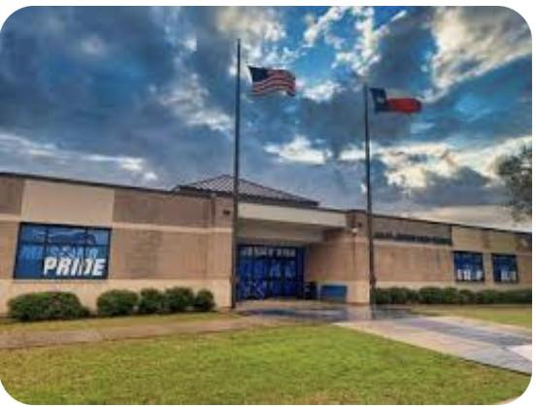
Have a great year Mustangs!
Rise Up!

