Slide 1


Welcome to dickinson Elementary
5th grade
2023-2024

Slide 2

Meet the 5th Grade Team
Mrs. Heikkila, Mrs. Hopkins, Ms. Canales, Mrs. Atkins

Slide 3

Meet the Instructional Leadership Team
Principal: Channon Almendarez
Assistant Principal: Angela Peters
Counselor: Suzanne Lowe
Instructional Coach: Lisa Morrey
EB Specialist: Yadi Salinas
Reading Interventionist: Leslie Norra
Librarian: Joanne Bromonsky

Slide 4

Communication
Tuesday Folders
  Sent home every Tuesday
  Contains graded work from the week before and papers from the front office.
  Please check these folders each Tuesday, review papers, sign the signature page inside, and return the next day.
Daily Take Home Binder
  Behavior chart inside (currently blue) sign weekly
  Homework should be in the front pocket & written in the agenda daily
  Please initial the agenda and return to school daily

Slide 5
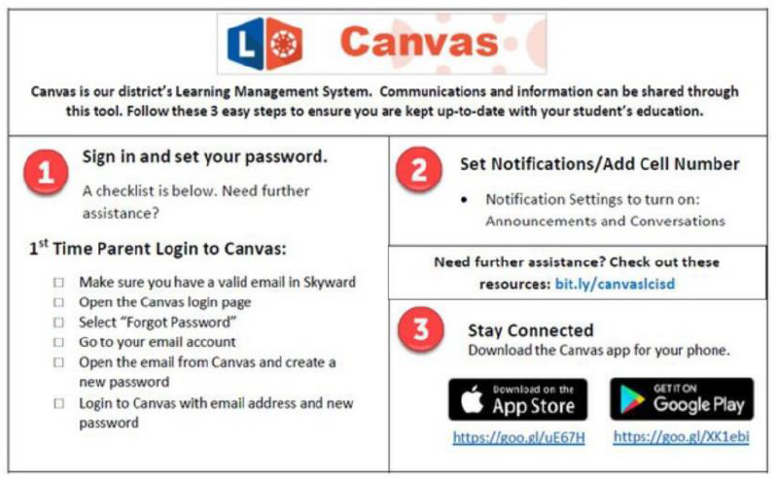
Weekly Newsletter
The newsletter will be electronically distributed every Monday through Canvas.
Newsletters will include events, objectives, upcoming major grade dates, and other information deemed necessary by the grade level.
Please make sure that you are signed up and have access to Canvas

Slide 6
Lcisd Student code of conduct Updates

Slide 7


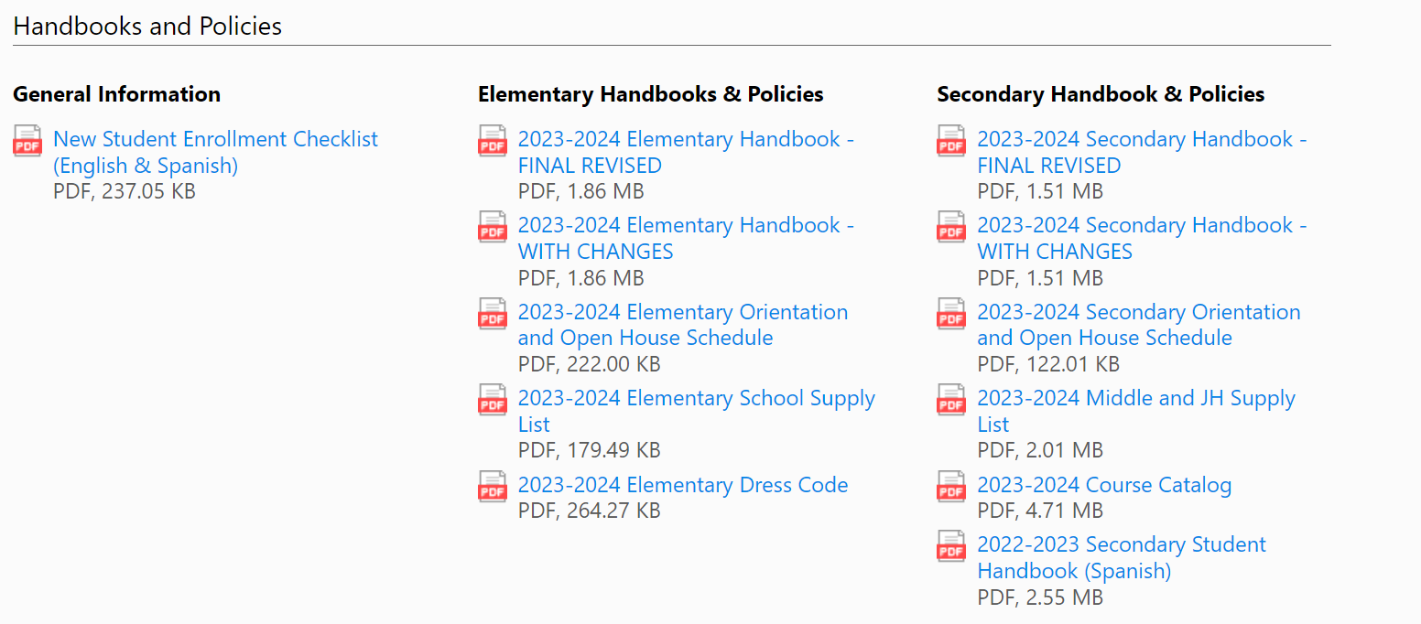

2023-2024 Handbook
The Student Code of Conduct can be found within the 2023-2024 Student Handbook.
Secondary – pg. 149
Elementary – pg. 91
The updated handbook can be found on the LCISD webpage at the bottom right-hand side under the Student & Parent section
Spanish version will be uploaded
once they are completed.

Slide 8
Cell Phone Policy
Changes

Slide 9
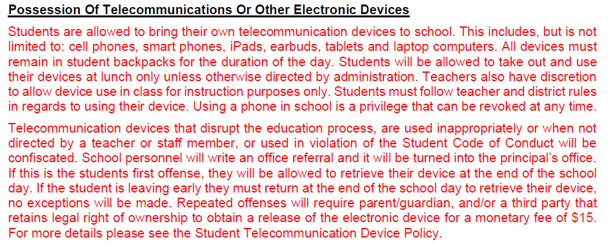
Possession of Telecommunications or Other Electronic Devices
Notes:
This slide is one of the recommendations indicated in RED to be added

Slide 10
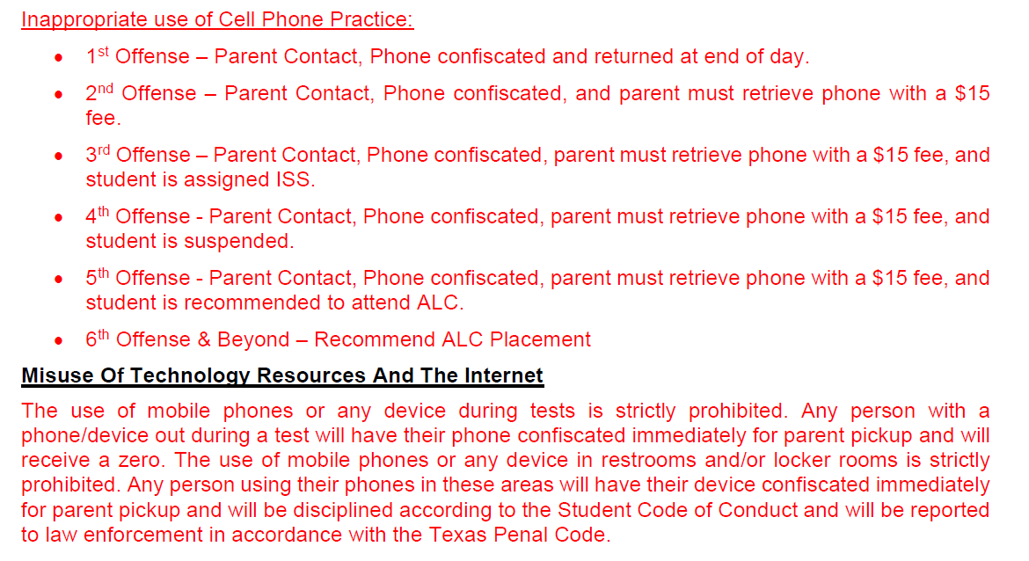
Inappropriate Use of Cell Phone/Smart Watch Practice
Notes:
Click Twice This next slide is a list of additional updates that we are recommending since the May meeting.

Slide 11

Please keep cell phones and smart watches in backpacks turned off.
“Technology will never replace great teachers, but in the hands of great teachers, it’s transformational.” – George Couros

Slide 12
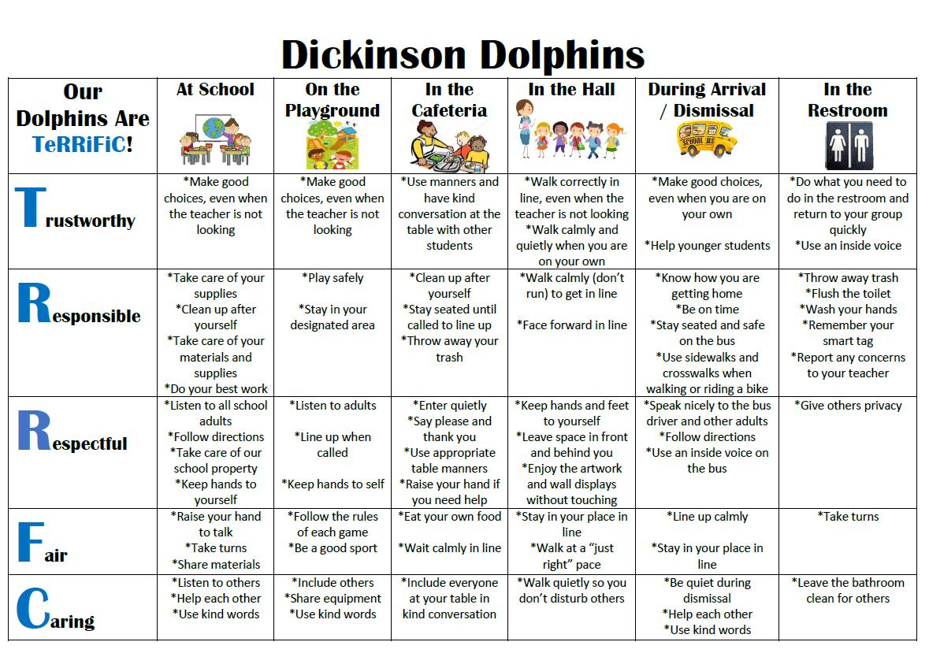
Dickinson Expectations

Slide 13

Ron Clark House System
This school year we will sort our students and staff into four different houses. They will remain in the same house throughout their elementary school experience. The goal is to build community within the school.
Each nine weeks we will have a school pep rally to celebrate good character and review high expectations for learning. At the pep rally, we will share who the winning house is for the nine weeks. PTO will be sponsoring the shirts this first year.
Our first House Pep Rally will be on October 4th. Parents will be able to participate through Facebook Live.

Slide 14


Classroom Rewards
Dolphin Dollars 1st Semester
PAT Points
House Points
Scholar Dollars 2nd Semester

Slide 15

Classroom Consequences
Steps that will be taken by the teacher:
  Signal (hand gesture)
  Verbal reminder
  Private conversation with student
  Signing of Behavior Chart in Daily Binder
  Note/email/call home
  Office referral after 3 minor or 1 major incident

Slide 16
Dickinson Dress Code
Collared solid navy blue, light blue, red or white short or long-sleeved shirt with no logo. School spirit shirts and denim-type clothing will be permitted on Fridays.
Shoes: Safe for school, athletic shoes with closed toes and tennis shoes preferred.
Hair: Clean, well groomed, out of eyes, and non-distracting. No painted/dyed hair
Khaki, navy blue or black slacks, dresses, skirts, skorts, jumpers or shorts not of denim or denim-type fabric.

Slide 17

Grades
Math, Science, and Social Studies:
  Math: 9 grades (7 minors and 2 majors)
  Science: 7 grades (5 minor and 2 majors)
  Social Studies: 7 grades (5 minor and 2 majors)
Reading & Language Arts:
  Minimum of 9 grades (7 minor and 2 major)
Go to LCISD.org. Click “Family Access” to view your child’s grades at any time through Skyward.
  You can also adjust your settings to get daily/weekly grade alerts on skyward.

Slide 18

Cheating
A student will receive a zero if caught cheating on an assignment. If a major assignment, they will have the opportunity to reassess with the highest grade being a 70.

Slide 19
Reassessment Guidelines
A teacher shall provide corrective instruction and a reasonable opportunity to reassess failure to master TEKS on major grades ONLY.
The highest possible grade that can be earned and recorded on the reassessment is a 70.
The teacher will make a note in the electronic gradebook when grades are reassessments.
Minor grades, district exams, compositions, and student projects are NOT subject to reassessment guidelines.

Slide 20
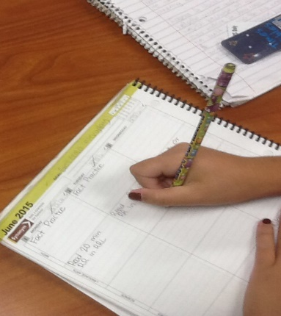
Students Head to class at 7:30 am
Students have the opportunity to unpack their backpack and get prepared for the day.
Allows them time to get focused for the day and be ready to begin learning.
Students who are in class by 7:45 do not miss the announcements.

Slide 21

Absences/Attendance
Please arrive on time, in class by 7:45 each day.
Attendance is taken at 8:45.
If an absence is necessary, send a written excuse with your child the day they return in their binder.
Five or more consecutive absences requires a doctor's note.
Attendance is factored into our accountability rating.

Slide 22
Every Day Counts!
1 or 2 days a week doesn’t seem like much but …
If your child misses. . . | That equals . . . | Which is . . . | And over 13 years of schooling that’s . . .
1 day every 2 weeks | 20 days per year | 4 weeks per year | Nearly 1-1/2 years of school
1 day per week | 40 per year | 8 weeks per year | Over 2-1/2 years of school
2 days per week | 80 days per year | 10 weeks per year | Over 5 years
3 days per week | 120 days per year | 24 weeks per year | Nearly 8 years

Slide 23
How about 10 minutes late a day? Surely that won’t affect my child!
He/she is only missing just . . . | That equals . . . | Which is . . . | And over 13 years schooling that’s . . .
10 min. per day | 50 min. per week | Nearly 1-1/2 weeks per year | Nearly ½ year
20 min. per day | 1 hr. 40 min. per week | Over 2-1/2 weeks per year | Nearly 1 year
30 min. per day | Half a day per week | 4 weeks per year | Nearly 1-1/2 years
1 hour per day | 1 day per week | 8 weeks per year | Over 2-1/2 years

Slide 24
Covid Guidelines
We are still following the CDC guidelines of being out for 5 days from onset of symptoms or the date of the test.
After the 5 days, they may return to school with a mask for the next 5 days.
Parents need to contact the clinic so we can also provide them with a return to school date.
All positive Covid cases must still be reported to the FBC Health Department.
We are not sending out class notifications of positive tests this year.

Slide 25
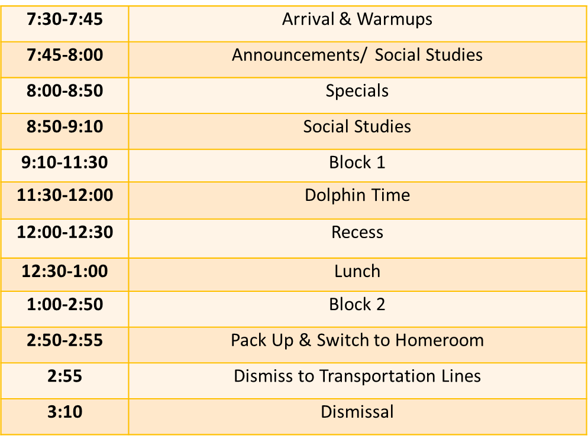
5th Grade
Daily Schedule

Slide 26

2024 STAAR SCHEDULE
April 9- Reading
April 17- Science
April 23- Math

Slide 27

English Language Arts
  Reading Workshop
  Reading MAP
  GRA testing
  Writing across all content areas
  Reading Plus
  Bluebonnet List
  Beanstack tracker
  Read 20 minutes minimum 4 nights per week

Slide 28
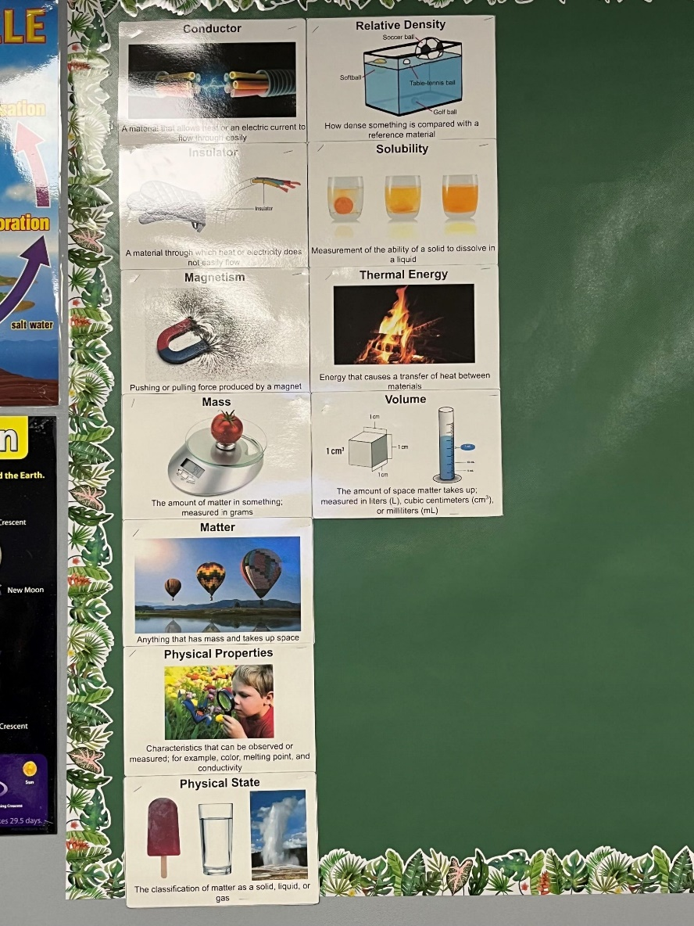
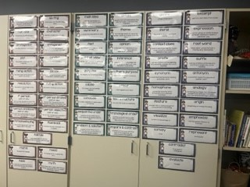
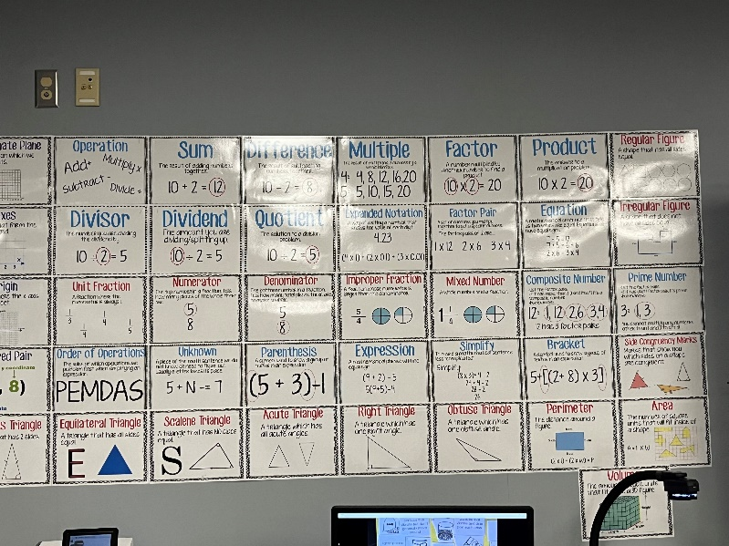
Word Walls

Slide 29
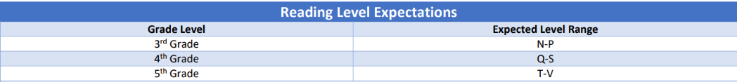
Guided Reading Assessment Levels
(GRA)

Slide 30
ACADEMICS Cont.
Math
Fact Fluency
Problem Solving with real world application
Hands On Experiences
Guided Math Instruction (small group)
Science
Content Knowledge
Lab (Safety Contracts)
Real Life Application
Social Studies
Unites States History
Study Guides for major tests

Slide 31
HOMEWORK
Monday | Tuesday | Wednesday | Thursday | Friday
Read for 20 minutes Math Skills | Read for 20 minutes Math Skills | Read 20 minutes Math Skills | Read for 20 minutes Study for vocab. Quiz Math Skills
Complete 5 Dreambox lessons & assigned Reading Plus lessons by Friday.

Slide 32

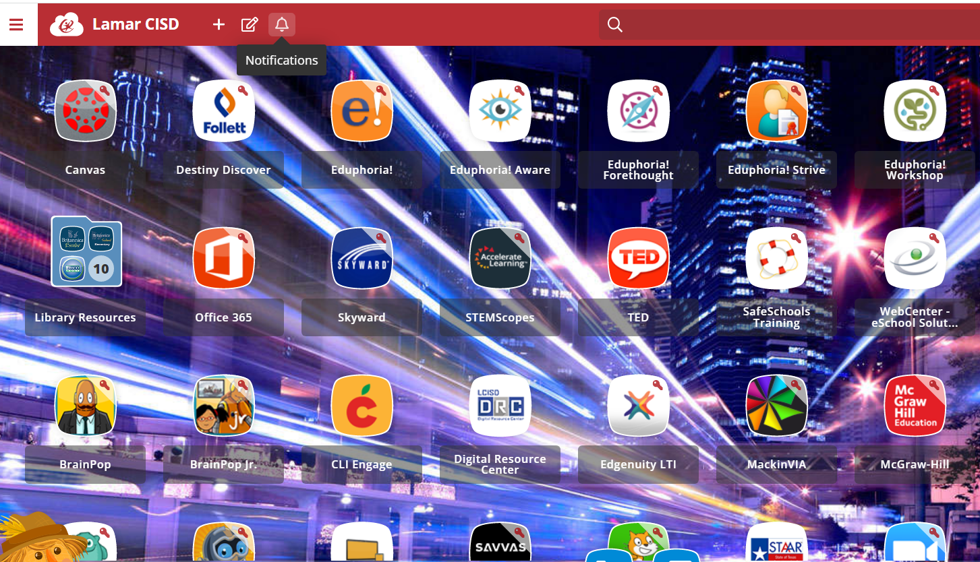
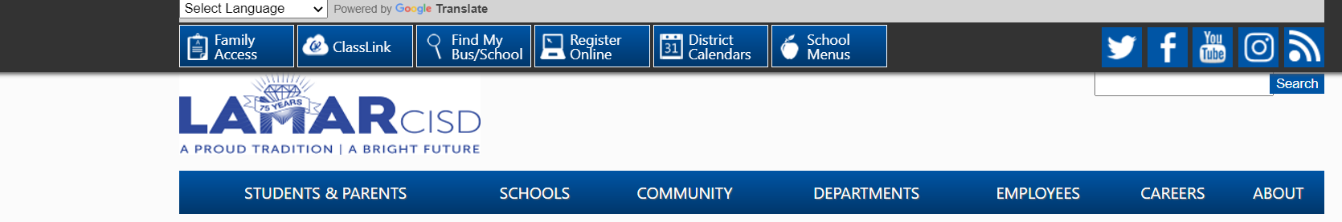
Class Link: Free to LCISD Students (www.lcisd.org)
Many programs are available to use at home to enrich learning!
Please encourage your children to use typing club to practice keyboarding. This will help with online testing.

Slide 33

Reading Plus
Students can access through Class Link. The expectation for students is to finish the assigned lessons for the week.
Consists of:
Comprehension Lessons
Fluency Builder
Vocabulary Lessons

Slide 34
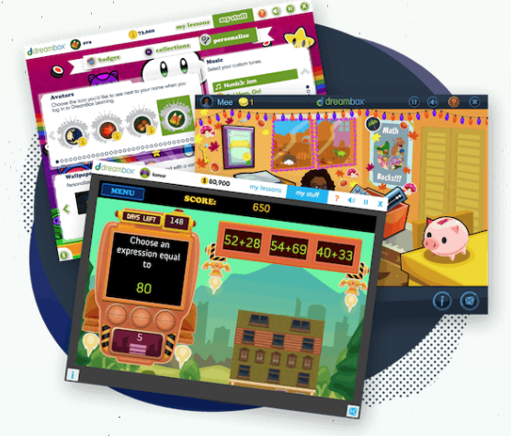

Dreambox
Dreambox is a math learning environment that adapts to your student’s needs.
Students see practice units and lessons dependent on how they perform on assessments.
Dreambox heavily incorporates manipulatives.
Since Dreambox is adaptive, teachers have little control over what unit students are working on.
Dreambox decides what skills your student needs to practice and when they are ready for new lessons.

Slide 35
District/ campus Expectation
FOR STUDENTS TO MAKE PROGRESS
IT IS RECOMMENDED THAT STUDENTS
COMPLETE 5 LESSONS PER WEEK in Dreambox

Slide 36


How To Access Dreambox/Reading Plus
To access on a PC,
your student needs to log in to Classlink and click on the Dreambox or Reading Plus icon.
To access Dreambox or Reading Plus on an iPad,
download the Classlink app and the Dreambox or Reading Plus app.
Login the Classlink app. Click on the Dreambox or Reading Plus icon.
It will prompt you to launch the Dreambox or Reading Plus app. The program will automatically open in the app.

Slide 37
WHAT INFORMATION IS AVAILABLE TO ME AS A PARENT?
Your Parent Dashboard allows you to see lessons/stories completed, tokens earned, a basic log of the time spent on DreamBox/Reading Plus, a total time on task, and progress on curriculum categories.
To create a Parent Dashboard have your student log-in to his/her account. Then, click Setup Parent Access at the bottom of the screen. Then, go to play.dreambox.com to see your Parent Dashboard.

Slide 38
TIPS FOR PARENTS
Encourage students to FINISH a full lesson.
Encourage them to use the “Help” (K-8)
Students should only use the program. They may use scratch paper to write out problems.
No calculator
Don’t help students answer problems.
Encourage a growth mindset. It is okay for students to make mistakes and try their own ideas!

Slide 39
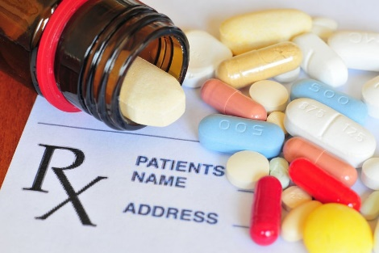
Medications
All medication must be kept in nurse’s clinic—this includes cough drops
All medication must be in original container—if prescription, must have label with student’s name and information on it
Over the counter, short term medications, such as cough drops or antibiotics also need appropriate paperwork, which can also be found on website under nurse’s notes and is called “Parental Permit to Administer Medication At School For 6 Weeks Or Less” –if unable to print this copy , you may send a dated note listing student’s name, name of medication, reason for giving, time/frequency and duration that it is to be given—parent signature is also needed
If your child has a life-threatening allergy or asthma, please get with Nurse Jarvis to discuss and provide appropriate paperwork and medication on campus for those “in case” moments for your child’s safety.
If you have any questions, please feel free to contact the nurse at 832-223-1406 or email at ajarvis@lcisd.org.

Slide 40
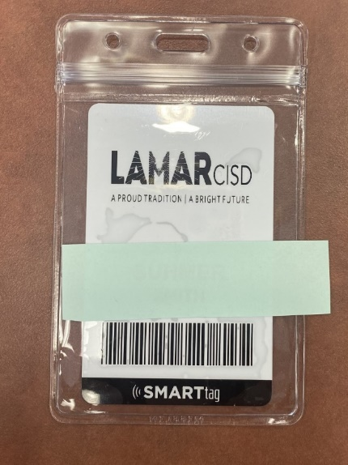
Smart Tags
Every child will have a smart tag which is used to: ​
Track when a student is on the bus​
Purchase breakfast and lunch​
Check out books in the library
Note: Replacement is $5​
Notes:
All students must wear their smart tags to and from school each day. They need them throughout the day for various reasons. If your child loses their tag, you may purchase a new one for $5. Send the money with your child and they will be ordered and delivered within 7-10 bus

Slide 41
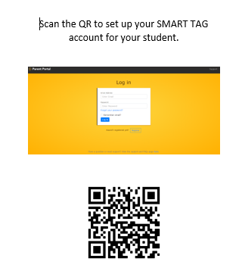
Register your SMART TAG

Slide 42
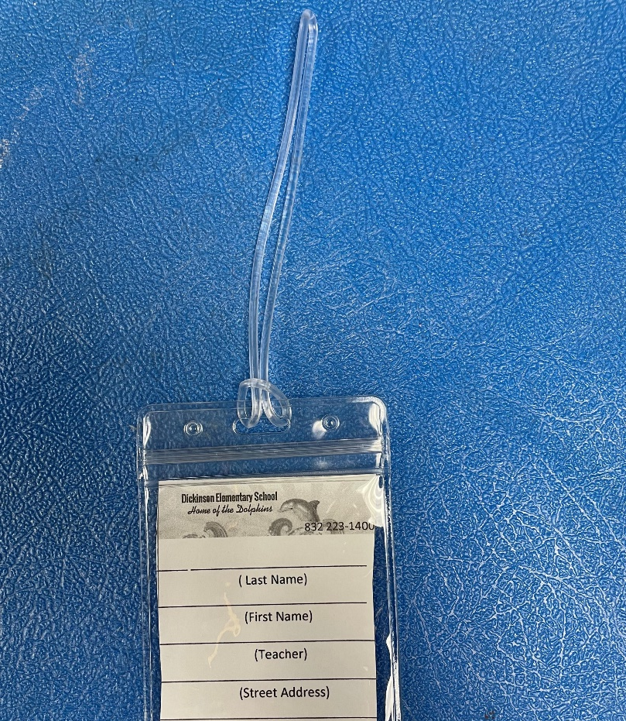
Leave on backpack please!
Name & Dismissal Information
Replacement is $2 at The front office
Transportation
Tags

Slide 43

Transportation Changes
Best practice is to send a written note to the school with your child.
If you need to make a last-minute emergency change, call the front office prior to 2:15 PM.
832-223-1400
Please do not email the teacher changes; they are busy teaching students.

Slide 44
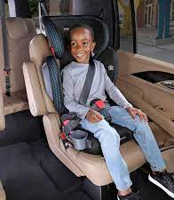
Car Riders
Students are picked up at the front ONLY.
The lines may be long, so pack your patience and cooperative spirit.
For the safety of the children, you may not park and walk up to get your child.
Car Tag-display your student number where it can easily be seen
Child needs to enter on the passenger side of car
Notes:
You may not drop off along the side. Less traffic between 7:00-7:15. Students should be ready to get out of the car. Parents that do not have car tags for pick up will be required to park and come in the school to be cleared to pick up the child.

Slide 45

Lunch
Procedures
Breakfast and lunch are not free this school year.
Snacks are available but are extra. If you want to limit their snack purchases, please add that information to their account online.
You are always welcome to drop lunch off in the front office for your child.
Students need to wear their smart tags in order to expedite lunch.
Parents are welcome to eat with your child at the first table once you walk in.

Slide 46

How to purchase school lunch
Go to www.schoolcafe.com to create a lunch account online for your student
You may add money to their lunch account from your online School Café account
You may also apply for free or reduced lunch at www.schoolcafe.com

Slide 47


Classroom Snack
Bring healthy snacks that are NOT messy
No liquid items or things that will stain their fingers and papers.
The only liquid allowed in class is water.
Chips, Cookies or Candy is not permitted for snack time.
Please send Spill Proof water bottles each day.

Slide 48

Peanut Free Classrooms
Classrooms are to be peanut free. A child with serious peanut allergy can potentially suffer a reaction merely by touching or smelling a food with peanut or peanut butter
Please do not send any peanuts, peanut butter or foods containing these items as snacks. They will not be allowed to be eaten in the classroom
Any food sent to share in classroom i.e., birthday cupcakes, cookies etc, is to be store bought, in original container with ingredient list that is peanut free
The above does not apply to lunches, children will still be able to eat food of their choice in lunchroom as we have ensured areas that will remain peanut free zones.
Thank you in advance for your cooperation. We are trying to ensure the safety of all of our children. We are striving to promote a safe environment for all of our students, and in working together we can work to keep our students safe.

Slide 49

Birthday Treats
Birthday treat guidelines are in the 2023-2024 Elementary Student Handbook on page 24: Because of the time constraints, the treat is limited to one item per classmate, and it must be store purchased, single serve item (i.e. cupcake, cookie, etc.) so that it can be served, eaten, and cleaned up within a reasonable time.
The 2023-2024 Elementary Student Handbook states that gifts, balloons, treat bags, and flowers are prohibited at school. Invitations to individual parties may not be distributed at school. Thank you for your understanding! ☺

Slide 50




dickinson Elementary PTO https://dickinsonpto.membershiptoolkit.com/Home
How can you help our school?
“We make a LIVING by what we GET,
but we make a LIFE by what we GIVE. “ -Winston Churchill
Notes:
Parents & Teachers working together = successful students.

Slide 51


Thanks for being a great audience!
Any questions?

